Slide 1
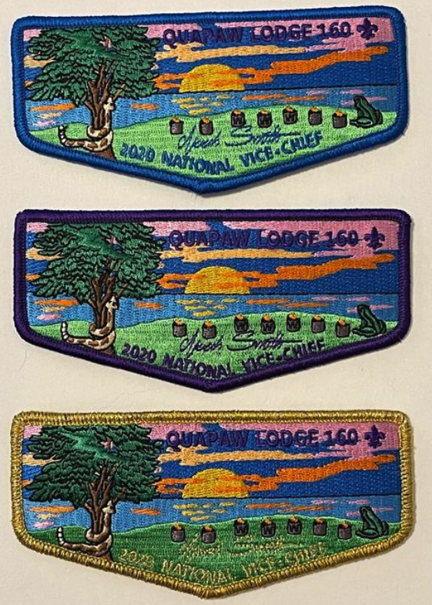
EXAMPLE #1
Internal Lodge Fund Raiser
LEC approves basic patch Design for a lodge fundraiser, 100% embroidered with 3 different colored borders. 300 Stadri patches ordered at $1.81 each
300 sold at $4.00 each (blue border)
75 sold at $50 each (purple border)
25 sold at $150 each (gold mylar border)
Investment = $543
Sales = $1,200 + $3,750 + $3,750 = $8,900
Profit = $8,357
One design with multiple border colors is still ONE design to a patch manufacturer
Don’t overuse this approach and enroll your lodge in the ”patch of the month” club

Slide 2
EXAMPLE #2
National Event Fund Raiser
LEC approves basic 100% embroidered patch Design for a National Event and orders 1000 Stadri NOAC patches at $1.24 each
800 sold (via WEB, and internal) at $4.00 each
75 sold at $100 each
25 sold at $150 each
Investment = $1,240
Sales = $3200 + $7,500 + $3,750 = $14,450
Profit = $13,210
One design with multiple border colors is still ONE design to a patch manufacturer
Repeat: Don’t overuse this approach and enroll your lodge in the ”patch of the month” club

Slide 3
PATCH
MANUFACTURING
BSA Approved Manufacturers
There are many BSA Approved patch suppliers. Call the National Office at 800 323 0732 of contact their vendors directly. Shop around for the quality and price you desire. Here are a few well known vendors:
AB Emblem22-A-B Emblem Dr.
Weaverville, NC 287787
888-797-4285
sales@abemblem.com
Moritz Embroidery Works
21 North Courtland Street
East Stroudsburg PA. 18301
800 533 4183
general.info@moritzembroidery.com
Stadri Emblems
1760 Glasco Tpke
Woodstock, NY 12498
Phone: 800-679-7909
Fax: 845-679-6649
sales@stadriemblems.com
Sunshine Emblem & Decal, Inc
3363 Sheridan Street
Suite 210
HOLLYWOOD, FL 33021
9549228634
patchguys@aol.com
Shelby Patch Company
3825 Hunt Club Court
Shelby Township, MI 48316
(586) 781-4778
KrelmanCo. LLC
Sales@Krelman.com
800-231-9556

Slide 4
THREAD COLOR
RESOURCE
Example
www.gopatch.com
Twill Colors:
http://www.shelbypatch.com/pdf/jm_fabric-twill-new.pdf
Thread Colors:
http://www.shelbypatch.com/pdf/fufus_thread-rayon-new.pdf

Slide 5
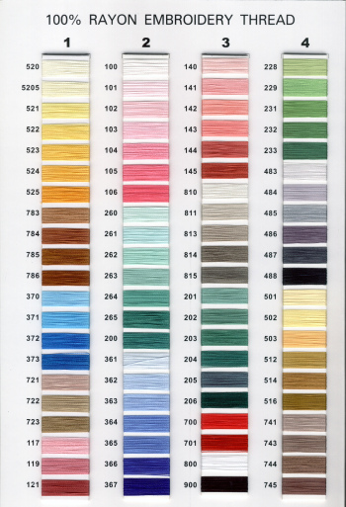
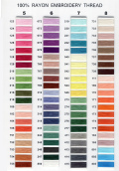
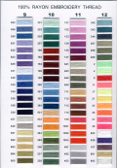
Hundreds of Colors are Available
Choose a few good ones for your design

