Slide 1

GREAT PATCH DESIGNS
WHAT MAKES THEM GREAT ?

Slide 2




SIMPLE BUT CLEAR
NICE USE OF COLOR
FINISHED ARTWORK FROM MANUFACTURER
YOU generate the idea
THEY make it pretty

Slide 3
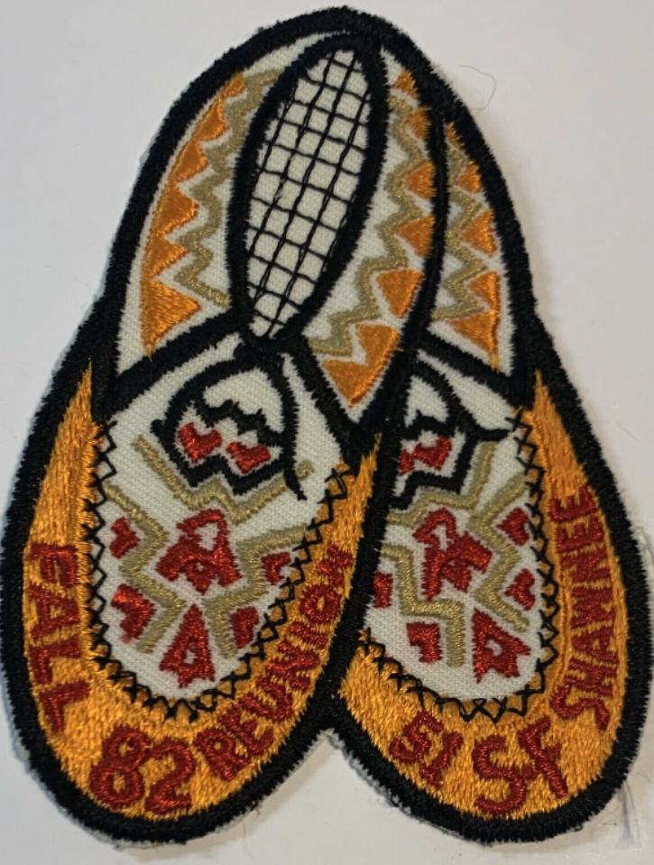

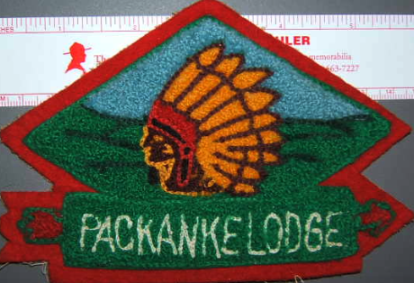

THINK OUT OF THE SQUARE BOX

