Slide 1
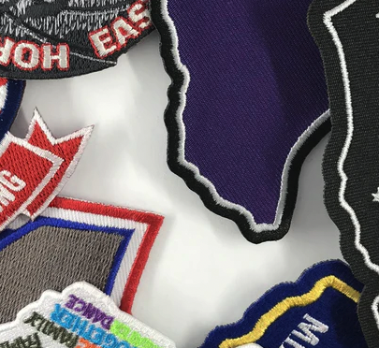

Design Tips - 3
Choose a Border Type that meets your needs
Ideas for specialty borders include:
Laser Contour or Laser Cut border leaves a small margin of non-embroidered material around the entire patch.
Hand cut or Die cut or Heat sealed border with a frayed Raw Edge provides a vintage look.
Glow in the Dark edge border is great for youth patches and also works as a safety feature for uniforms
Leave some space at the edges
An overlock edge border is ⅛ inch thick. For best results, keep your embroidered detail at least ¹⁄₁₆ of an inch away from the edges.
https://www.youtube.com/watch?v=HaKH_BR14Xc
Commonly referred to as a “cut edge”

Slide 2
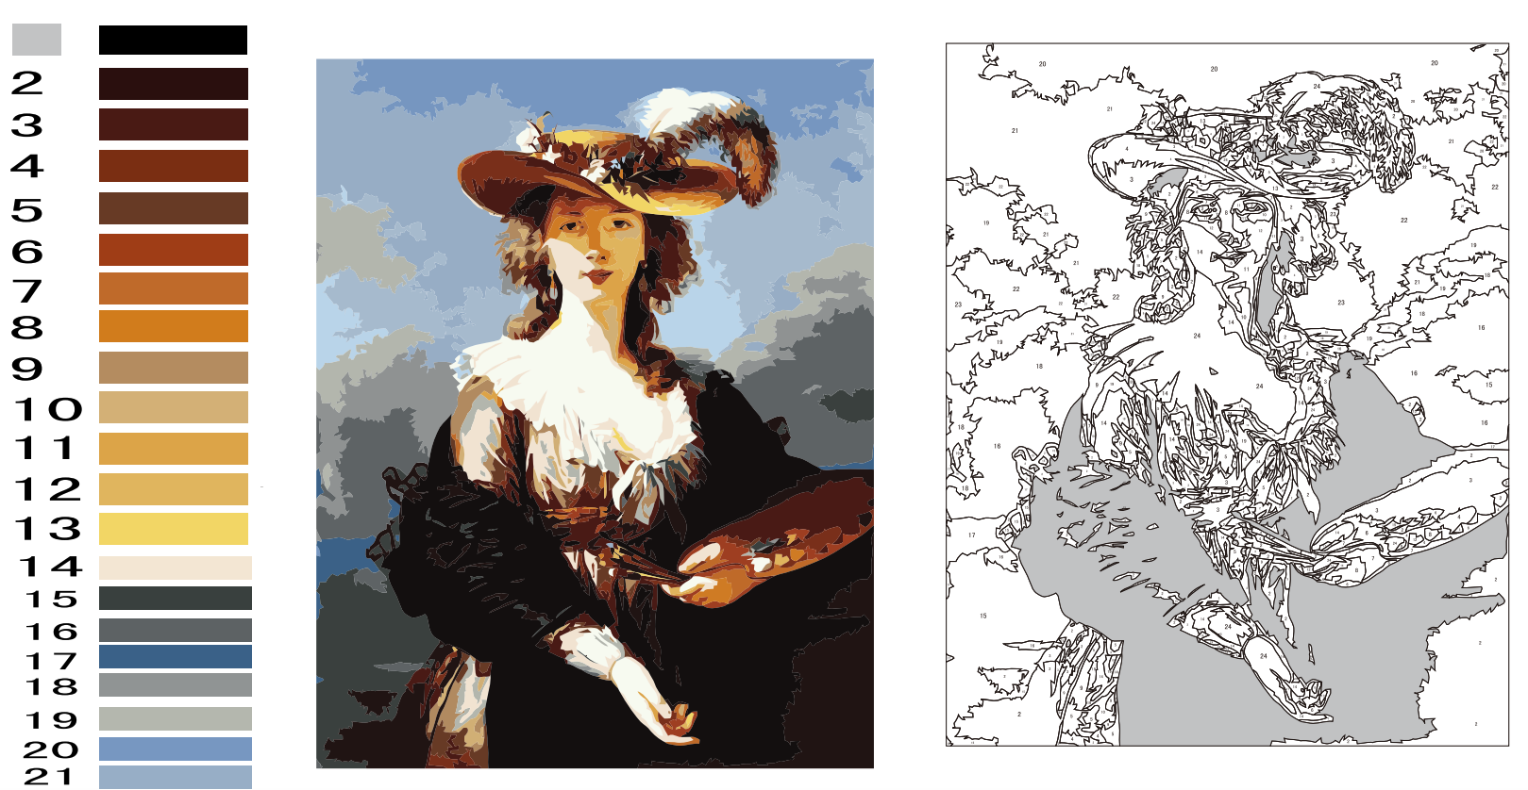
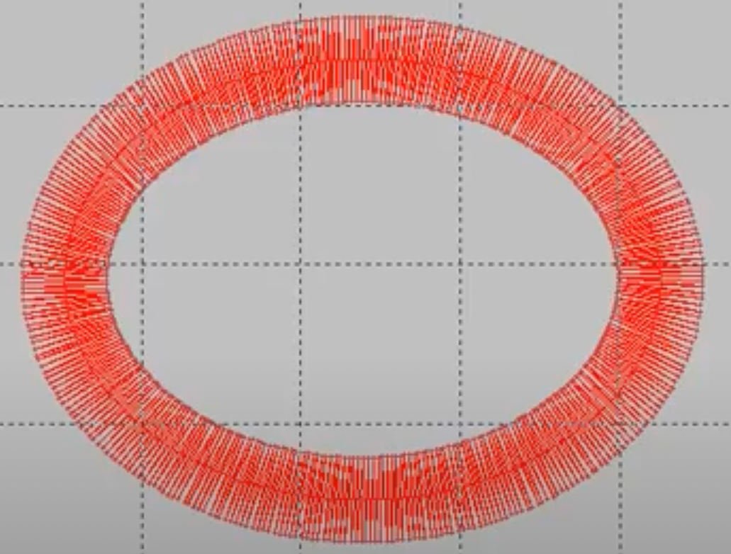
Design Tips - 4
Beware of Thin Black Lines!
Does your design have a lot of black lines separating elements? Are these “capture lines” necessary to the graphic? If they can be reduced or removed, the finished product will look better!
Keep it simple (KIS)
Think “Paint-by-Numbers”. To start there is no color, only numbered shapes contained by capture lines. As the capture lines are covered over in the paint, they disappear. All that remain is colors
When Capture Lines are essential, make them thicker
Sometimes capture lines are essential to the graphic design, as in cartoon graphics for example. In this situation, thicken the capture lines so they can be done in a Stiehl stitch.
This is a reciprocal stitch (back and forth)
that binds the edge of a graphic element.
The thickness of a Stiehl stitch can be
varied for added emphasis and effect. To
summarize, if you must use a capture line, make it THICK !

Slide 3
HOW TO BEST USE COLOR IN PATCH DESIGNS

Slide 4

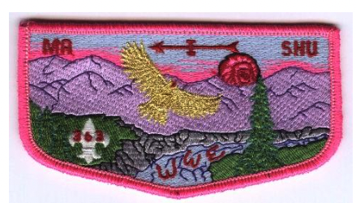

DOES MORE COLOR ALWAYS INDICATE A BETTER PATCH DESIGN ?
WHICH TWO DESIGNS WORK THE BEST?
Lots of Colors does not always yield a better design

Slide 5

DOES A TWILL PATCH WITH ONLY A FEW COLORS EVER LOOK GOOD?
WHICH DESIGNS ARE BEST?

Slide 6
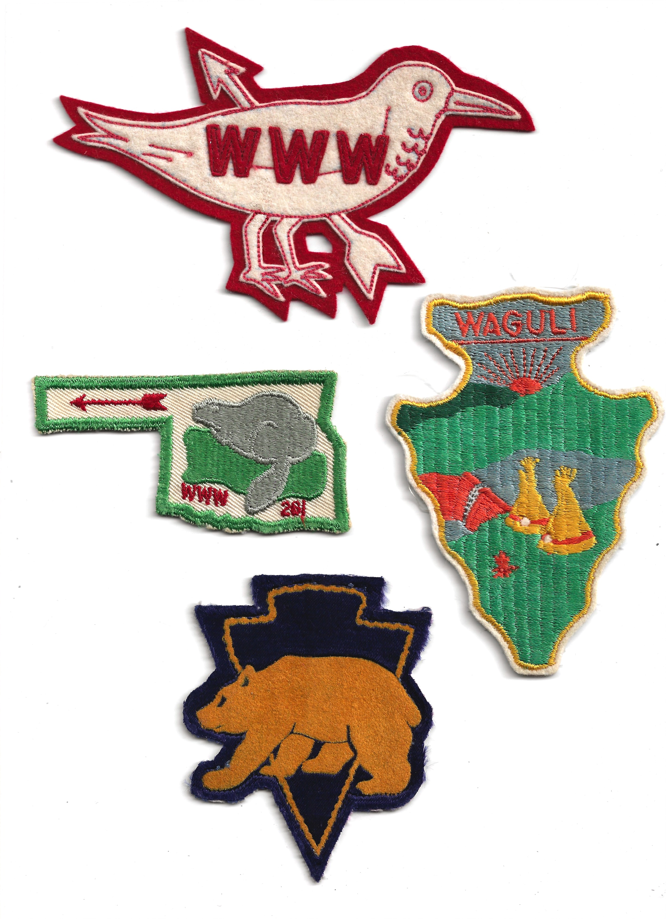

GREAT PATCH DESIGNS ARE ROUND OR RETANGULAR
REALLY?
WHY DO THESE DESIGNS WORK SO WELL?

Slide 7

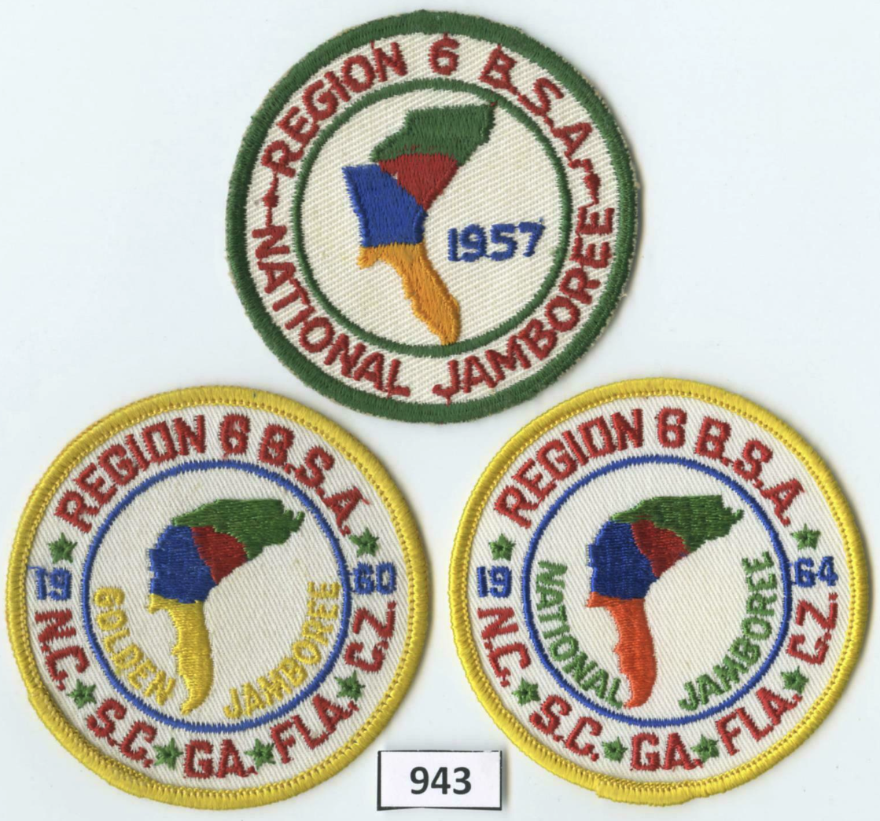
PATCH DESIGNS CAN ALSO COMBINE THEMES
WHEN NECESSARY
PATCH COLORS CAN
ACCENTUATE A THEME

