Slide 1
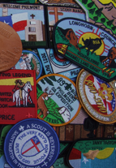
ABCs of Patch Design
Patch Design, Ordering
And
Advanced Concepts

Slide 2
PATCH DESIGN &
ORDERING PROCESS
Step 1: Plan Ahead Normal production and delivery takes 3-12 weeks. However one-week “5-7 business-day production” rush orders are some times available. Price per emblem, regardless of shape, is based on quantity produced and the overall height and width of the design along with the amount of embroidery.
Step 2: Design Your Emblem Think about all of the details that you want to see in your emblem design. Maybe a group or event name is very important; or perhaps a special logo or icon. After you have a design in mind, put together a rough sketch or graphic. Scan it and e-mail it to the manufacturer. They accept photos or scanned images in any standard file formats (.jpg, .ai, or .pdf ). If you’re not an artist, you can talk with their representative to have artwork designed for you based on a description, idea, or even just a basic theme. Avoid overseas vendors.
Step 3: Order Your Emblems To order, call them or request a quote online. Supply
Size (width x length) and shape
Picture of your artwork (usually jpeg or pdf)
Quantity needed
70% or 100% embroidered patch
Type of backing (heat seal, plastic, Velcro, no backing)
If you need any specialty threads (metallic) or need a button loop
Within a week or two (or three), of your order, they will usually e-mail you a full color emblem design or scan for your final approval.
Step 4: Receive Your Emblems Manufactures want your business and will sometimes deliver your patches for free is they don’t meet their
“promised” delivery date

Slide 3
Design For
Success

Slide 4
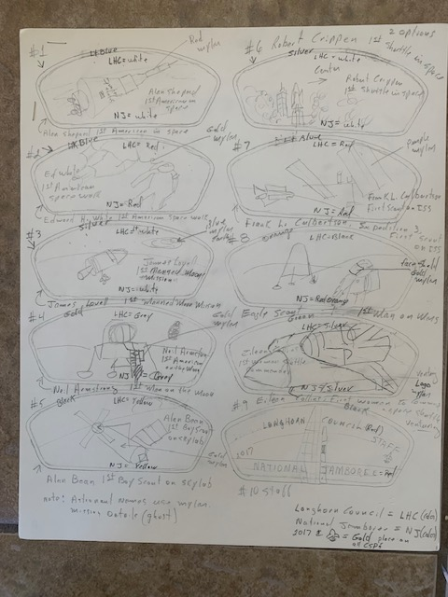
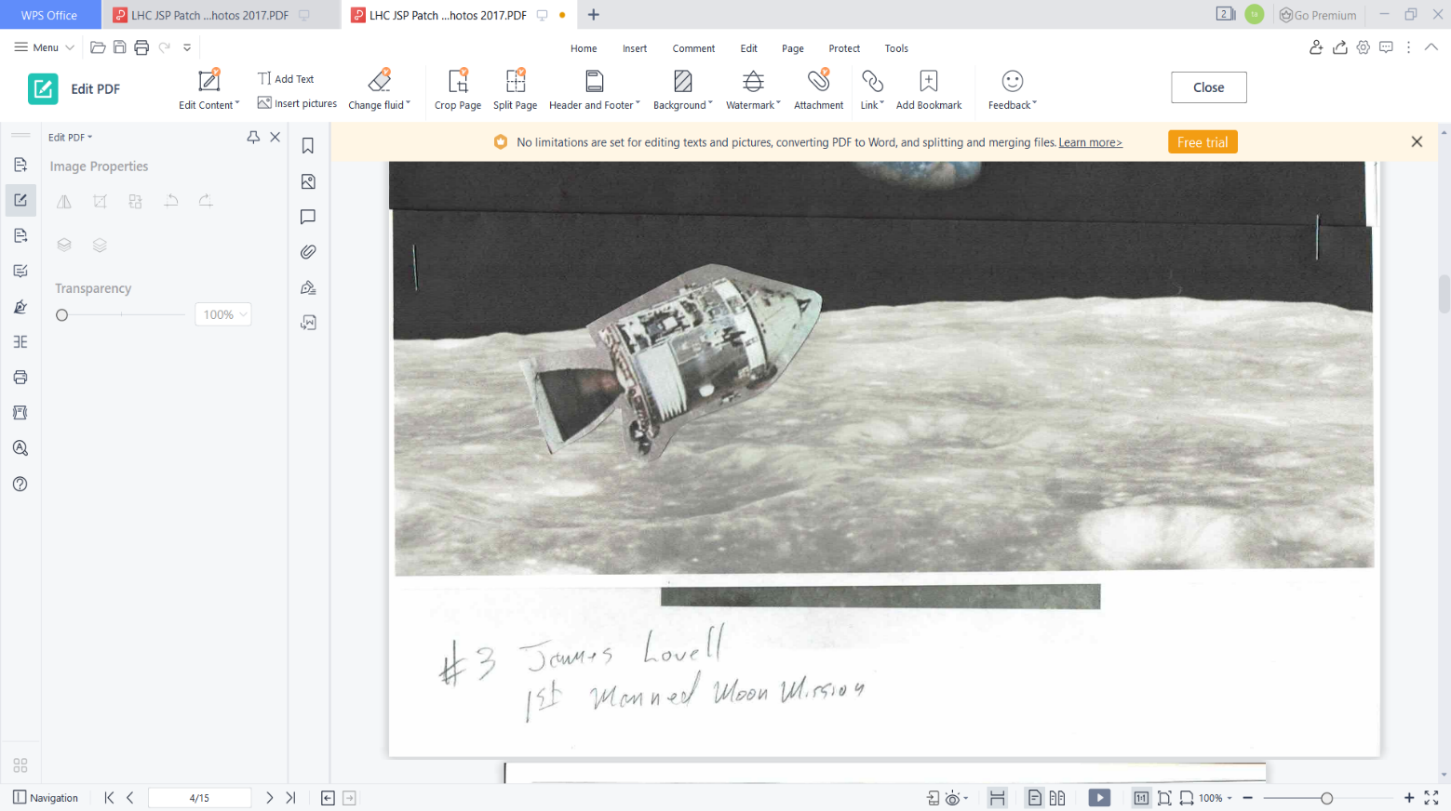
Jamboree Shoulder Patch Concept
1st Scout to Moon
James Lovell
Rough Draft
Inspiration
Compilation
What is the concept and general colors desired ?
Find graphics that match your concept and sketch it out.
The Graphic does NOT require more than this
Notes:
Chart

Slide 5

JSP Finished Artwork
From Graphic Designer
Notes:
Chart

Slide 6
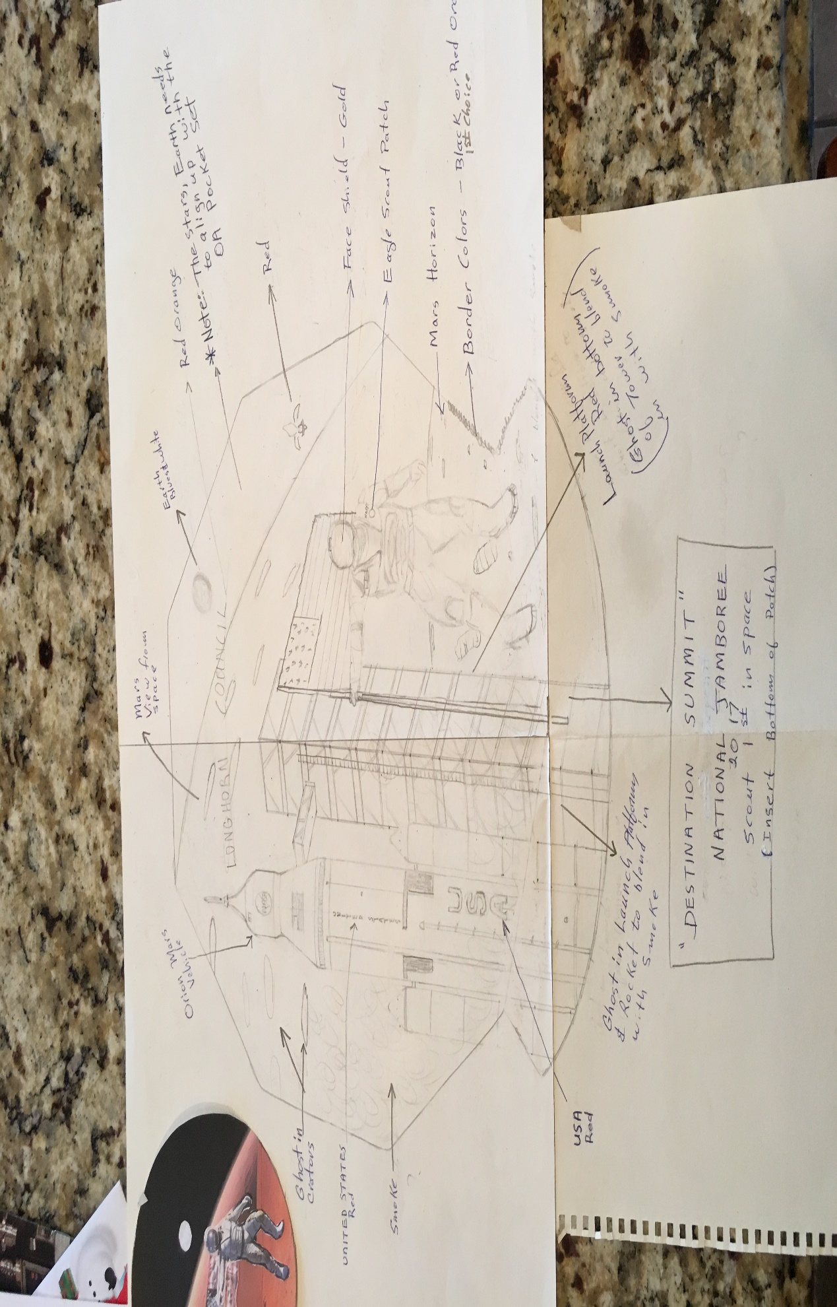
Jamboree Back Patch Concept
Does this look like finished artwork ?
Notes:
2017 Hand drawn draft.
My original design would have required a special machine that could create this patch. Too Costly!
Know your limits or at least be flexible.

Slide 7
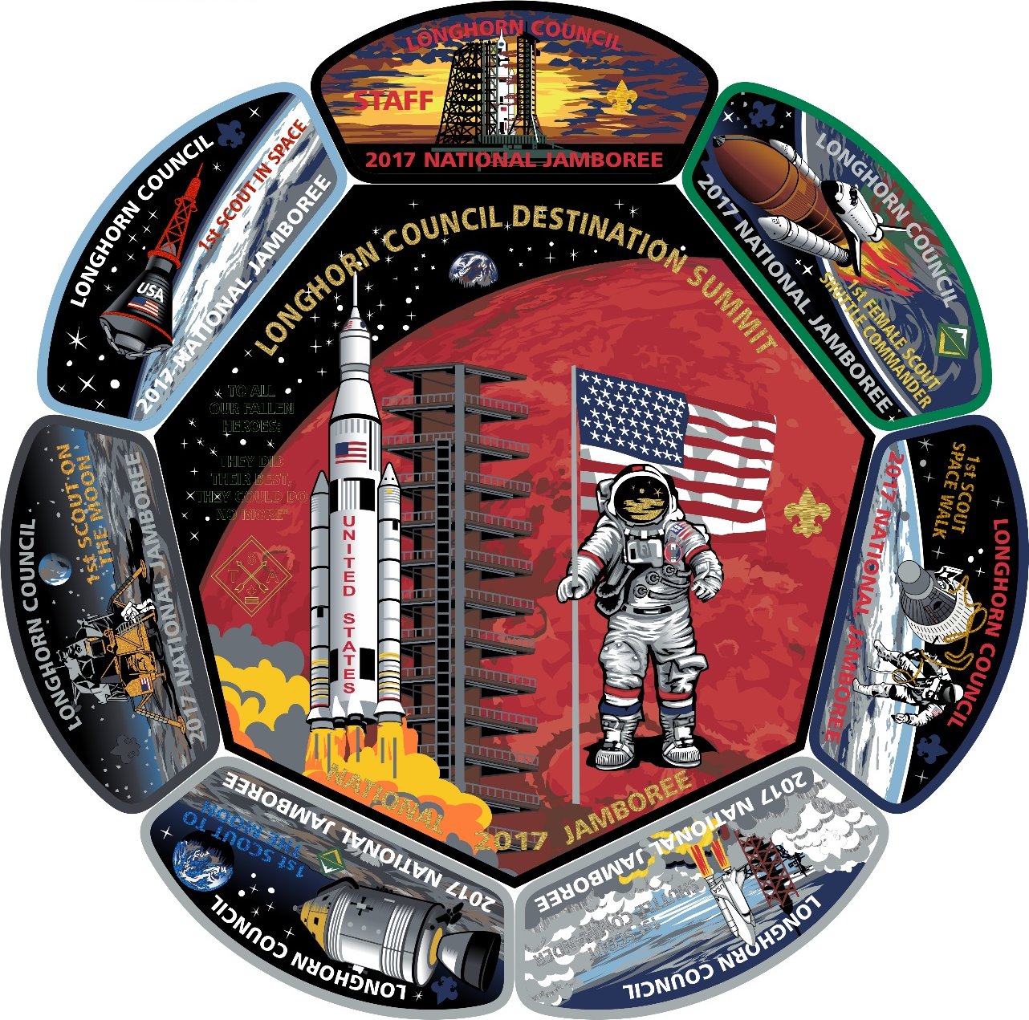
Jamboree Back Patch Finished Artwork from Supplier
Good concept + simple sketch becomes beautiful with some help from the patch manufacturer
Notes:
2017 National Jamboree Council Set.

Slide 8
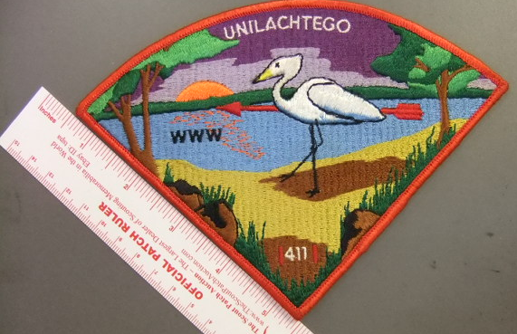
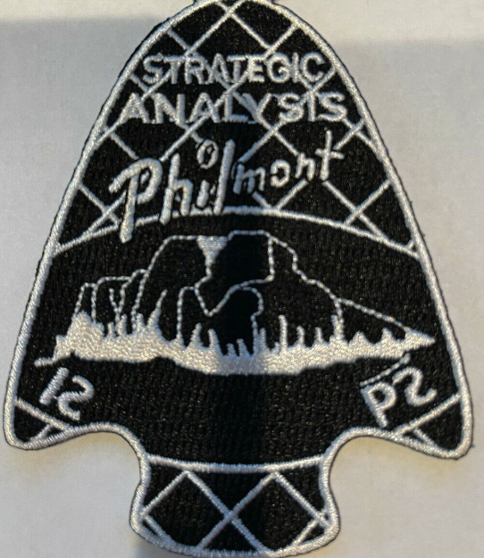
Design Tips – 1
Bold is better
Bold letters and design elements are more visible and look better when embroidered. This simple advice can make your patch look so much better!
Strong Color Contrast is Ideal
Strong color contrast is better than light-on-light or dark-on-dark colors. In other words, if visibility is an issue with your current design, please consider improving the contrast for a better result.
The Exceptions
The exceptions to this rule are black-on-white,
or white-on-black color schemes. Either can result
in poor-quality embroidery coverage.
Lettering – Minimum Size ⅛″
Letters smaller than ⅛″ of an inch will be vert hard to read.
Small letters are not visible from a distance, no matter how well they are embroidered. AVOID THEM !
Open Block Lettering is More Legible
Narrow types tyles do not embroider well. Tall and skinny font styles should be avoided. Squat and bold (not extra bold) are preferred.
.
.

Slide 9
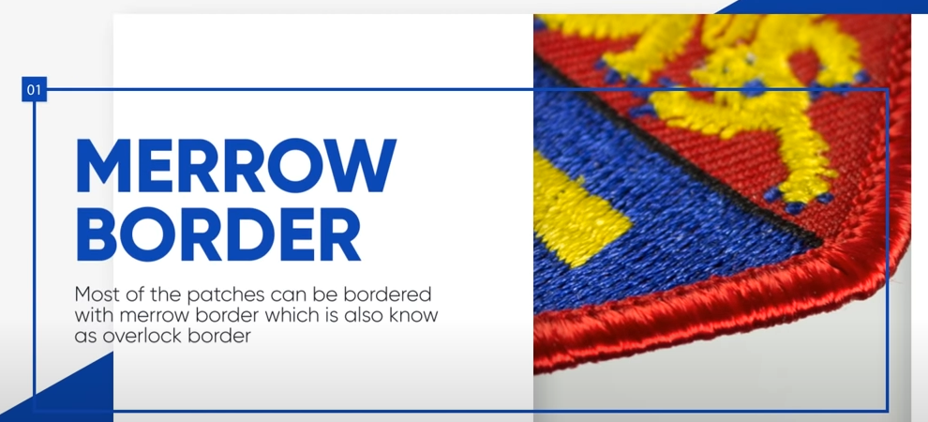
Design Tips - 2
Blank Spaces are Boring!
Effective use of space is important. Enlarging graphic elements, extending or enlarging text, and introducing added graphic elements are ways to use blank space better. Design to fill blank space for a more impactful patch but don’t fill in blank areas with more “stuff” just to fill them !
Choose a Complimenting Border
The Classic
For the most Classic patch look, choose a color that works well with your design and use an Overlock Edge border (Merrow® border.)
Interestingly, an overlock edge border is applied after the patch is die cut from the roll. A Merrow® overlock sewing machine is used to create the border.
Don’t run your design into the border area

