Slide 1
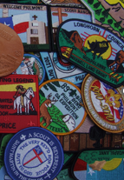
ABCs of Patch Design
Patch Type
How Many Types Are there?

Slide 2
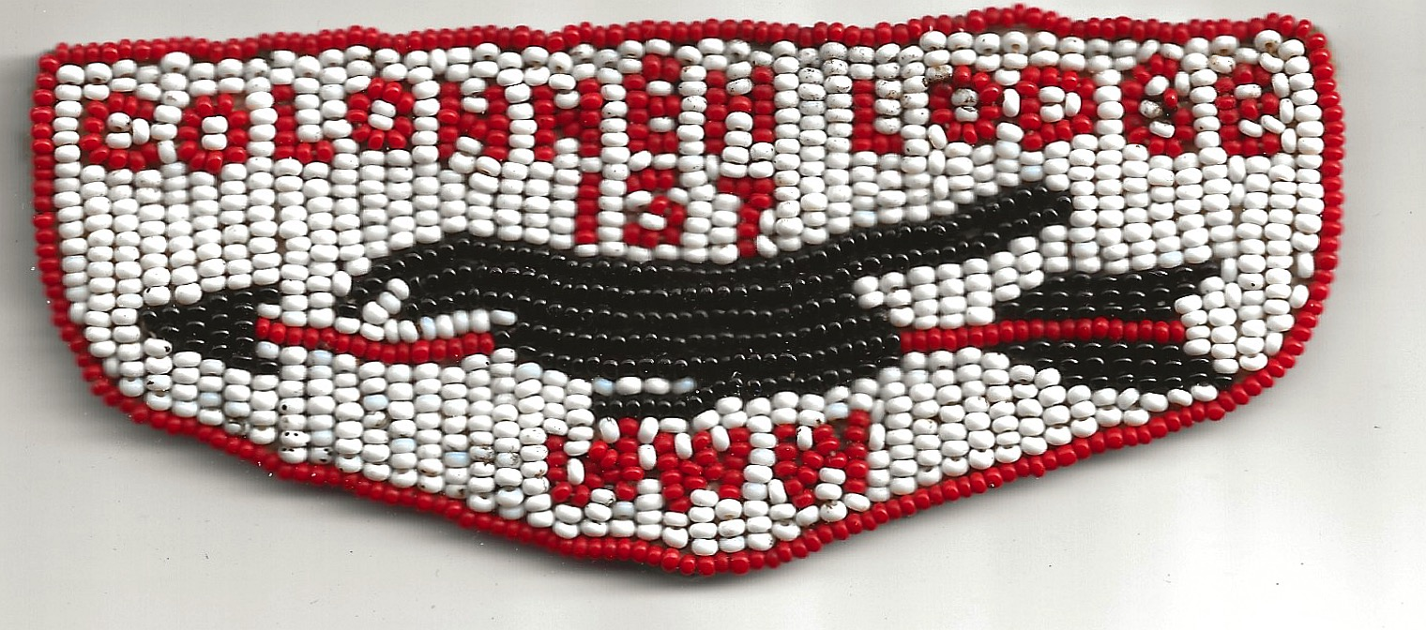
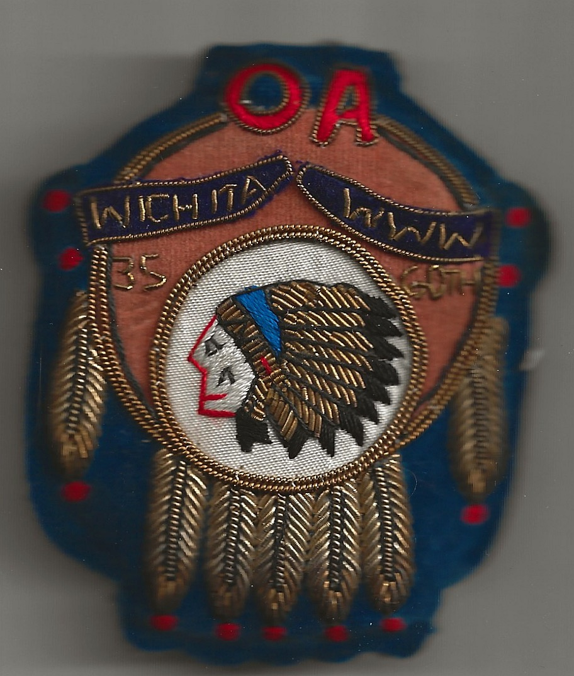
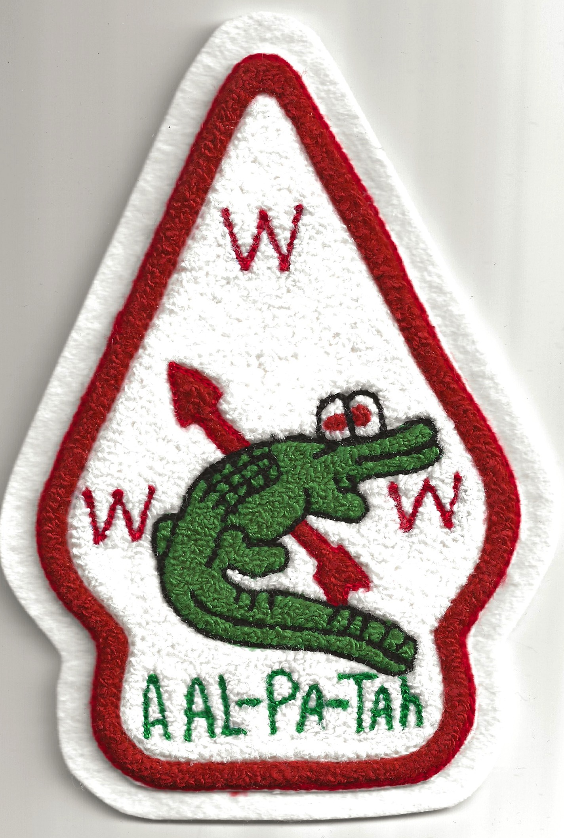
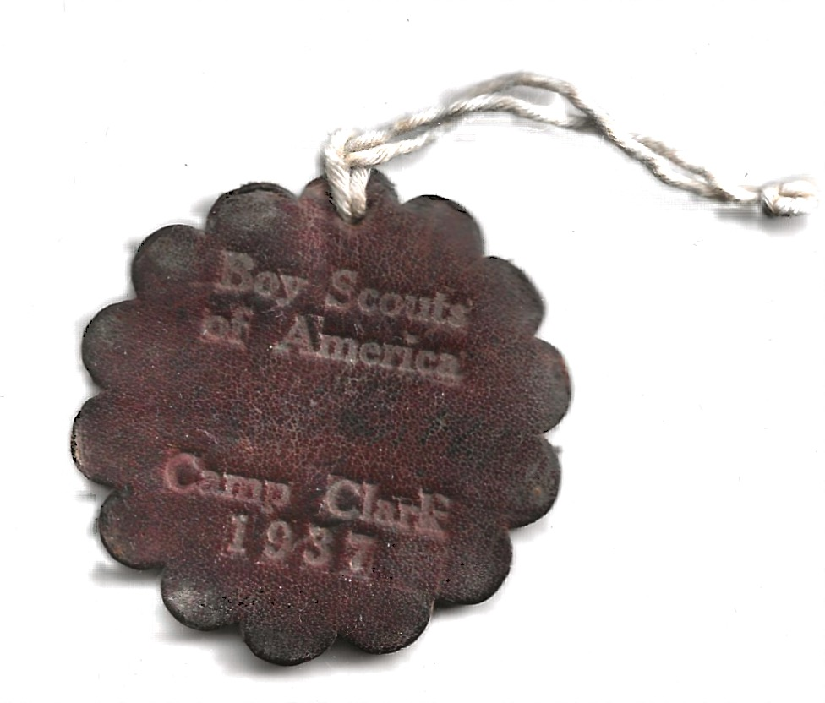
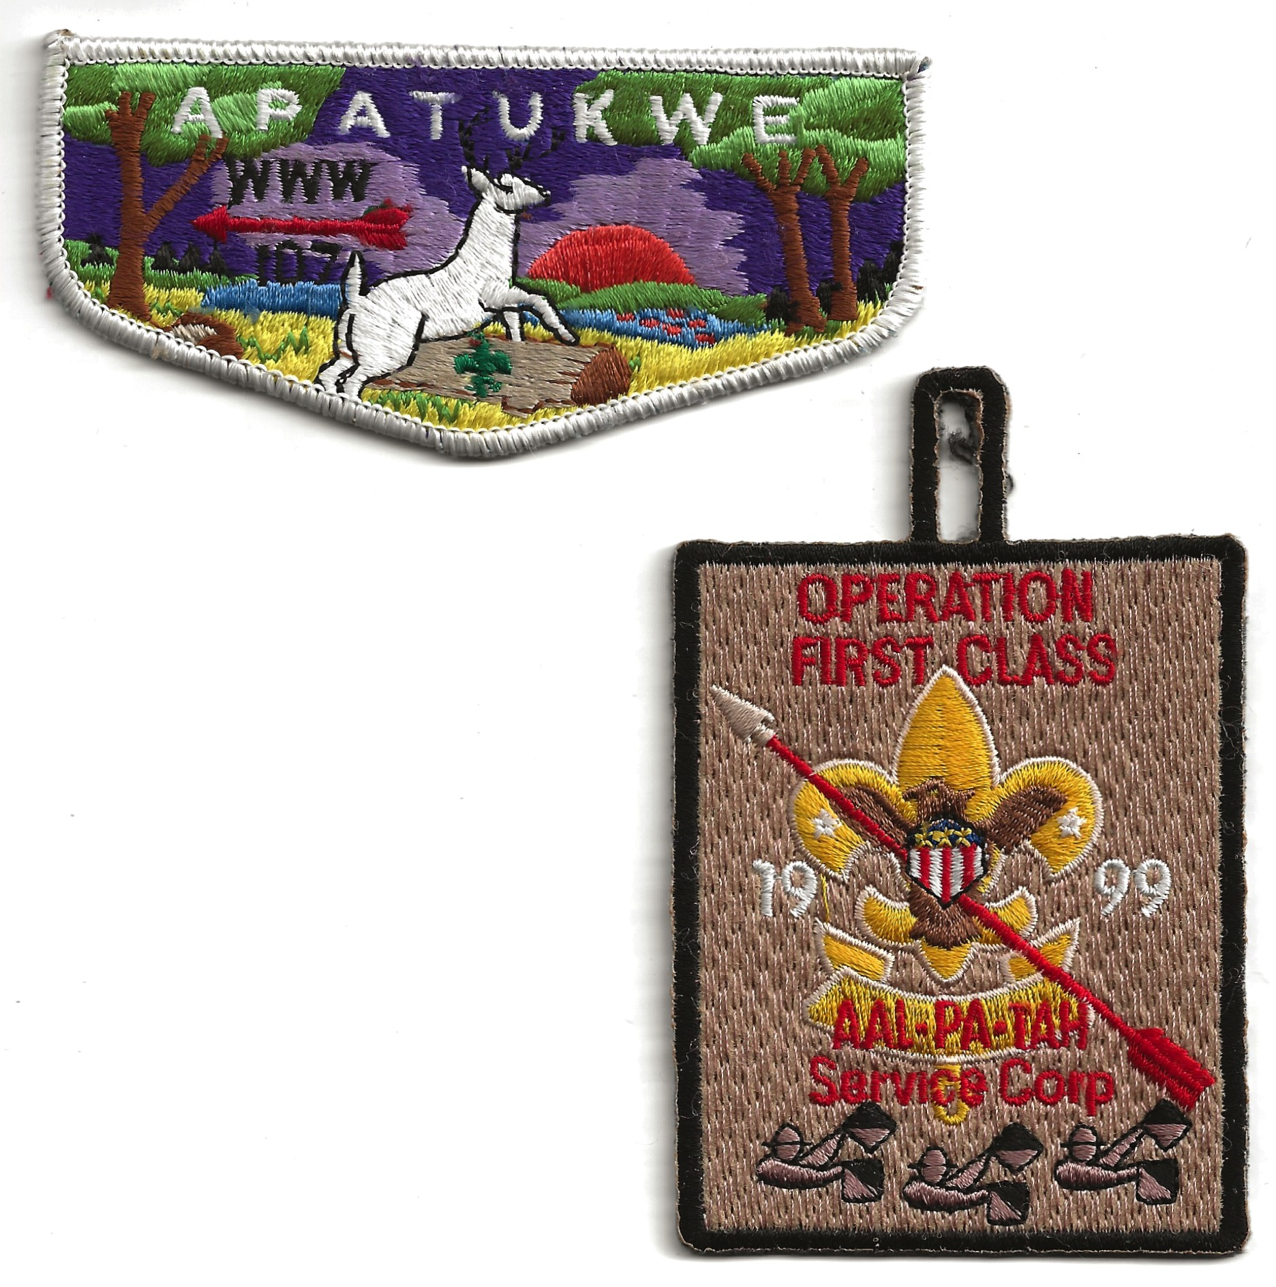
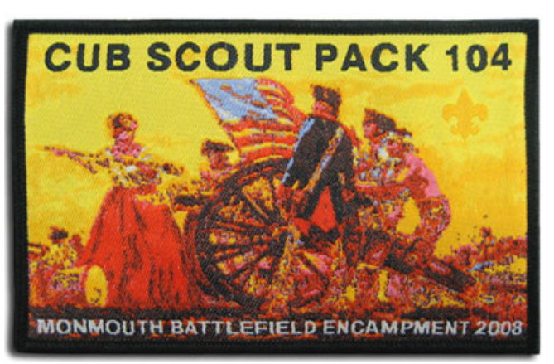
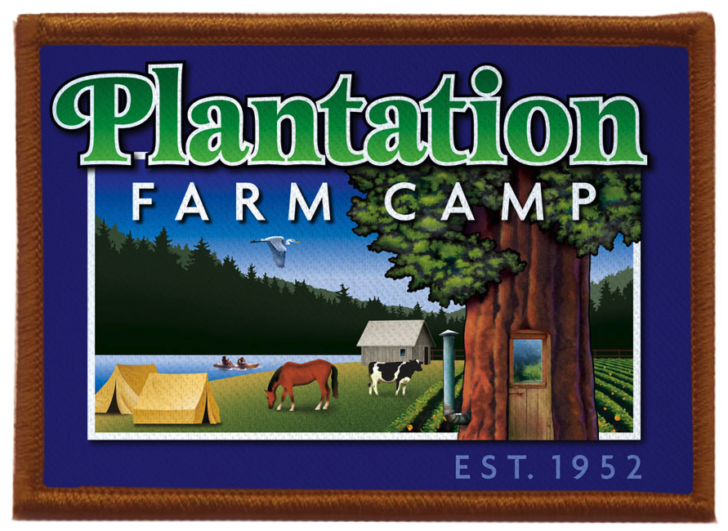
Patch Types
Beaded: stitched by hand directly on fabric or made on a loom and transferred. Not suitable for detailed patches
Bullion stitch: a decorative technique that is worked by twisting a thread around a sewing needle several times before inserting the needle into the cloth. Suitable for detailed patches
Chenille: Soft, fuzzy fabric gets its name from the French word for “caterpillar,” which it resembles. Not suitable for detailed patches
Leather: leather patches can be stamped, hand tooled or laser etched
Embroidered Patches have designs achieved by interlacing threads and are suitable for detailed designs
Fully Embroidered: Entire surface is embroidered and patch has a 3D appearance
Single Stitch Fully Embroidered: patch, usually the background, is only partially stitched
Woven: done by stitching a design with thinner threads woven together instead of embroidered into fabric. Ideal when design is too detailed for embroidery process
Printed: done by printing the design on cloth. No color limitations, washable with photographic realism unavailable with embroidery

Slide 3
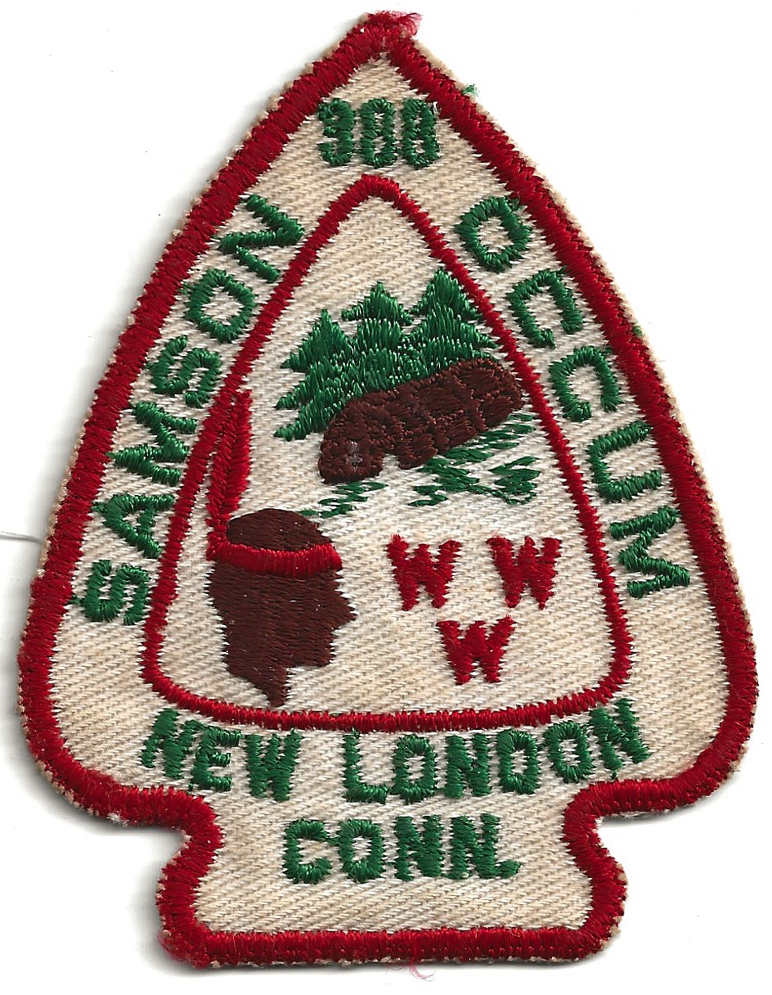
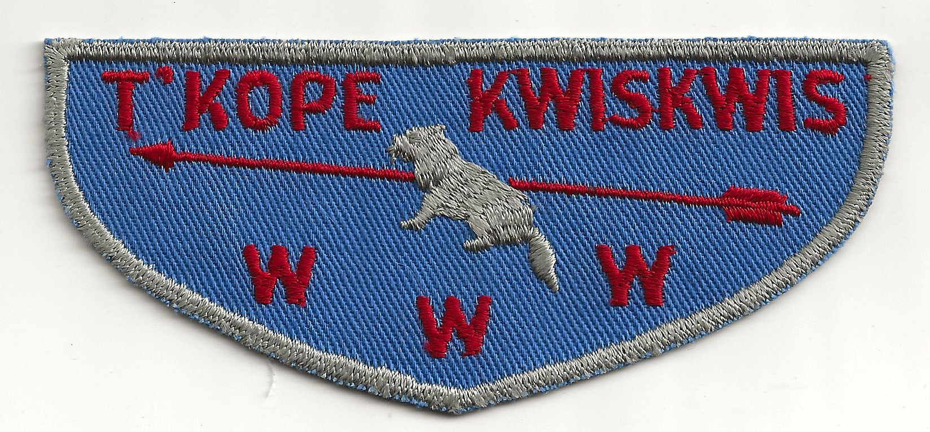
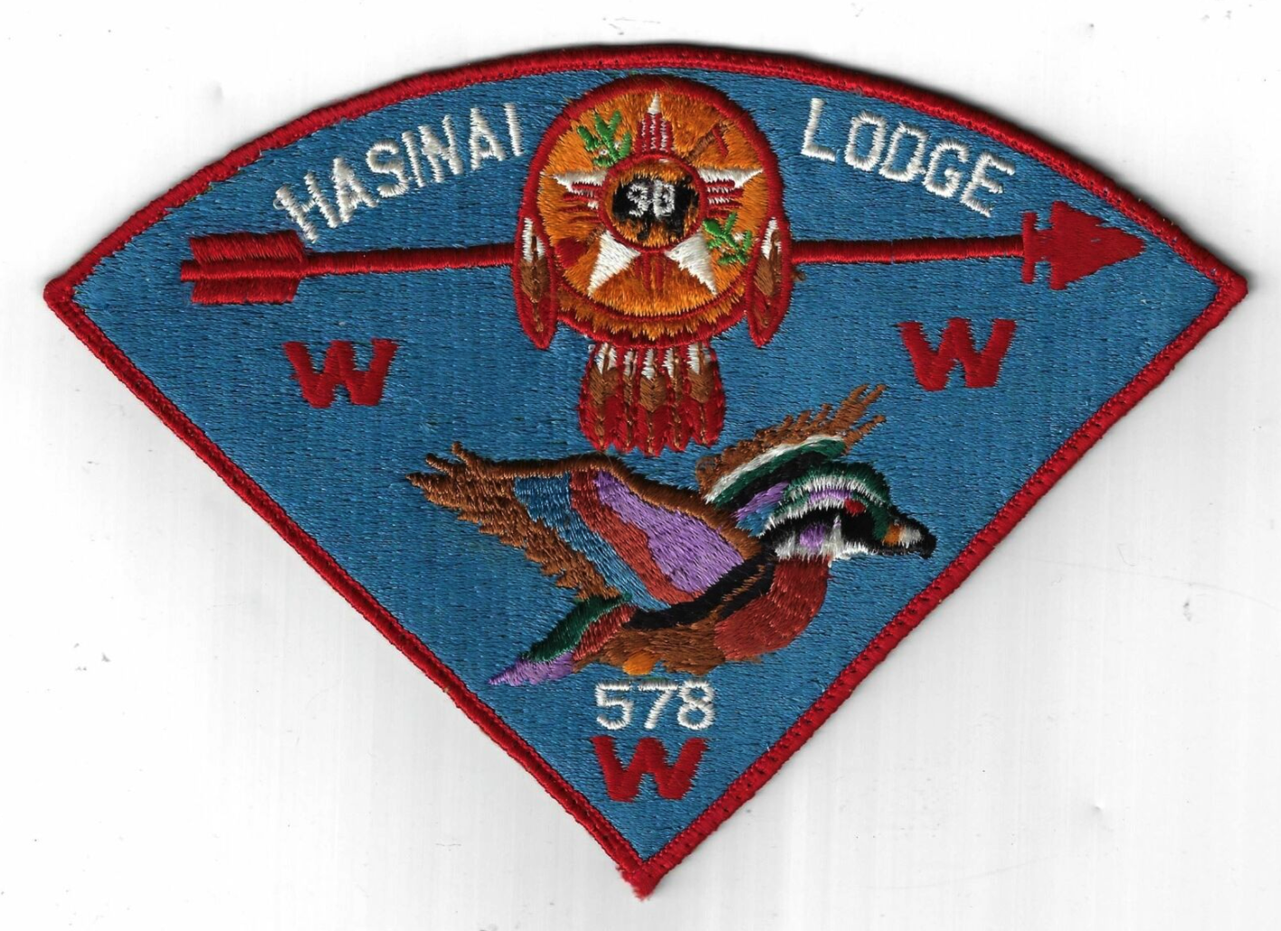
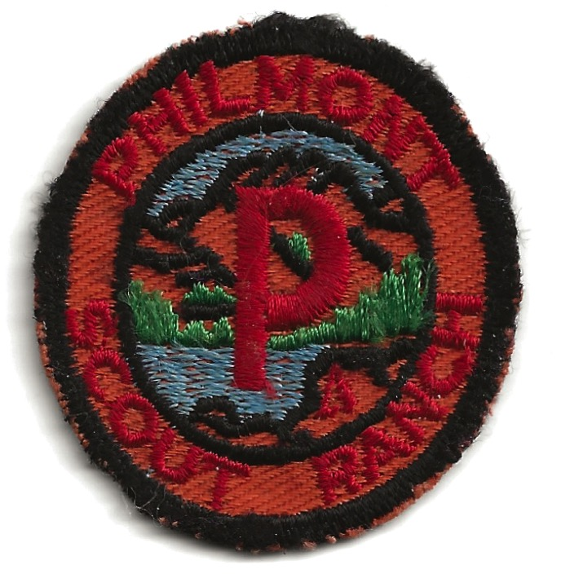
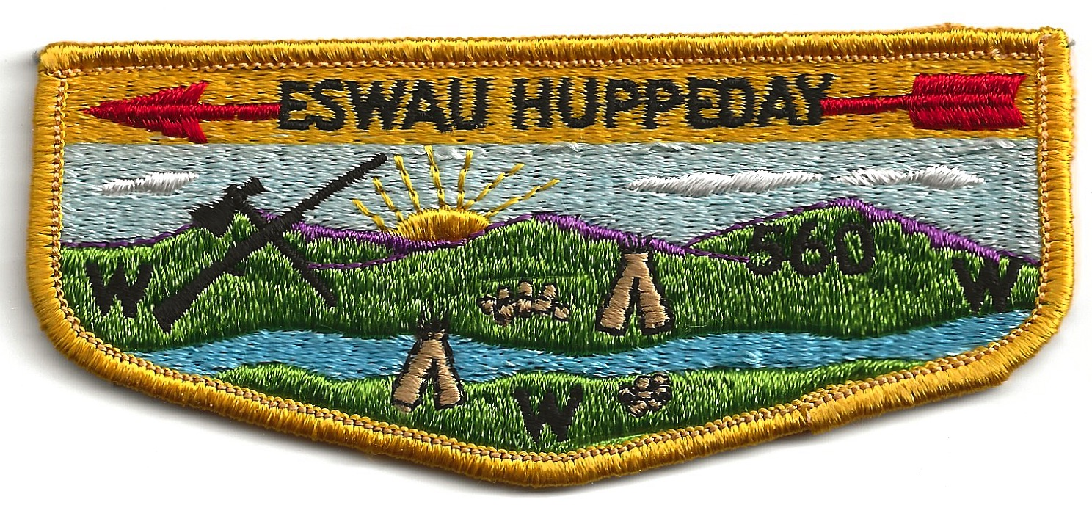
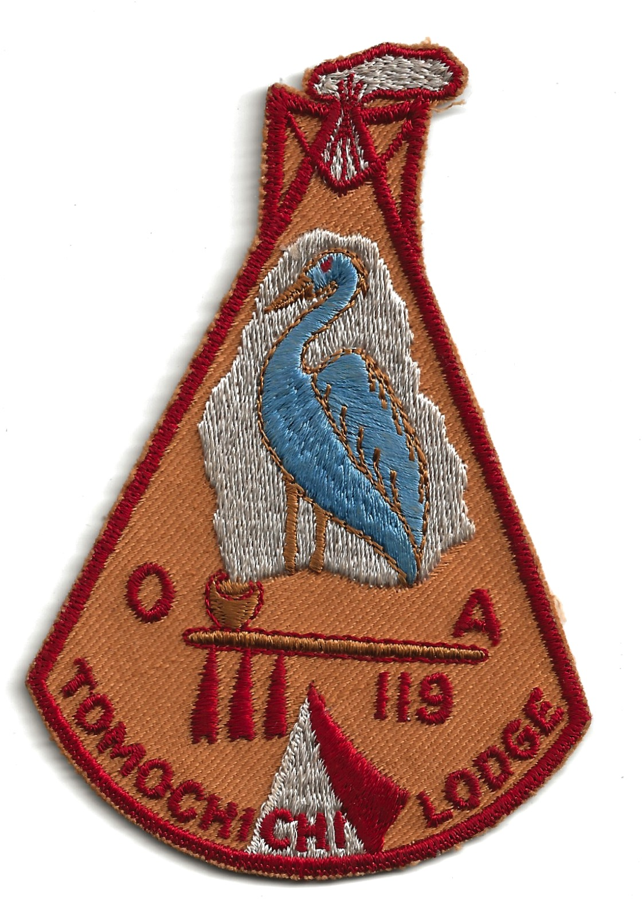
Patch Shape Designations
A = Arrowhead shaped patch usually less than 5 inches tall
F = Flap shaped patch not fully embroidered
P = Pie shaped or Triangle shaped patch designed for a neckerchief
R = Round shaped patch usually less than 5 inches in diameter
S = Flap shaped patch that is fully embroidered
X = Patch shapes that do not fit the above descriptions

Slide 4
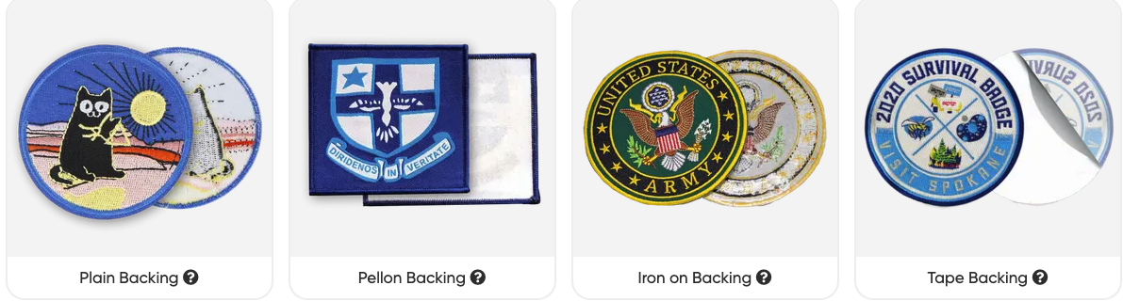
There are Also SEVERAL Types of Patch Backings
Plain Backing Pellon Backing
Iron on Backing Tape Backing

Slide 5
ABCs of Patch Design
Process, Guidelines,
Inspiration

Slide 6
Design Process
What is the purpose of your patch Design
Lodge Identifier
Event Souvenir
Trader
Fundraiser
What quality do you seek?
Loom Embroidery is high quality but comes at a cost
Patches that are not fully embroidered or made from Single stitch solid embroidery cost less IF that’s a major requirement
Bullion and Chenille patches are great for special issues but they are not commonly worn on uniforms & expensive
Printed and woven accommodate high resolution designs
Leather patches are a great option but there are fewer vendors
What is your budget?
What is your delivery schedule Requirement?
How many do you expect to sell near term?
What is the main “THING” you want your design to emphasize?
Understand the BSA patch design guidelines
KNOW THE ANSWER TO THESE QUESTIONS BEFORE PROCEEDING

Slide 7
BSA GUIDELINES FOR CUSTOM PATCHES AND EMBLEMS
Prohibited Patches or Design Features:
Items currently sold by National Supply
Emblems that contain the confederate flag
No trademarks without prior authorization
No text or designs over the BSA Emblem or FDL
No text or designs superimposed over the US flag
No obscene gestures, language or slang or Political reference
Council Shoulder Patches (CSPs) cannot have the city, state on them.
Order of the Arrow (OA) Emblems with the letters WWW should not have periods between the WWW and must fit the exact size of the uniform pocket
JSPs must NOT have city and state as a means of identifying the local council
Patches or Designs must contain:
“BSA” without any periods, “Boy Scouts of America” or the BSA fleur-de-lis
Patches must carry a QR code from a BSA licensee
American Indian imagery must adhere to BSA American Indian guidelines
Jamboree shoulder patches (JSPs) should have “National Jamboree” or “National Scout Jamboree”
Reference these web sites for complete requirements:
https://filestore.scouting.org/filestore/pdf/33066/33066_Guidelines_for_Custom_Patches_And_Emblems.pdf
https://oa-bsa.org/sites/default/files/training-documents/BSA%20Guidelines%20for%20Custom%20Patches%20and%20Emblems%207-2009%20.pdf

Slide 8

Patch Inspirations
Find an Image
of interest from your
state of from your lodge or your event or from your camp
or from a Scout book or from
your imagination and add to it

Slide 9
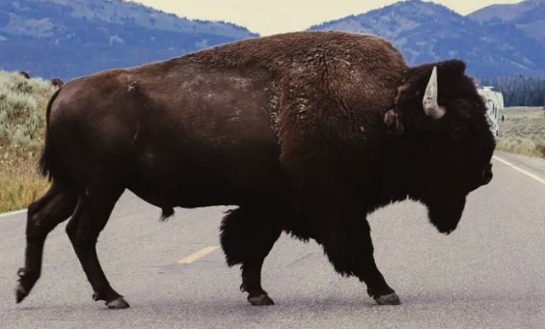
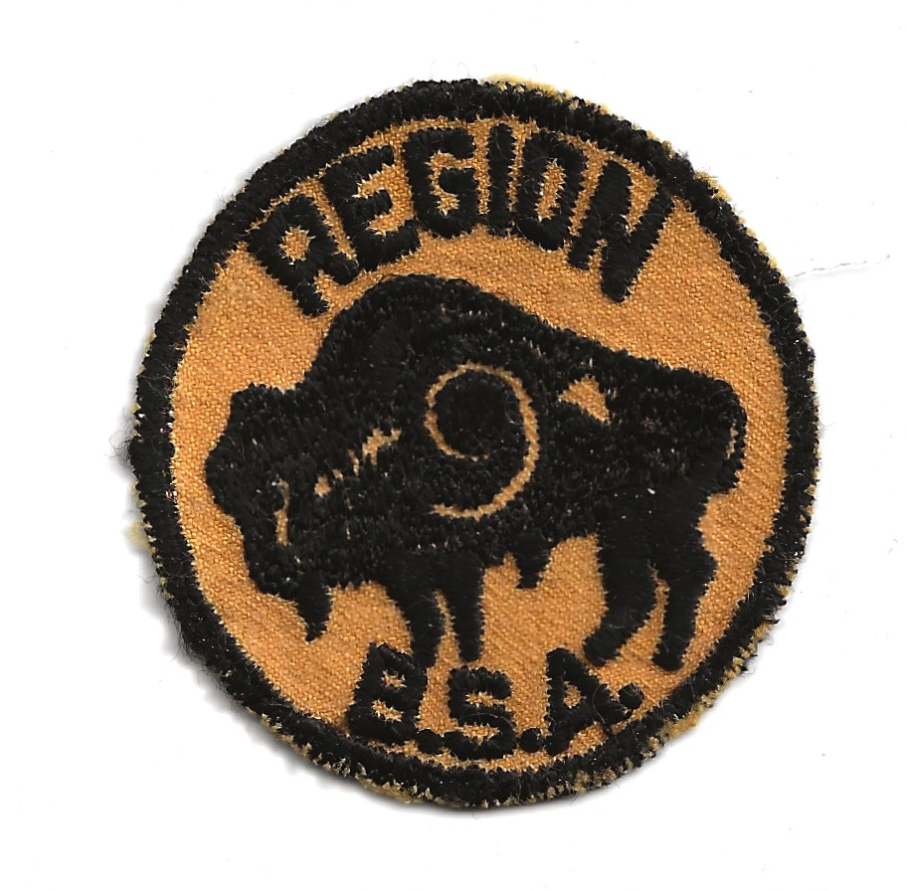
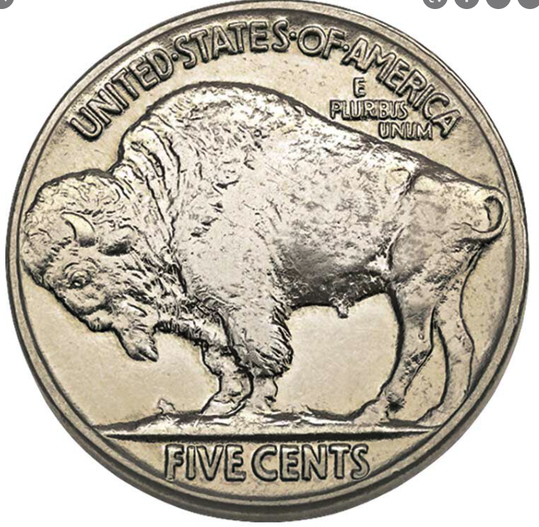
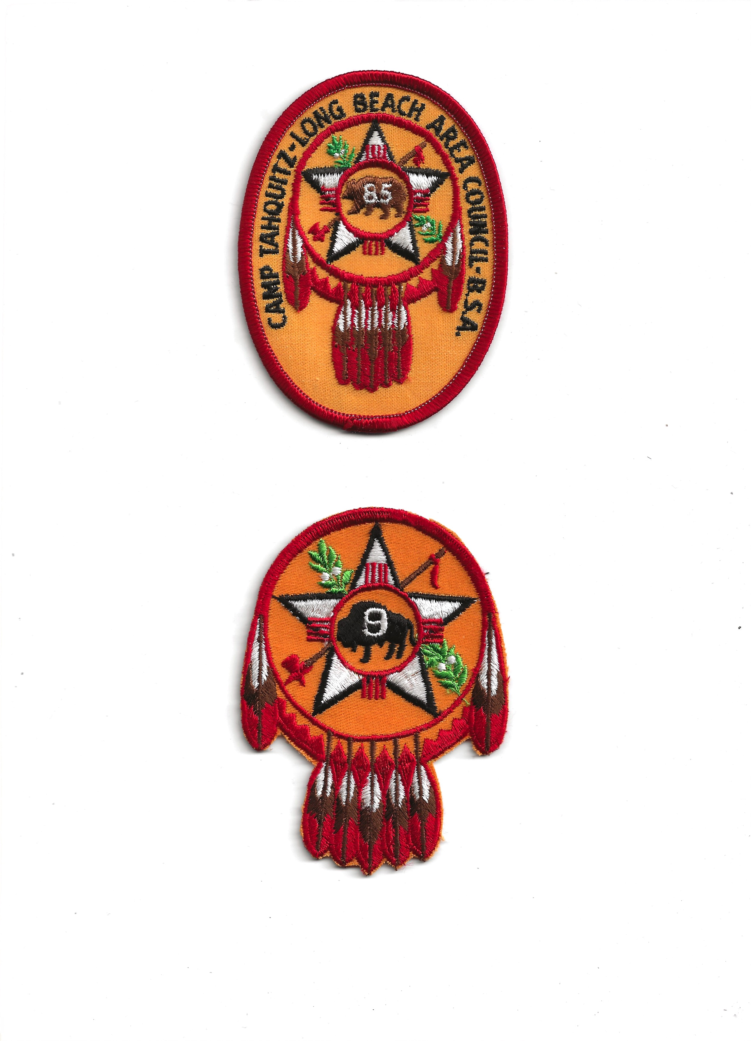
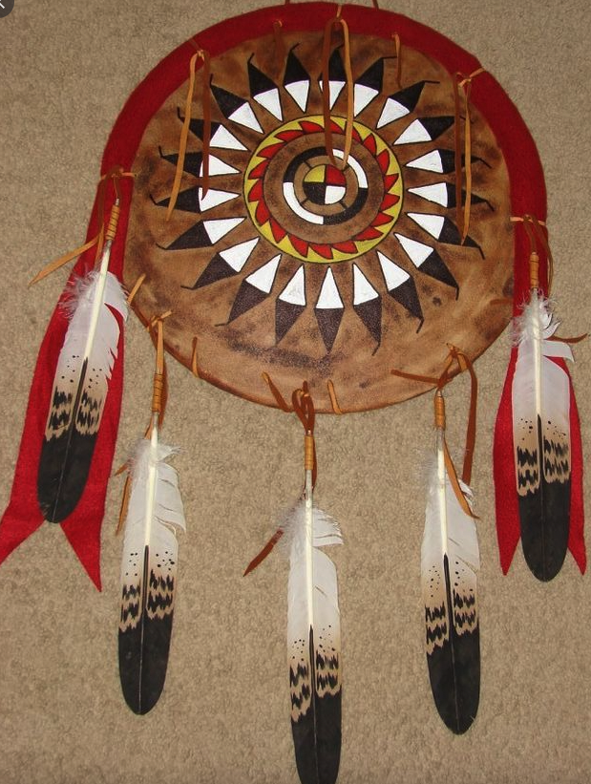
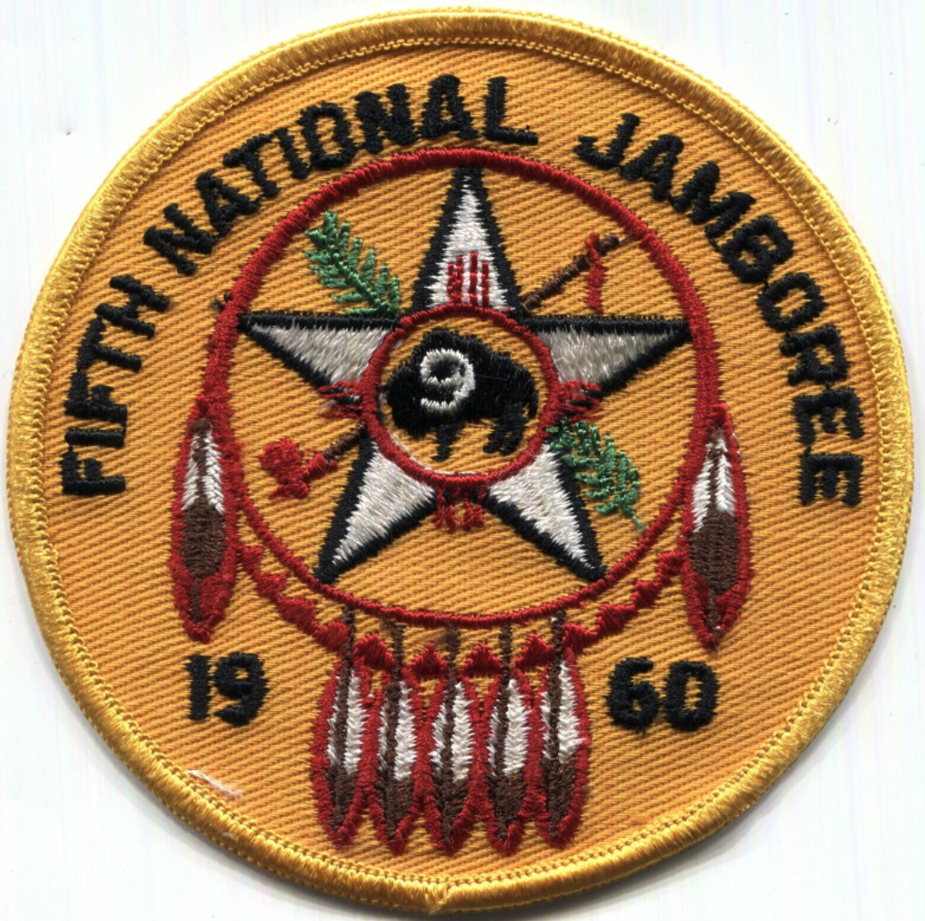
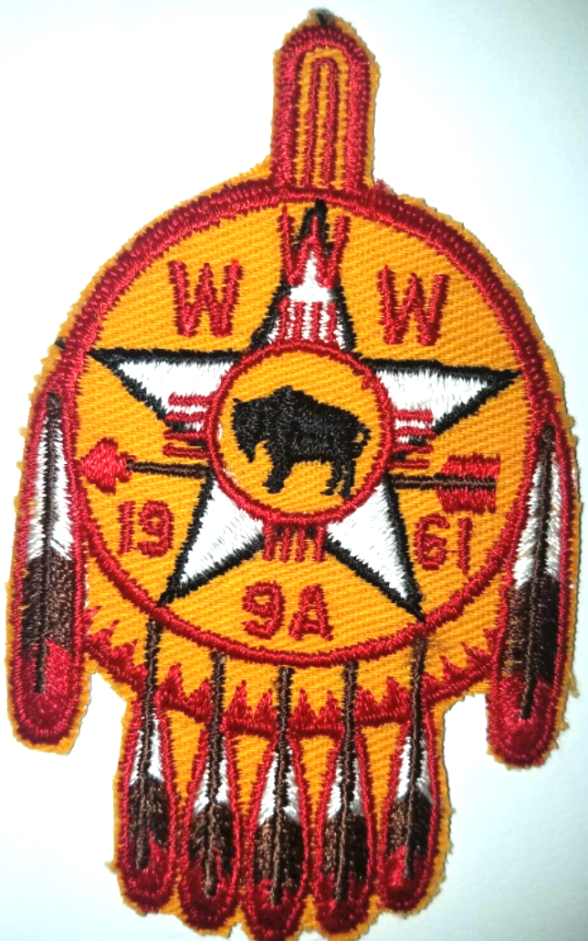
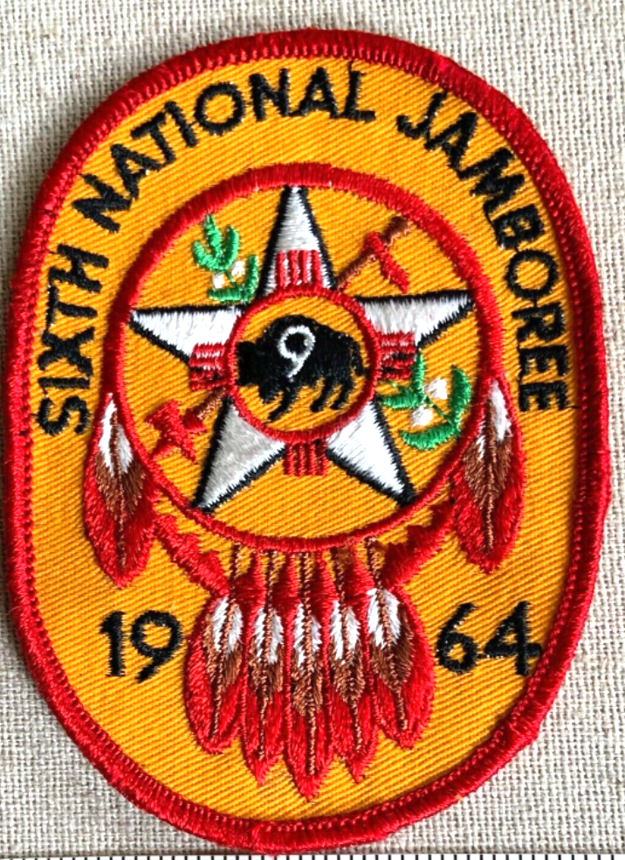
SOMETHING INSPIRES EVERY DESIGN
The ”THING”
Inspiration Image
The “main thing”
1913-1938
Coin
1940’s
Region 9 Patch
1950’s Region 9 Patch
1800’s
Shield
THINK THESE WERE INSPIRED BY THE 1950s REGION 9 PATCH ?

Slide 10
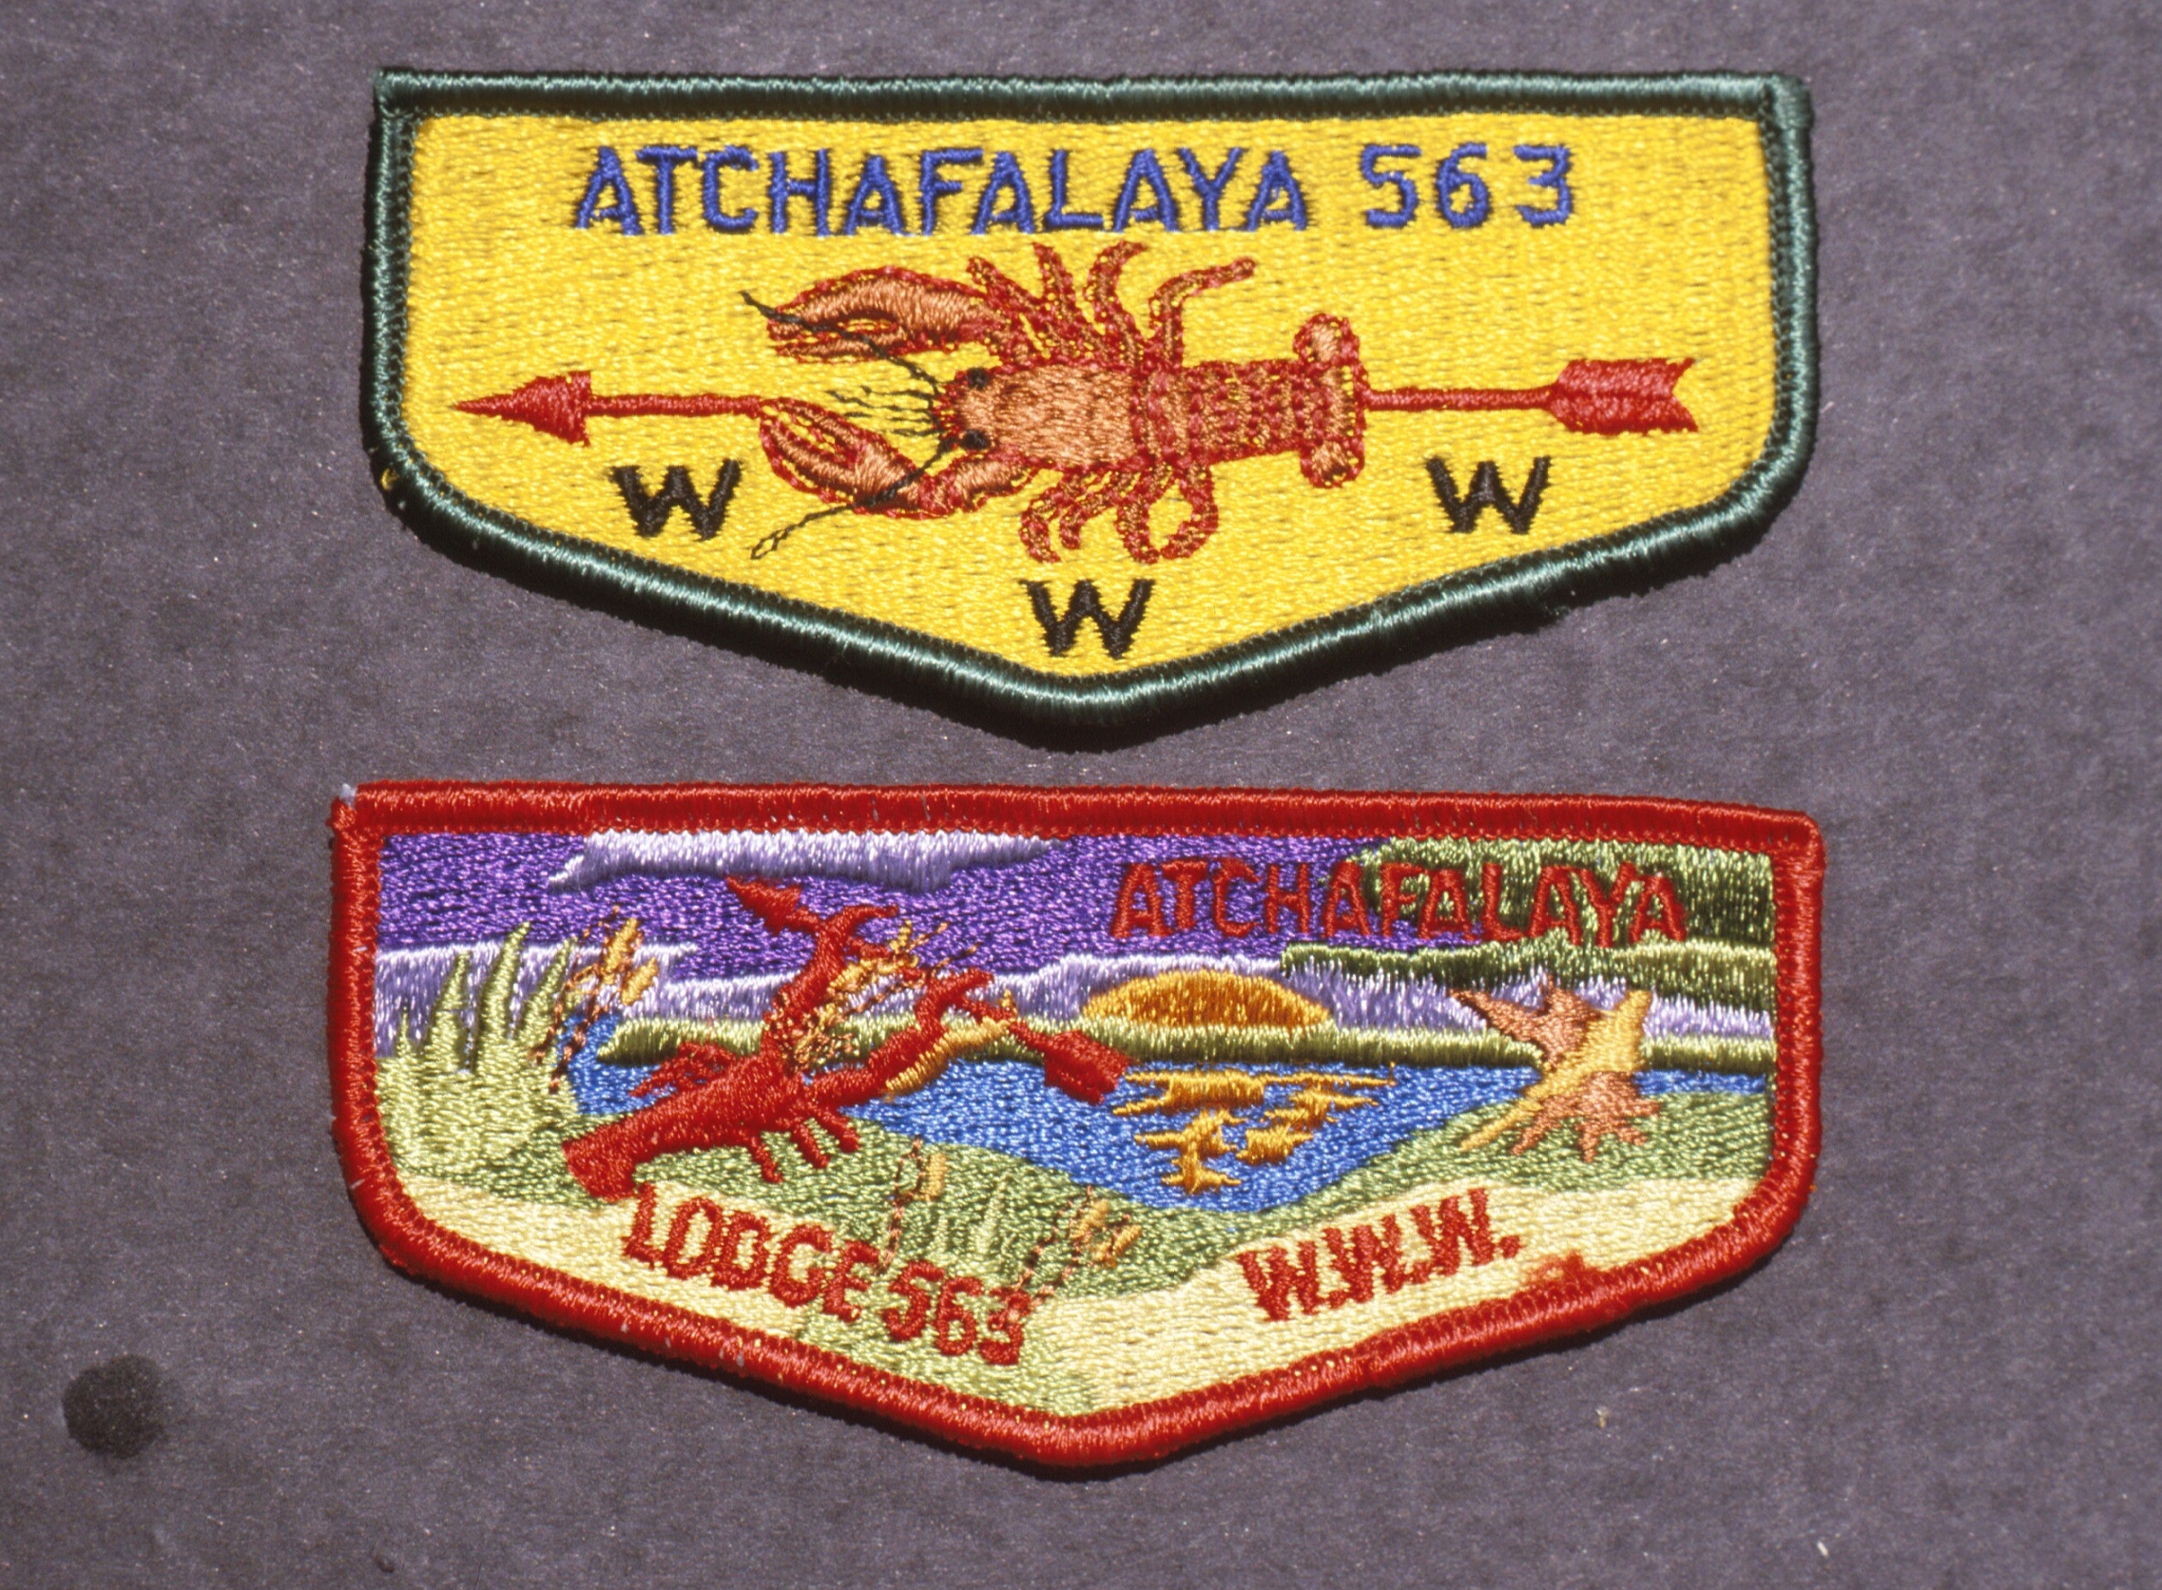
DESIGNS CAN BE AN EXPANSION OF AN EXISTING DESIGN
Both show “the thing”
The Lobster changed dramatically but it still
Remains the focus of the design
How do you feel about the color choice in the red bordered patch?

Slide 11
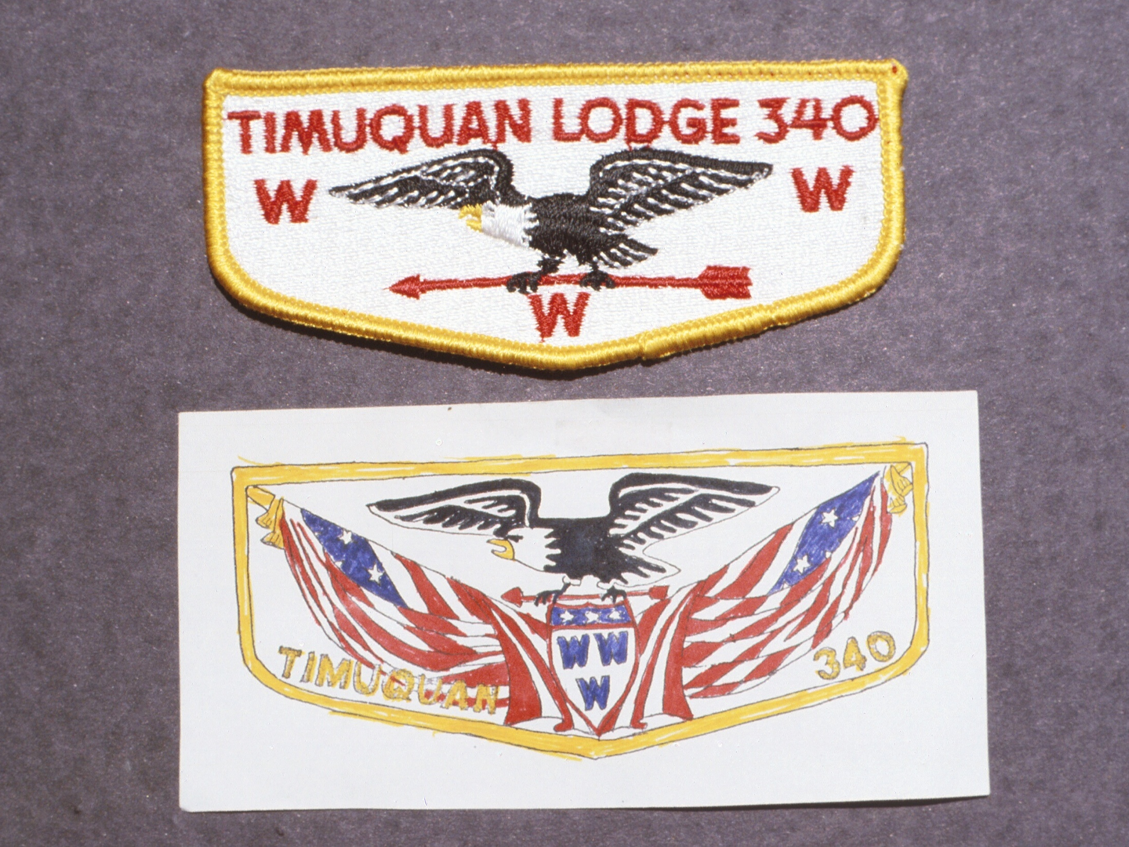
Existing Lodge Patch was Inspiration for New Design
What is the main “thing” ?

