Slide 1
USING A COMPUTER
TO AIDE PATCH DESIGN PROCESS
Version 2.0

Slide 2
WHY USE A COMPUTER TO HELP DESIGN A PATCH ?
PROS
It will allow multiple design iterations in a fraction of the time
CONS
IT TAKES SOME TIME

Slide 3
Step 1
GENERATE BASIC SHAPE OF DESIRED DESIGN

Slide 4
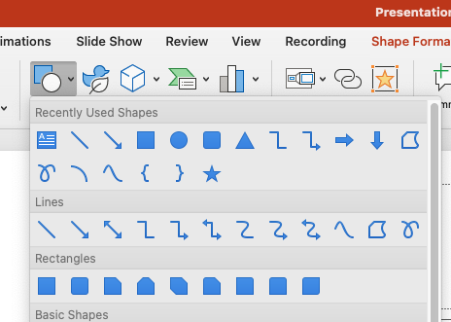
Create Outside shape
(circle for this example)
Add circle to represent outside diameter
Insert /shapes/select circle/click mouse to approximate location on page where you want the circle
”circle” icon

Slide 5
Result

Slide 6
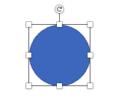
Select circle/hold Shift Key and drag mouse to enlarge to desired size
Ignore the circle color for now
Selected circle
Enlarged Circle

Slide 7
Step 2
ADD BORDER TO BASIC SHAPE OF DESIRED DESIGN

Slide 8
Select circle/duplicate it (control “D”)
Ignore the circle color for now
Selected circle
Enlarged Circle

Slide 9
Resulting Shapes
Enlarged Circle superimposed
over identical circle
Ignore the circle color for now

Slide 10
Result:
Select Circle in Front/hold shift key and drag mouse as needed to make the inner circle smaller
Select one Enlarged Circle superimposed
over identical circle
Ignore the circle color for now

Slide 11
Result:
Circles become concentric with the outside diameter becoming the border
Select both circles
Arrange / Align Middle / Align Center
Ignore the circle color for now
The result is two concentric circles
Representing a blank patch with a border

Slide 12
Step 3
ADD SHAPED TEXT TO BASIC SHAPE OF DESIRED DESIGN

Slide 13
Adding Text:
Add a line of desired text: select Insert / Word Art / and a white letter “A”
I selected “Word Art”, an “A” with no color and typed:
“Camp Bear Creek”
Camp Bear Creek
The result is “Camp Bear Creek” in
WORD ART
placed randomly
on the patch blank
Ignore the circle color for now

Slide 14
Shaping Text:
Select text / Shape format / text effects (select uncolored “A”)
/ Transform / select desired arc
Camp Bear Creek
The result is a “Camp Bear Creek” placed randomly
on the patch blank
Ignore the circle color for now

Slide 15
Fitting Text to top of Shape:
Select text box / drag leader lines at 12, 3, 6 and 9 to shape text to fit patch shape
Camp Bear Creek
The result is a “Camp Bear Creek” placed in a arc along the top half of the design
Ignore the circle color for now

Slide 16
Adding Text for bottom of Shape:
Add next line of desired text and select: Insert/ Word Art/ new text
Example; Insert/ Word Art / Alamo Area Council
Camp Bear Creek
The result is a “
Alamo Area Council’ placed
in a straight line randomly in
the design
Ignore the circle color for now
Alamo Area Council

Slide 17
Fitting Text into arc Shape:
Select text / Shape format / test effects (capital “A”) /Transform /select desired arc
Camp Bear Creek
The result is a “
Alamo Area Council’ placed
in an arc randomly in
the design
Ignore the circle color for now
Alamo Area Council

Slide 18
Fitting Text to bottom of Shape:
Select text box / drag leader lines at 12, 3, 6 and 9 to shape text to fit patch shape
Alamo Area Council
Camp Bear Creek
The result is a “
Alamo Area Council’ placed
in an arc in at the bottom of
the design
Ignore the circle color for now

Slide 19
Step 4
ADD THEME TO BASIC SHAPE OF DESIRED DESIGN

Slide 20
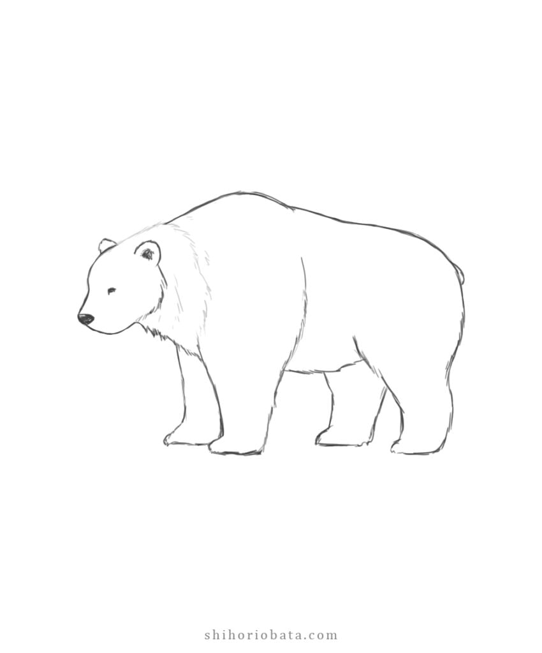
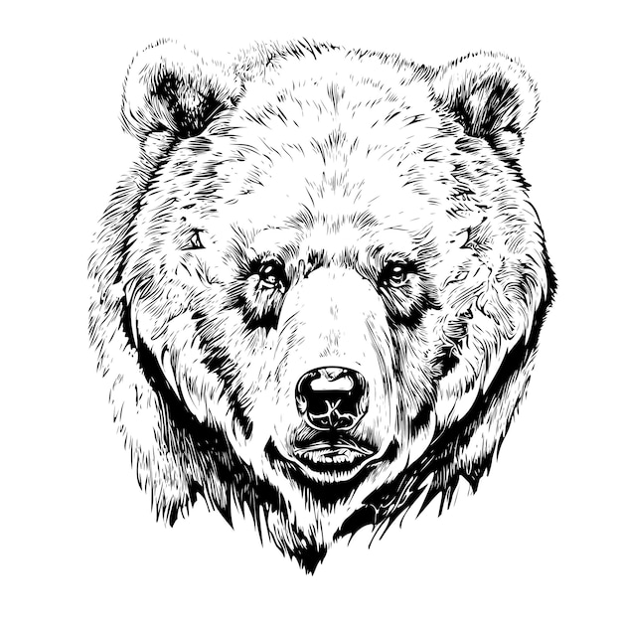
Add Theme Design Images
Use your sketch or an on line free downloadable image (or two) and paste into design
Alamo Area Council
Camp Bear Creek
Ignore the circle color for now
The result is a a few shapes
Than can be sized and placed within the design for comparison
Choose one or many !

Slide 21
Select Theme Design Image
Size, paste and locate image within design
Alamo Area Council
Camp Bear Creek
The result is a the desired image, sized and placed at the approximate location within the design
Lets trim out the white square behind the bear
Ignore the circle color for now

Slide 22
Step 5
TRIM THEME SELECTED FOR DESIRED DESIGN

Slide 23
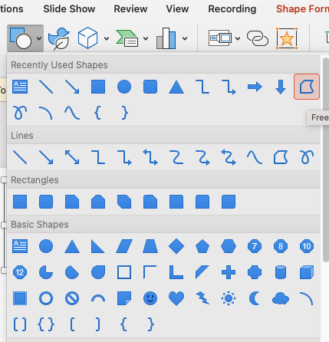
Begin Process to Trim image
Go to “Insert Shapes” and select the “Freeform” icon
Ignore the circle color for now
Freeform icon

Slide 24
Outline image to be Trimmed
Select the image and use the free form tool to trace the perimeter of the image.
When the entire image has been traced, it will turn a solid color
Alamo Area Council
Camp Bear Creek
Ignore the circle color for now
The result is an outline of the desired image

Slide 25

Begin the Trim image Process
Select the original image and then what you just outlined.
Under “Shape Format” select “Merge Shapes” / “Intersect”
This will remove the background and leave only desired image.
Select original image
Select image outline
Ignore the circle color for now

Slide 26
Trim Image Complete
The background of the item is gone leaving only the image of interest
This allows the designer to take ANY well designed image and trim away what is NOT needed
Alamo Area Council
Camp Bear Creek
Ignore the circle color for now
THE POSSIBILILITES ARE ENDLESS !

Slide 27
Step 6
ADD COLOR TO DESIRED DESIGN

Slide 28
Adding Color to background
Select Circle 2 / Shape Fill /and choose desired color
Circle 1
Circle 2
Alamo Area Council
Camp Bear Creek
For this example I chose orange for Circle 2 and a blue border is automatically created !
Ignore the circle color for now
Ignore the circle color for now

Slide 29
Adding Color to the border
Select Circle 1 / Shape Fill /and choose desired color
Circle 1
Circle 2
Alamo Area Council
Camp Bear Creek
Try selecting Black for Circle 1
Which one do you prefer ?
NOT SURE
Save File and try another color
Ignore the circle color for now
Ignore the circle color for now

Slide 30
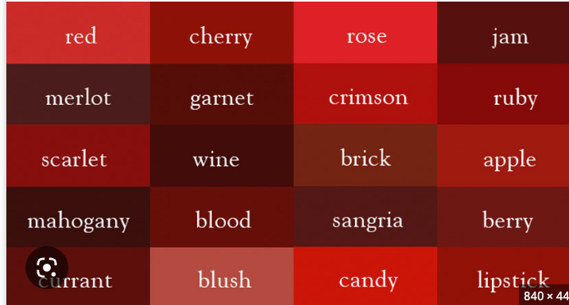
Adding Color to the text
Select Text 1 / text color /and choose desired color
Text 1
Text 2
Don’t see a PowerPoint color you like?
Download a pallet off the internet
Go to Shape Fill / More Fill Colors
Select the Eye Dropper and hover mouse over desired color and hit Enter
You can NOW use the any color downloaded in your design
Alamo Area Council
Camp Bear Creek
Ignore the circle color for now
Ignore the circle color for now
For this example I chose “Rose” red for Text 1

Slide 31
Adding Color to the text
Select Text 2 / Text Color /and choose desired color
Text 1
Text 2
For this example I chose rose red again
But a standard PowerPoint color or another color from the internet or a thread pallet from the patch manufacturer could be selected
Camp Bear Creek
Alamo Area Council
Ignore the circle color for now
Ignore the circle color for now
Want the bear bigger?
Select it, hold down mouse and drag image to desired size

Slide 32
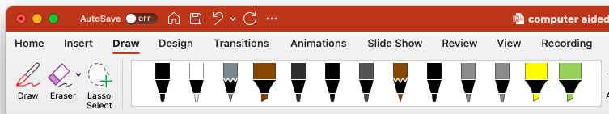
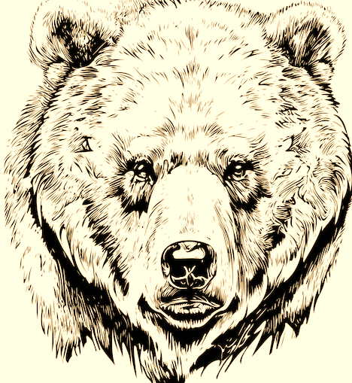
Adding Color to the Image use ”Draw” Select color for image
Text 1
Text 2
Camp Bear Creek
Alamo Area Council
Ignore the circle color for now
Ignore the circle color for now
For this example I chose the 6mm brown highlighter
Unfortunately in PowerPoint, one cannot select a “Merged” shape and use “Shape Fill” to colorize it

Slide 33

Adding Color to the Image use Selected color and use mouse to add color to image
Text 1
Text 2
Camp Bear Creek
If you don’t lift the mouse the color will remain constant across the entire image.
If you lift the mouse and color
over what was done already, the color will darken !
Alamo Area Council
Ignore the circle color for now
Ignore the circle color for now

Slide 34
Step 6
ADD ADDITIONAL FEATURES TO DESIRED DESIGN

Slide 35


Adding any desired extra Design features
Text 1
Text 2
Camp Bear Creek
Alamo Area Council
Add dates or fdl’s or any additional desired features
20 23
Ignore the circle color for now
Ignore the circle color for now

Slide 36
Step 7
EXPERIMENT WITH COLORS
TO PROVIDE MULTIPLE
POTENTIAL DESIGNS

Slide 37
Add Colors to Basic Design
ALL colors can easily be changed so CHANGE them
Select the outside circle and use ”shape Fill” to change the border color
Select the inner circle and use “Shape
Fill” to change the background color
Select the lettering (use mouse to
Highlight lettering you wish to change)
use “Font Color” to change text colors
Remember to save each version to allow you to down-select later to you favorite color combinations
Camp Bear Creek
Alamo Area Council
20 23
Ignore the circle color for now
Ignore the circle color for now

Slide 38


GENERATE DESIGN ITERATIONS
Experiment with colors and layers and size
Camp Bear Creek
Camp Bear Creek
Alamo Area Council
Alamo Area Council
Ignore the circle color for now
Ignore the circle color for now
20 23
2023
Ignore the circle color for now
Ignore the circle color for now
The possibilities are endless

Slide 39












Basic Design is Done
Experiment with colors and layers and size
Camp Bear Creek
Camp Bear Creek
Alamo Area Council
Alamo Area Council
Ignore the circle color for now
Ignore the circle color for now
20 23
2023
Ignore the circle color for now
Ignore the circle color for now
The possibilities are endless

Slide 40
HAVE FUN EXPERIMENTING WITH COLORS

