Slide 1
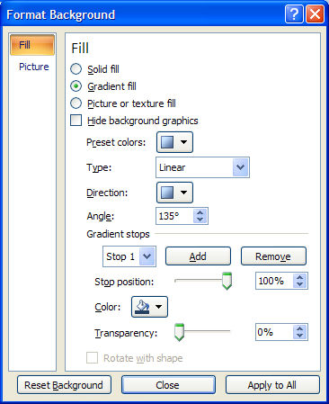
Gradient Samples
These colors are not chosen to look well together – just to better illustrate the gradients… sorry!
Each slide will give the options selected in the Format Background dialog box for that slide.
To open the dialog box, click the Dialog Box Launcher in the Background group on the Design tab.
Play around with the Type and Angle to see some interesting effects!

Slide 2
Two Step Gradient
2 Colors
Type: Linear
Angle: 90°
Gradient Stops:
  Stop 1: Stop position 0% - Color Accent 1, lighter 60%
  Stop 2: Stop position 100% - Color Accent 2, lighter 60%
    Stop 3: Remove

Slide 3
Two Step Gradient
2 Shades of the Same Color
Type: Linear
Angle: 90°
Gradient Stops:
  Stop 1: Stop position 0% - Color Accent 1, lighter 60%
  Stop 2: Stop position 100% - Color Accent 1, darker 50%
  Stop 3: Remove

Slide 4
Three Step Gradient
2 Colors
Type: Linear
Angle: 90°
Gradient Stops:
  Stop 1: Stop position 0% - Color Accent 2, lighter 60%
  Stop 2: Stop position 50% - Color Accent 1, lighter 60%
  Stop 3: Stop position 100% - Color Accent 2, lighter 60%

Slide 5
Three Step Gradient
2 Shades of the Same Color
Type: Linear
Angle: 90°
Gradient Stops:
  Stop 1: Stop position 0% - Color Accent 1, darker 50%
  Stop 2: Stop position 50% - Color Accent 1, lighter 60%
  Stop 3: Stop position 100% - Color Accent 1, darker 50%

Slide 6
Three Step Gradient
3 Colors – Same Shade
Type: Linear
Angle: 90°
Gradient Stops:
  Stop 1: Stop position 0% - Color Accent 1, lighter 60%
  Stop 2: Stop position 50% - Color Accent 2, lighter 60%
  Stop 3: Stop position 100% - Color Accent 3, lighter 60%

Slide 7
Three Step Gradient
3 Colors – Progressively Darker Shades
Type: Linear
Angle: 90°
Gradient Stops:
  Stop 1: Stop position 0% - Color Accent 1, lighter 60%
  Stop 2: Stop position 50% - Color Accent 2, lighter 40%
  Stop 3: Stop position 100% - Color Accent 4, darker 25%

Slide 8
Four Step Gradient
4 Colors – Same Shade
Type: Linear
Angle: 90°
Gradient Stops:
  Stop 1: Stop position 0% - Color Accent 1, darker 25%
  Stop 2: Stop position 33% - Color Accent 2, darker 25%
  Stop 3: Stop position 66% - Color Accent 3, darker 25%
  With Stop 3 selected, click Add to set Stop 4
  Stop 4: Stop position 100% - Color Accent 4, darker 25%

Slide 9
Four Step Gradient
4 Colors – Progressively Lighter Shades
Gradient Fill
Type: Linear
Angle: 90°
Gradient Stops:
  Stop 1: Stop position 0% - Color Accent 1, darker 50%
  Stop 2: Stop position 33% - Color Accent 2, darker 25%
  Stop 3: Stop position 66% - Color Accent 3, lighter 40%
  With Stop 3 selected, click Add to set Stop 4
  Stop 4: Stop position 100% - Color Accent 4, lighter 60%

Slide 10
Four Step Gradient
4 Colors – Progressively Lighter Shades
Gradient Fill
Type: Linear
Angle: 0°
Gradient Stops:
  Stop 1: Stop position 0% - Color Accent 1, darker 50%
  Stop 2: Stop position 33% - Color Accent 2, darker 25%
  Stop 3: Stop position 66% - Color Accent 3, lighter 40%
  With Stop 3 selected, click Add to set Stop 4
  Stop 4: Stop position 100% - Color Accent 4, lighter 60%

Slide 11
Four Step Gradient
4 Colors – Progressively Lighter Shades
Gradient Fill
Type: Radial
Angle: 90°
Gradient Stops:
  Stop 1: Stop position 0% - Color Accent 1, darker 50%
  Stop 2: Stop position 33% - Color Accent 2, darker 25%
  Stop 3: Stop position 66% - Color Accent 3, lighter 40%
  With Stop 3 selected, click Add to set Stop 4
  Stop 4: Stop position 100% - Color Accent 4, lighter 60%

Slide 12
Four Step Gradient
4 Colors – Progressively Lighter Shades
Gradient Fill
Type: Shade from title
Angle: 90°
Gradient Stops:
  Stop 1: Stop position 0% - Color Accent 1, darker 50%
  Stop 2: Stop position 33% - Color Accent 2, darker 25%
  Stop 3: Stop position 66% - Color Accent 3, lighter 40%
  With Stop 3 selected, click Add to set Stop 4
  Stop 4: Stop position 100% - Color Accent 4, lighter 60%

