Slide 1
Laser-Induced Breakdown Spectroscopy (LIBS) for the RAPID Elemental analysis of solids
C&E News Webinar

Slide 2
Outline of today’s seminar
Overview – What is LIBS?
  LIBS / Hardware overview
  Principle of operation
  Strengths of LIBS as an analytical technique
Example applications
  Microanalysis – Glass, Gems, Forensics
  Bulk analysis – Aluminum, Steel
  Complex samples – Geological
  Depth profiling / surface mapping – Thin Films
TSI’s ChemReveal LIBS Desktop analyzer
Summary

Slide 3
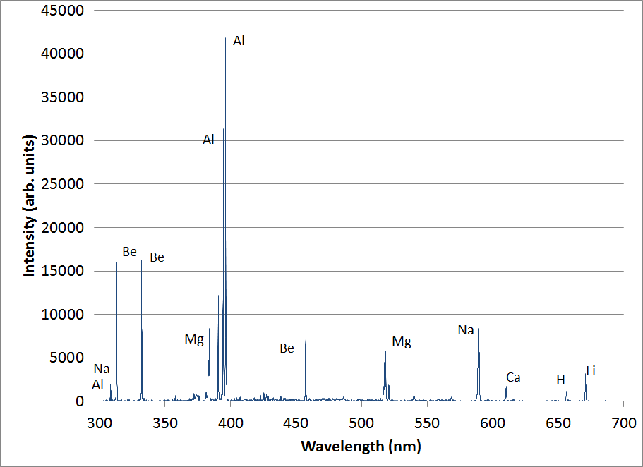
Typical LIBS Hardware schematic
Line position provides species identification.
Line intensity provides species concentration.
Laser energy used for both ablation and plasma formation
Pulsed
laser,
video
Fiber optic
Laser
plasma
Spectrometer
and detector
Atomic
emission
collection
Sample

Slide 4
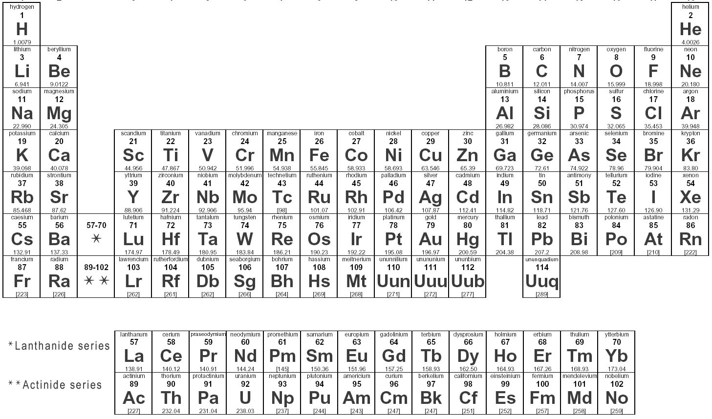
Elements across the periodic table can be detected with LIBS
Approximate DL
1-10 ppm
10-100 ppm
10-200 ppm
0.05-0.5%
Notes:
Most elements can be measured with LIBS

Slide 5
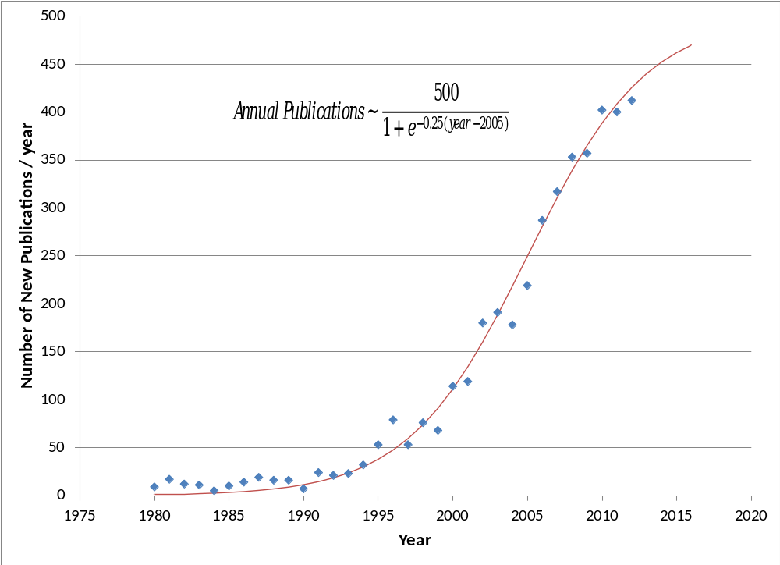
Substantial and growing LIBS interest

Slide 6
LIBS has several “steps”
ABLATION – the laser removes / vaporizes material from the sample
PLASMA – electrons are stripped from the atoms by the high electric field, followed by absorption and multiphoton ionization to create a plasma
EXCITATION – the plasma electronically excites the vaporized material – forming excited atoms
EMISSION – as the plasma cools, atoms return to the ground state and give off LIGHT
Excited states
Ground

Slide 7
Overview of LIBS plasma emission
Ionic emission
0.25-3 μs
Atomic emission
0.5-50 μs
Ablation
Molecular recombination
2-100 μs
0
1 μs
10 μs
Time
Local thermodynamic
Equilibrium
Plasma emission is a function of time, as plasma expands and cools
Emission in the early time is dominated by white light – “Brehmstraalung emission” from electrons
Collect emission on a delay and we can see emission from ions, atoms, and molecules

Slide 8
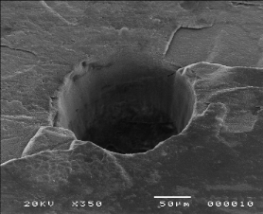
“Matrix” dependence
Differing results with different types of material – common to almost all methods
Primarily due to ablation
  Ablation on various materials is of differing effectiveness
  Controls amount of analyte vaporized
  Directly affects signal and energy in plasma
Once aerosols are formed, process is similar for most materials
craters
Aerosols,
Fractionation,
Matrix
Implication → LIBS measurements (detection limits, calibrations, etc.) are specific to a particular class of materials

Slide 9
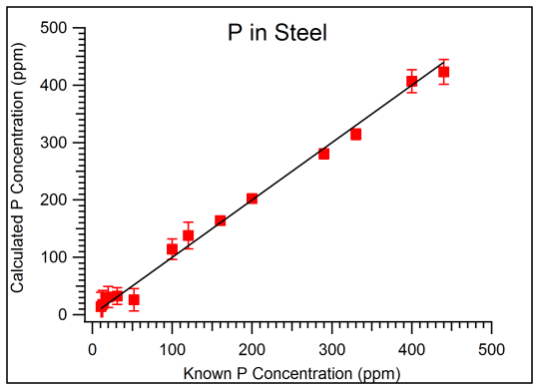
Implementation of LIBS
Qualitative identification can be done on any material
Different system components yield different performance (material detection limits)
Each type of material needs its own “calibration curve” for quantification, because of matrix effects
Typical detection limits ~10 ppm
RSD ~ 2-3%

Slide 10
Primary benefits of LIBS
Rapid analysis / No reagents
“Stand-off” projection of laser
Light elements (Z<12) that XRF cannot see
Micro- to Macro-Analysis
Surface mapping and depth profiling
Compliment ICP-OES, AA, ICP-MS with rapid screening
No need to modify samples
Connect the dots to directly measure C, N, O, Be, Li, B, etc.
Analysis spot sizes from 10 μm to 400 μm
Evaluate coatings and surfaces without the complexity of GD or SEM

Slide 11
Poll question #1
Which characteristic of LIBS would be most valuable in your applications?
Direct analysis – no sample prep
Light elements
Micro-analysis
Surface mapping
Depth Profiling
Other

Slide 12
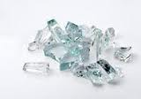
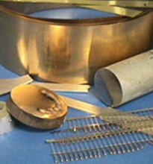
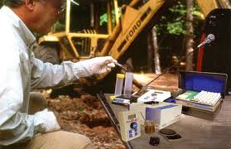
Example applications
What can LIBS do?

Slide 13
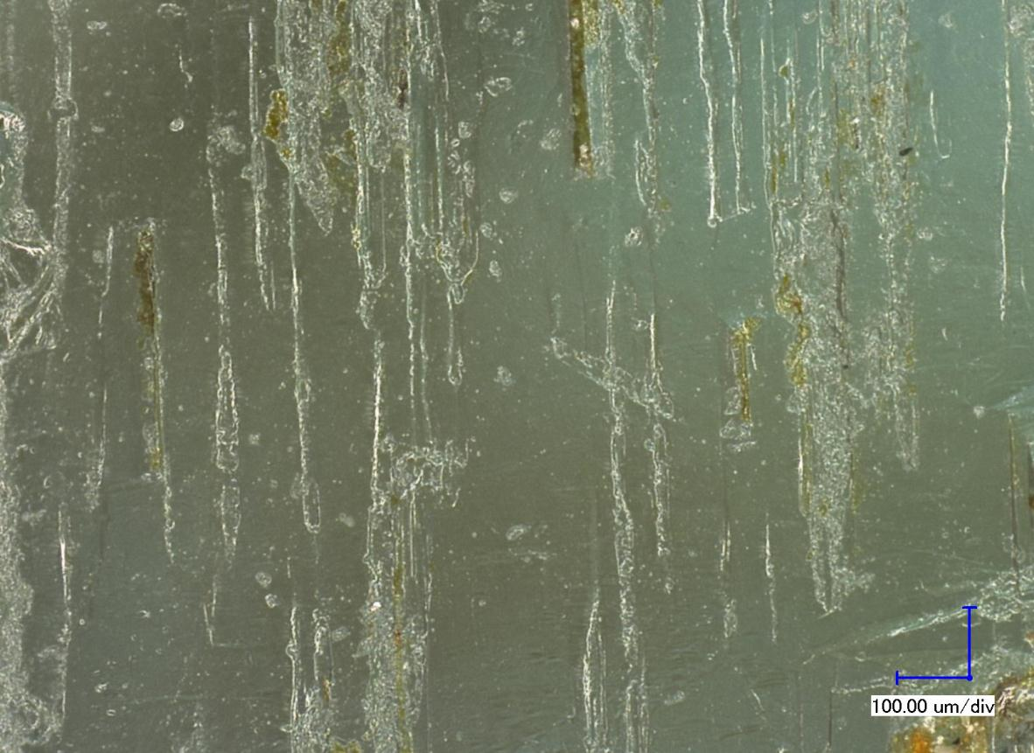
Example 1: Investigation – Sample analysis occurs with little damage
Can you see the analysis points on this gemstone?

Slide 14
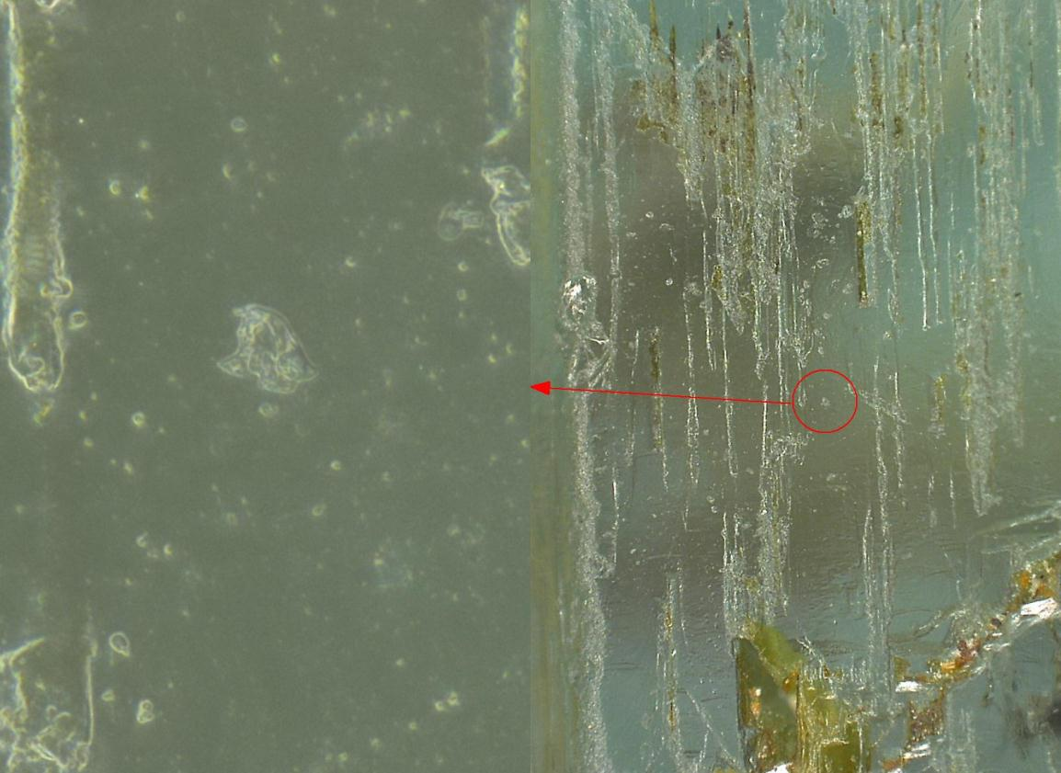
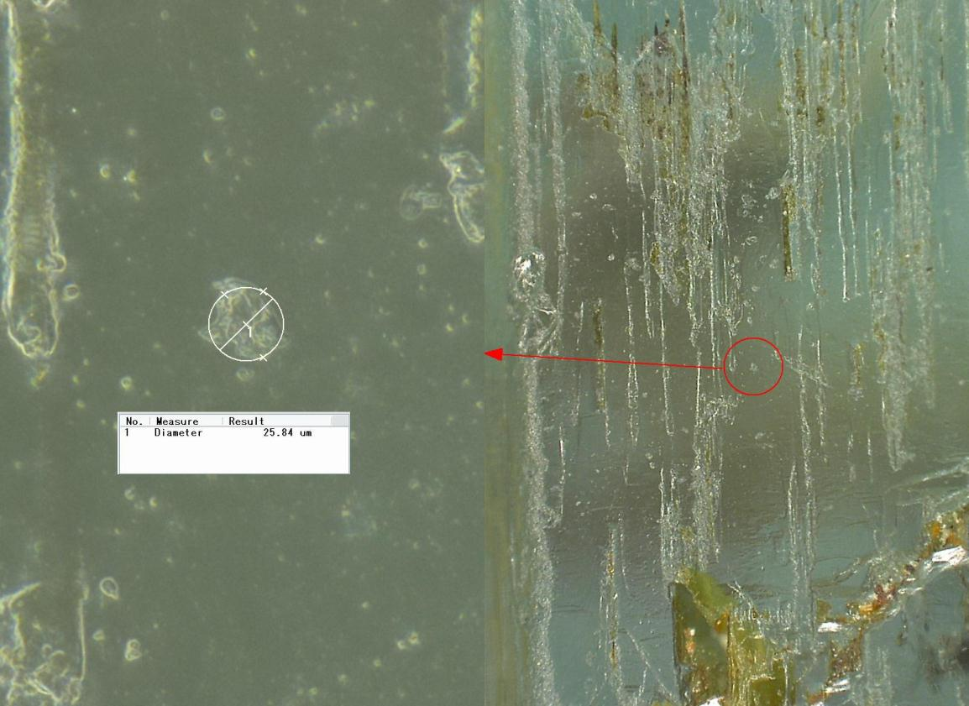
Small analysis spots yield many advantages
Expansion of the view shows that this is a 25-micron spot
Not distinguishable under jeweler’s inspection loupe
Good for analysis of small features
Range of spot sizes can span from micro- to macro-analysis
High resolution
Low resolution

Slide 15
Approximate DL in USGS Basaltic Glasses with LIBS
Element | LOD (µg/g) | Element | LOD (µg/g) | Element | LOD (µg/g)
Alkali and Alkali Earth |  | Transition Metals |  | Lanthanides/Rare Earth Elements
Li | 5.66 | Sc | 41.2 | La | 164
Be | 2.98 | Ti | 136 | Ce | 261
Rb | ND | V | 36.0 | Pr | 476
Sr | 25.6 | Cr | 24.9 | Nd | 92.7
Cs | ND | Mn | 191 | Sm | 512
Ba | 34.9 | Fe | Major Element | Eu | 337
 |  | Co | 46.7 | Gd | 390
 |  | Ni | 17.7 | Tb | 525
 |  | Cu | 6.59 | Dy | 359
 |  | Zn | 59.6 | Ho | 577
 |  |  |  | Er | ND
 |  |  |  | Tm | ND
 |  |  |  | Yb | 4.85
 |  |  |  | Lu | 269

Slide 16
Features of LIBS that Glass, Forensic, and Gem analyses require
Minimally-destructive microanalysis
No sampling / digestion
Targeting to measure composition of particular features
High sensitivity to particular light elements such as Be and Li
➔ The ChemReveal was specifically designed to target this market
  -- Excellent for small spots, repeatable sample targeting

Slide 17
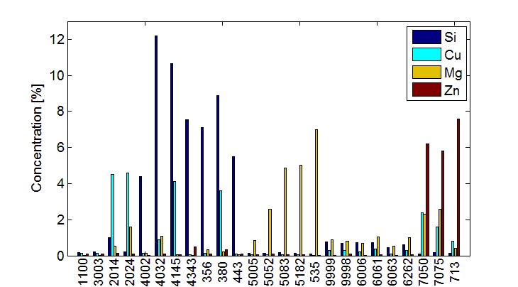
Example 2: Quantitative Analysis on Aluminum and Steel
25 known samples
  23 Al alloy standards from ARMI and Alcoa
  2 measured at TSI using Arc/Spark-OES (9999, 9998)
Major elements Si, Cu, Mg, and Zn are studied

Slide 18
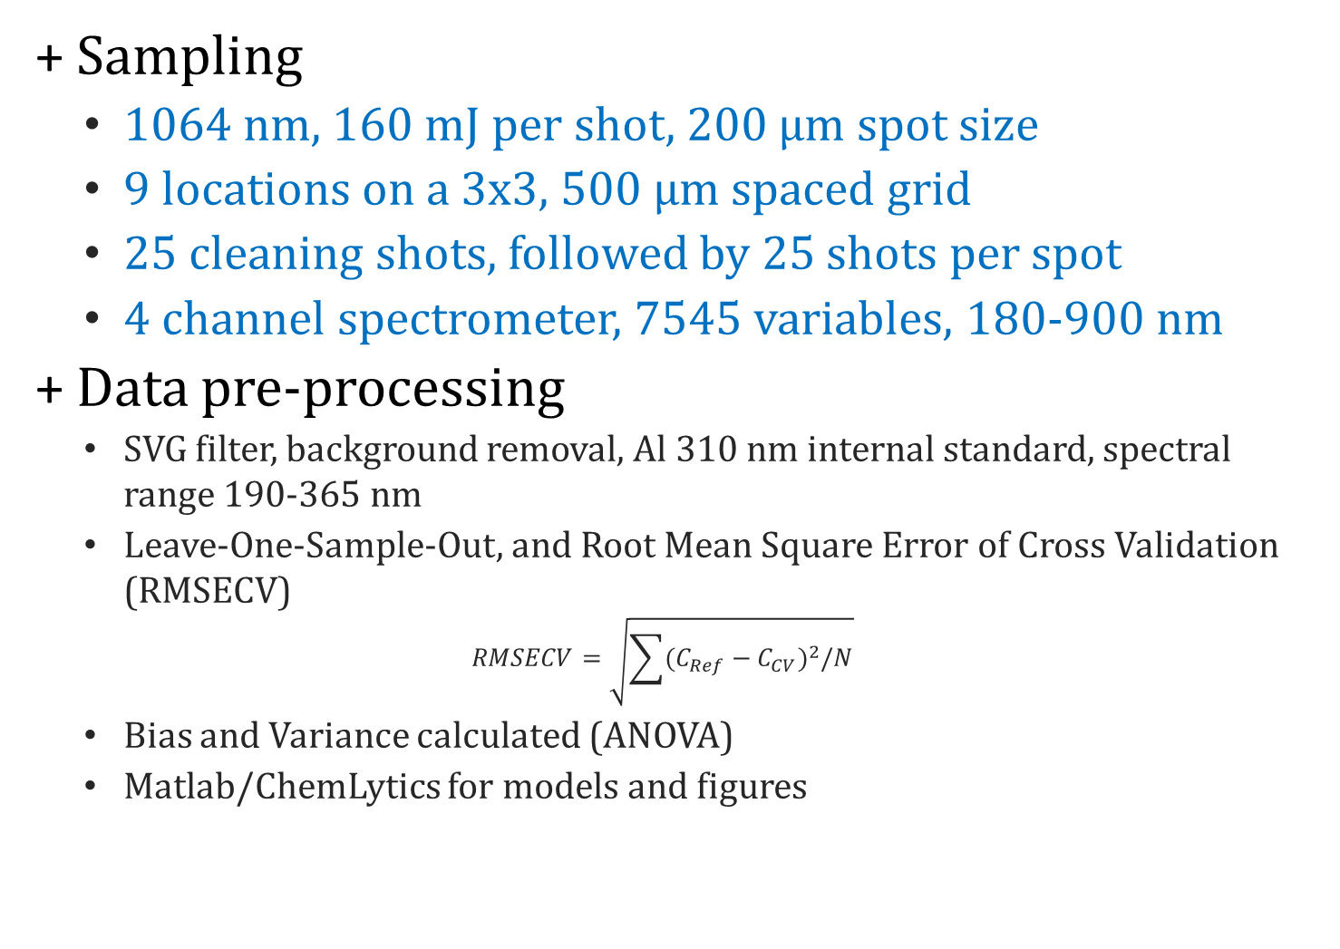
Sampling and Data pre-processing
Sampling
  1064 nm, 160 mJ per shot, 200 μm spot size
  9 locations on a 3x3, 500 μm spaced grid
  25 cleaning shots, followed by 25 shots per spot
  4 channel spectrometer, 7545 variables, 180-900 nm
Data pre-processing
  SVG filter, background removal, Al 310 nm internal standard, spectral range 190-365 nm
  Leave-One-Sample-Out, and Root Mean Square Error of Cross Validation (RMSECV)
  $$RMSECV=\sqrt{\sum{(C_{Ref}−C_{CV})^{2}/N}}$$
  Bias and Variance calculated (ANOVA)
  Matlab/ChemLytics for models and figures

Slide 19
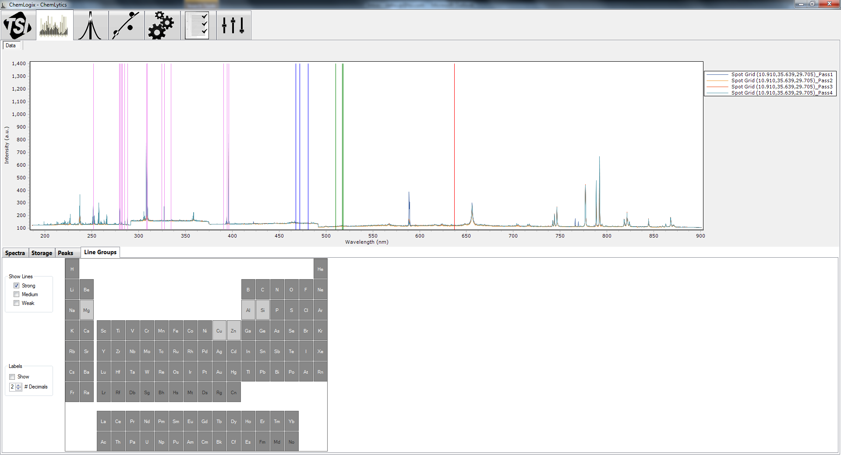
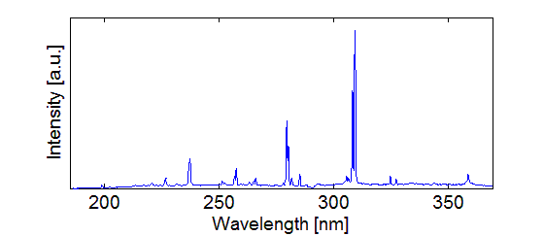
Spectral Range Selection on ChemLytics
190-365 nm, 3700 variables
Al
Mg
Cu

Slide 20
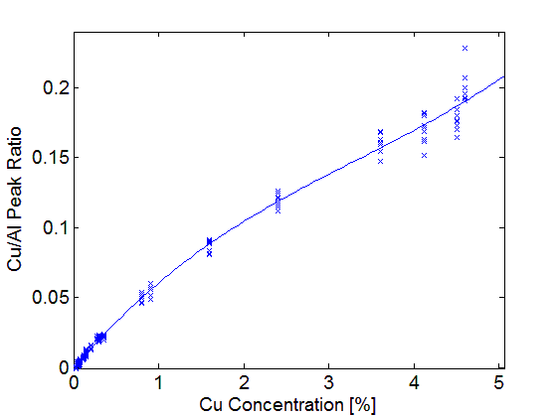
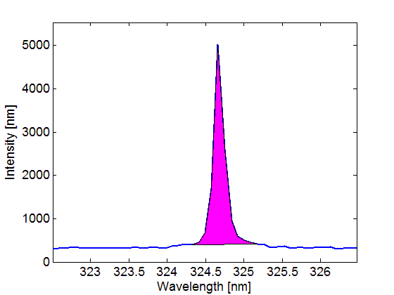
Aluminum Univariate Calibration
Single or summed area of peaks
Linear at low concentrations, self-absorption at higher concentrations
Cu
Notes:
nonliear regression, or "linear regression in nonlinear space..."
this is very standard LSR

Slide 21
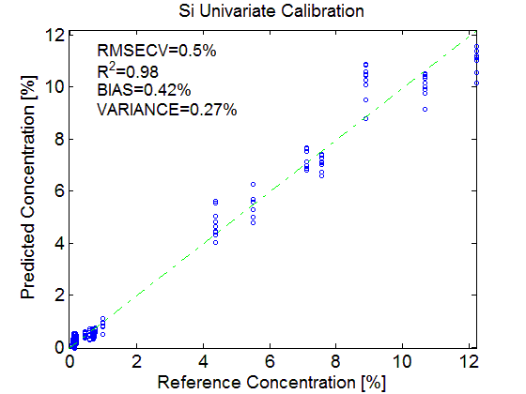
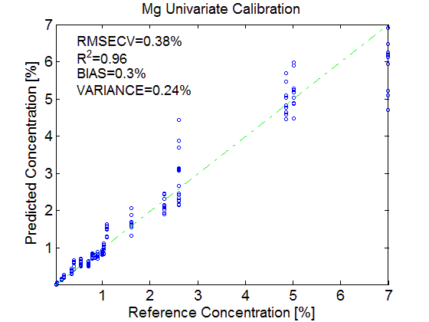
Aluminum Univariate Calibration
Good R² and model fit
Some bias
Si
Mg

Slide 22
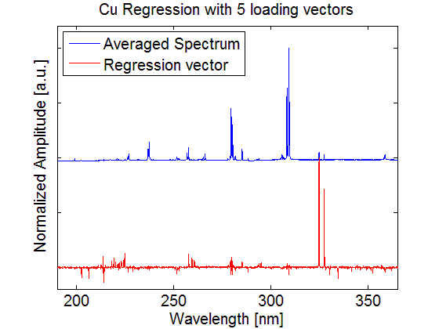
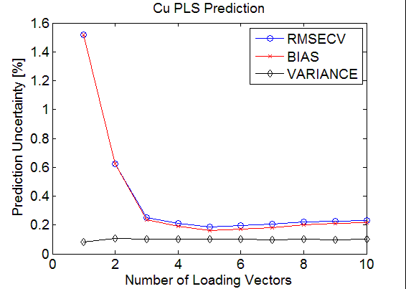
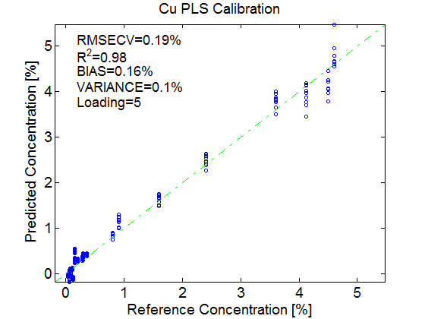
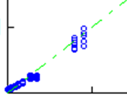
Aluminum Multivariate
Cu
5 loading vectors
Supporting evidence: regression vector corresponds to element features.
Linear model with ability to partly model nonlinear features.
Cu
Univariate

Slide 23
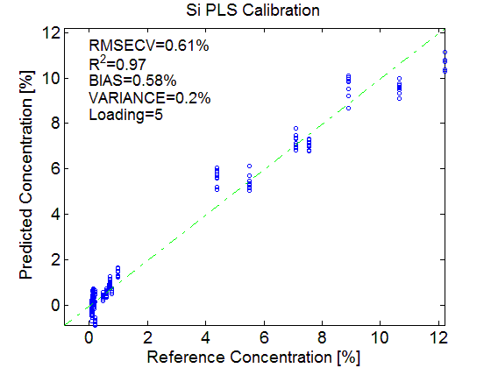
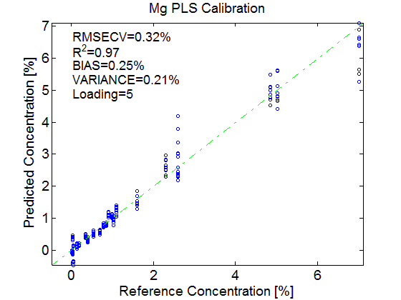
Aluminum samples: PLS
Good R² and model fit
Improved statistics overall

Slide 24
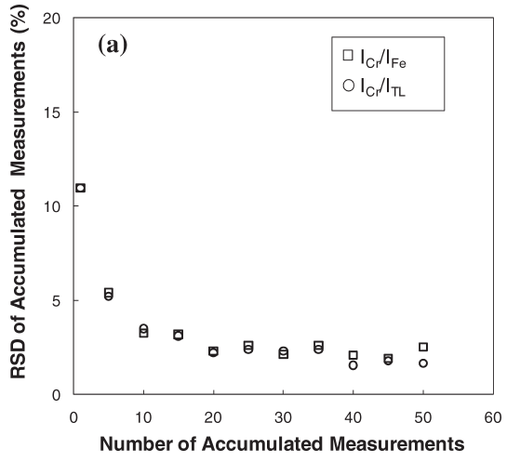
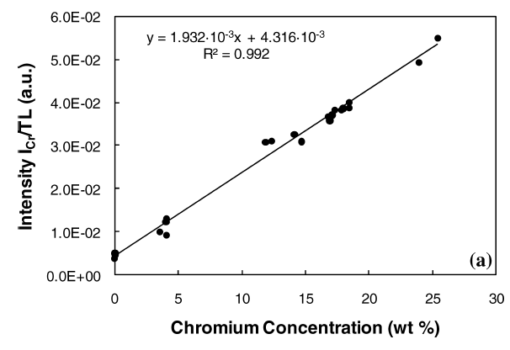
Example 2b: Typical LIBS Univariate calibration – Stainless Steel
Data from Stipe, Buckley et al.,
Applied Spectroscopy 64 (2) p154. (Feb 2010)
Typically the best RSDs on homogenous materials ~1%

Slide 25
Example 2b: Stainless Steel Multivariate Analysis
 | Slope | Intercept | r² | RMSEP | Range (%)
Si | 1.00 ± 0.01 | 0.001 ± 0.005 | 0.9994 | 60 ppm | 0.01 - 0.62
P | 0.99 ± 0.03 | 0.0002 ± 0.0003 | 0.997 | 5 ppm | 0.001 - 0.023
S | 0.99 ± 0.01 | 0.003 ± 0.003 | 0.9993 | 43 ppm | 0.004 - 0.36
Cr | 1.00 ± 0.01 | -0.1 ± 0.3 | 0.999 | 487 ppm | 17.0 - 21.3
Mn | 1.00 ± 0.01 | 0.00 ± 0.01 | 0.9994 | 157 ppm | 0.01 - 1.62
Fe | 1.01 ± 0.01 | -0.5 ± 0.9 | 0.9991 | 442 ppm | 66 - 70
Ni | 1.00 ± 0.01 | 0.0 ± 0.1 | 0.999 | 453 ppm | 8.2 - 11.8
Cu | 0.99 ± 0.01 | 0.00 ± 0.02 | 0.9991 | 378 ppm | 0.1 - 3.2
Mo | 1.01 ± 0.02 | -0.002 ± 0.003 | 0.998 | 56 ppm | 0.01 - 0.32
Comparison of predicted versus actual concentrations
  Linear, slope = 1, intercept ≈ 0, R² ≈ 1
Completed with customer samples

Slide 26
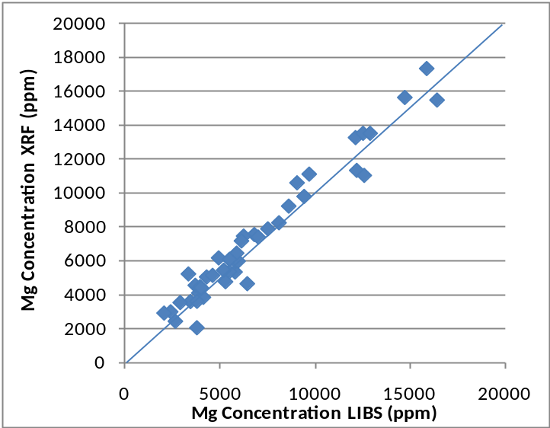
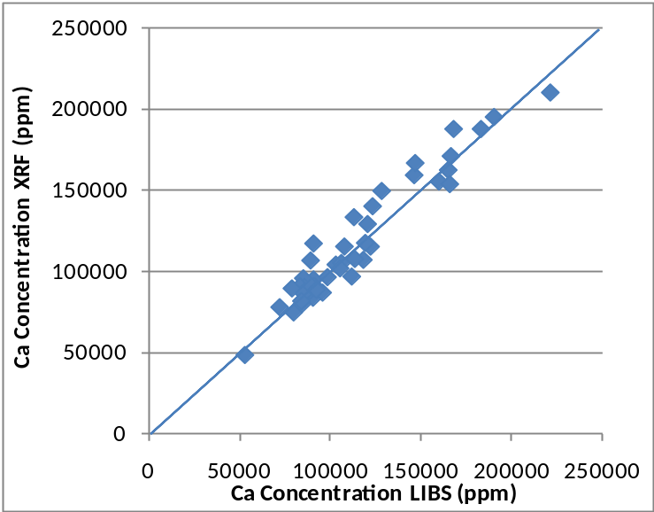
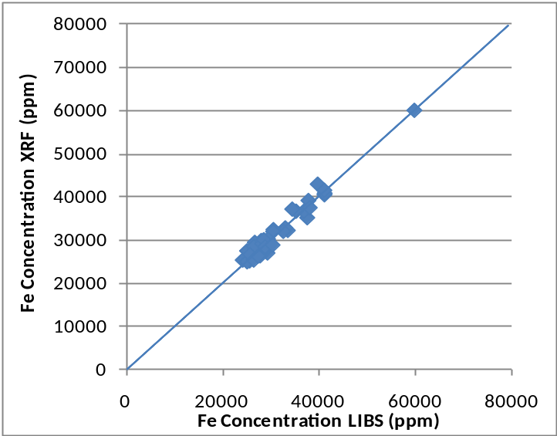
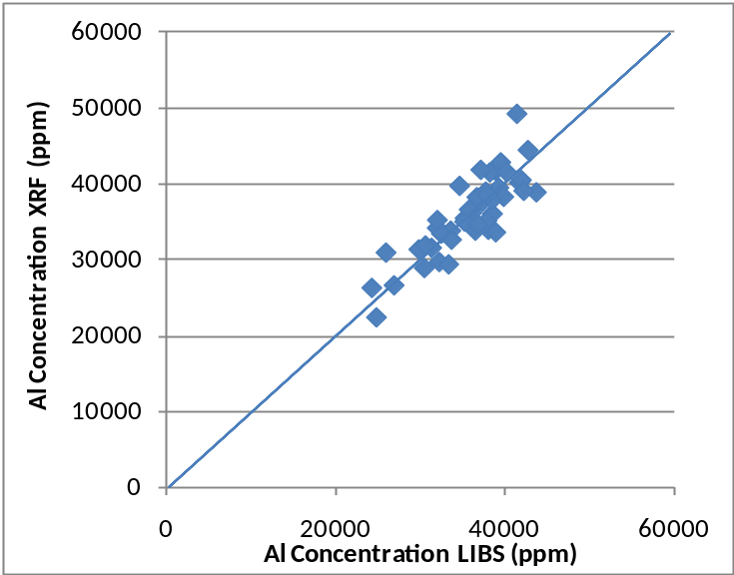
Example 3: LIBS versus XRF Results:
Geological Samples
Mg
Ca
Fe
Al

Slide 27
Depth profiling and surface mapping
This combination is a unique feature of LIBS
Depth profiling
  Semi-quantitative
  Depth per shot needs calibration for each material
Surface mapping can be made quantitative

Slide 28
Depth profiling with LIBS
As laser pounds into material there is typically some influence from upper layers
Plasma goes into the crater
Side walls influence spectra slightly
Result: continued slight presence of elements from upper layers as depth increases
Laser
Laser
Laser
Laser
Successive laser shots

Slide 29
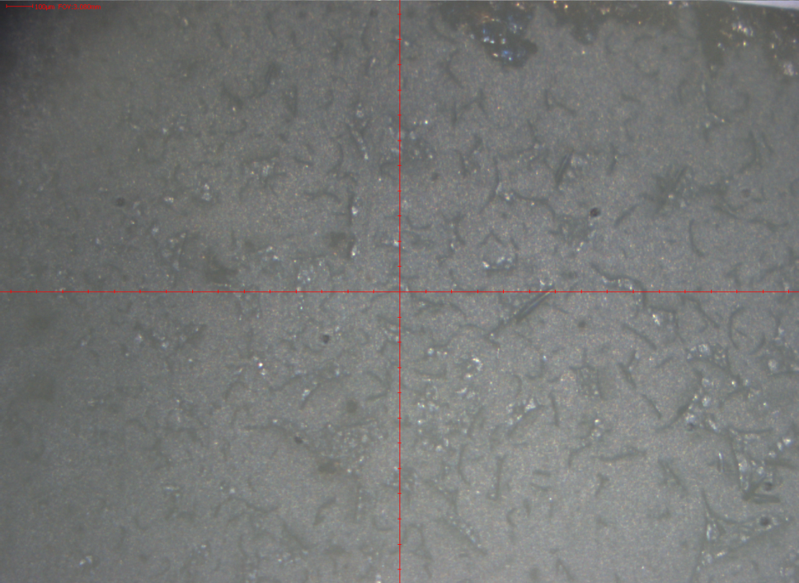
Sample before ablation

Slide 30
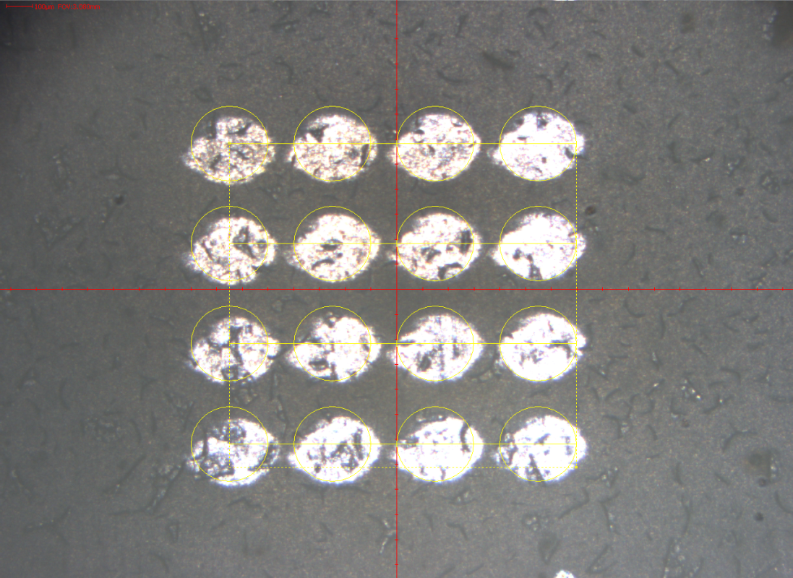
Sample after ablation
300 micron spots

Slide 31
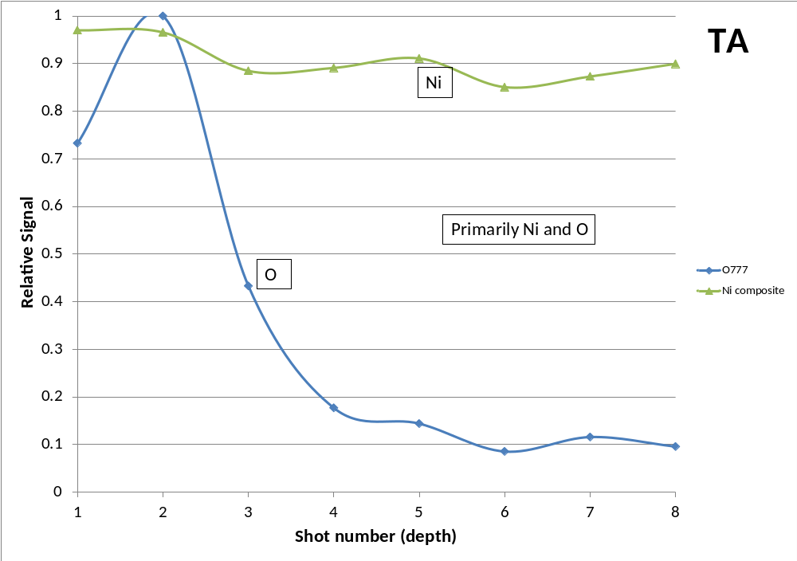
Depth Profiling: Sample 1

Slide 32
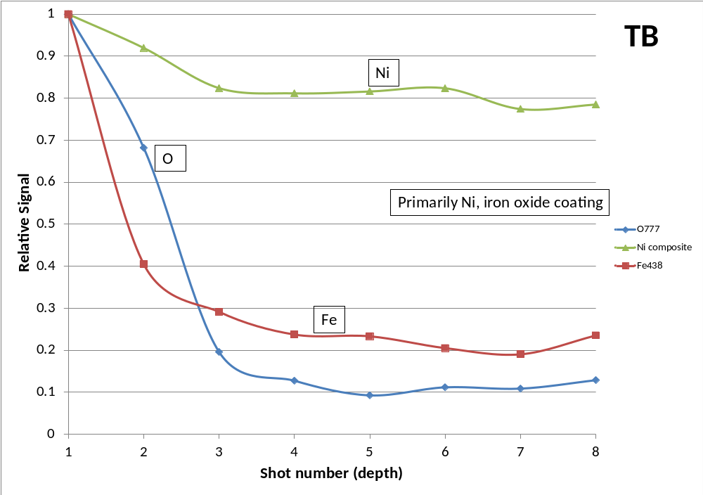
Sample 2

Slide 33
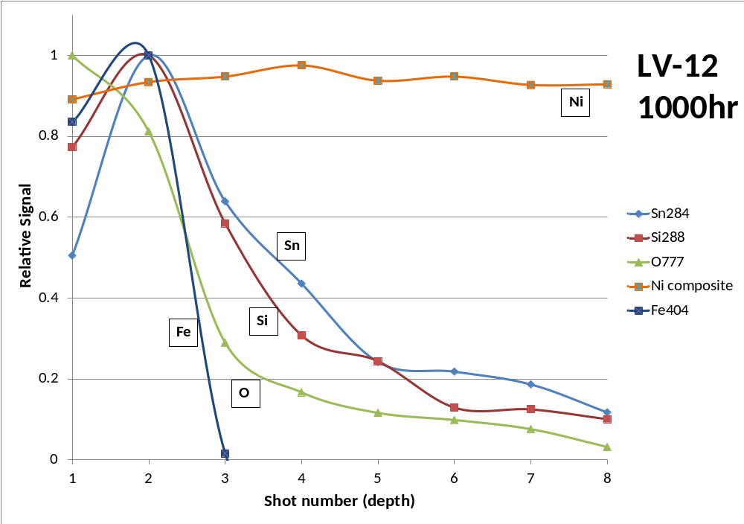
Sample 3

Slide 34
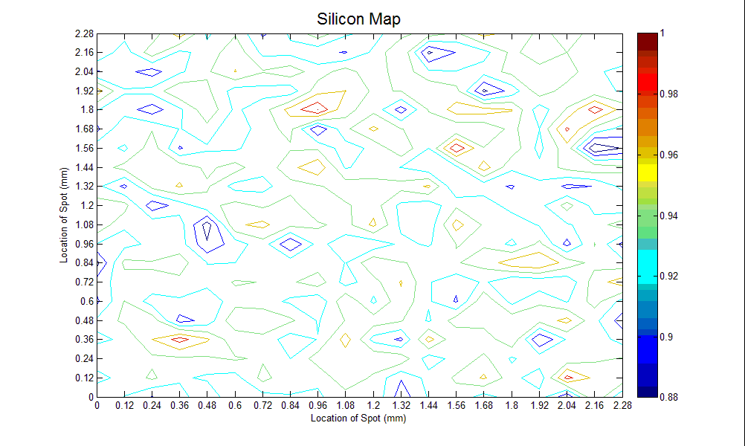
LIBS Applications: Elemental Mapping
Elemental maps can be generated
Resolution determined by laser spot size
No sample cell required
2024 aluminum sample from www.onlinemetals.com
20x20 map produced with approximately 75 micron spots
Argon purge on sample

Slide 35
Applications summary
LIBS capabilities were demonstrated for:
  Microanalysis
  Bulk analysis
  Complex samples
  Depth profiling / surface mapping
Quantification of elements comparable to other established elemental techniques
Calibration curves are material-specific

Slide 36
Poll question #2
Which characteristic of LIBS would be most frequently used in your applications?
Quantification of major and minor elements in solid materials
Qualitative, rapid identification of materials and elements

Slide 37
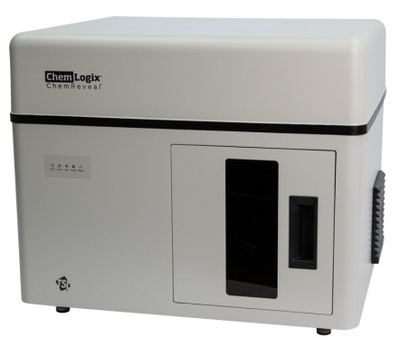
Chemreveal LIBS desktop
Elemental analyzer

Slide 38
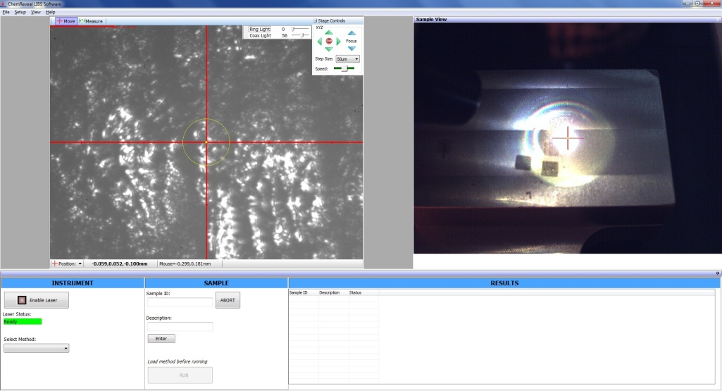

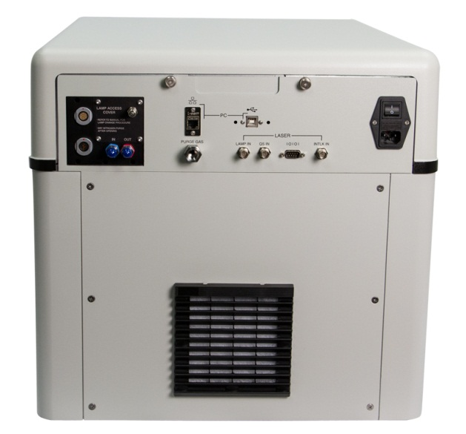
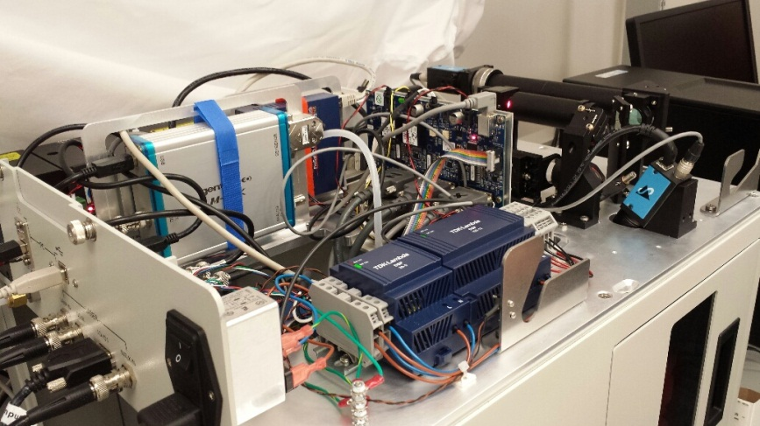
ChemReveal Designed for Industrial & Research Applications
Industrial QA/QC Capable
  Technician-User Interface
  Higher-throughput analyses
  Designed for serviceability & Robustness
Research ready
  Detailed Analyst –level software
Pass
Fail
Pass
Pass

Slide 39
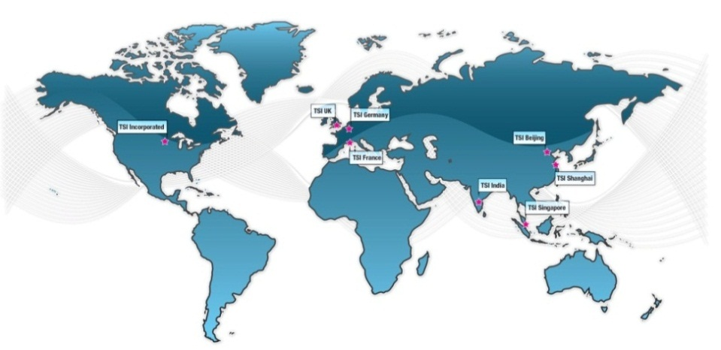
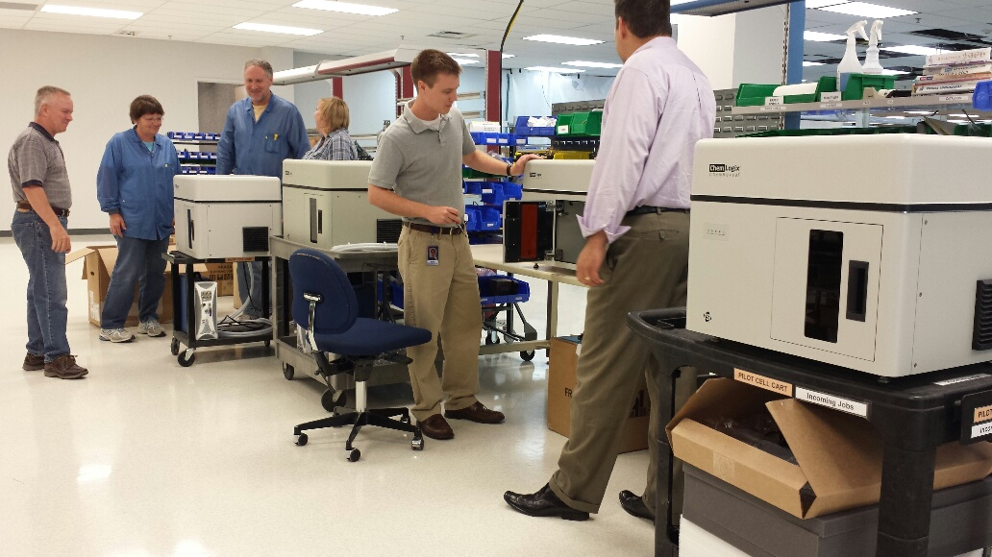
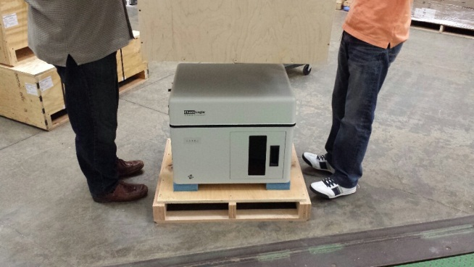
ChemReveal Designed with Quality
  + TSI is an ISO9001:2008 QMS manufacturer
  + Products go through V&V and are supported by TSI’s global sales and service organization
  + Standards shipped with every
  ChemReveal Instrument

Slide 40
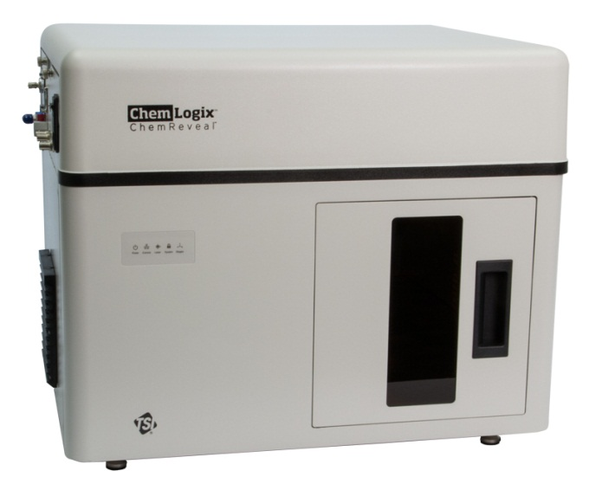
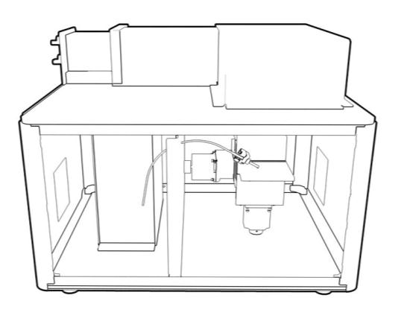
Features of the ChemReveal
LIBS Desktop Elemental Analyzer
Hardware:
Integrated system for conducting LIBS
Small footprint (24” x 20”)
Large sample chamber (9” x 5” x 5” samples)
XYZ stages with 2” travel and < 1 um resolution
CE Certified, Class I Laser product built under ISO9001:2008 quality management system

Slide 41
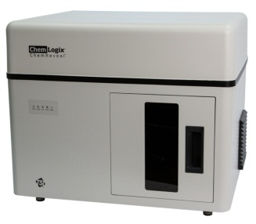
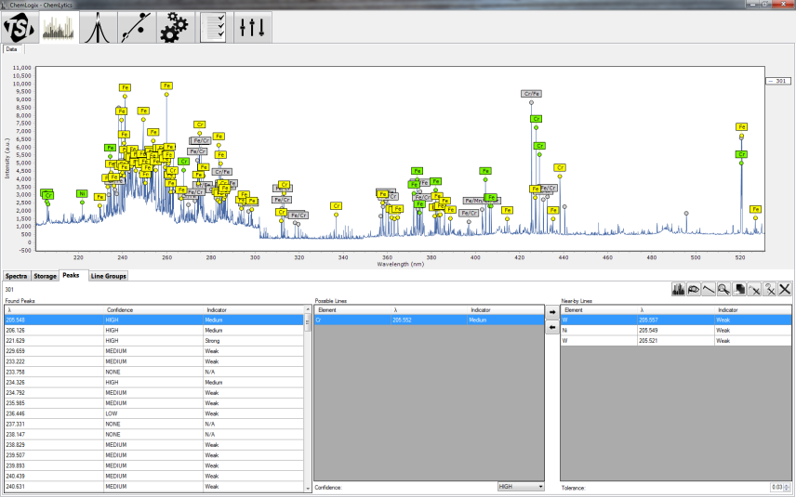
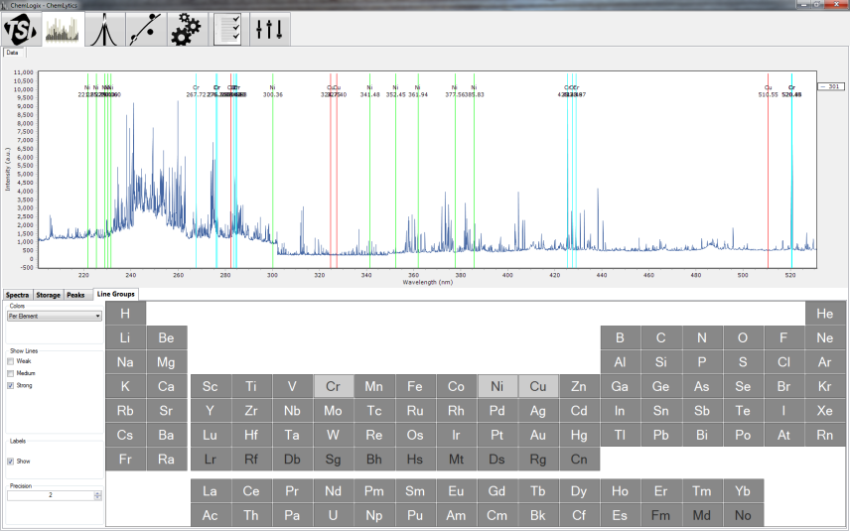
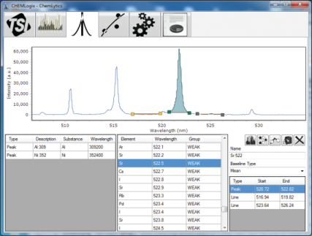

Features of the ChemReveal
LIBS Desktop Elemental Analyzer
Software:
Intuitive software for operation, method development and calibration
Software for different user levels
Report generation for record keeping
Notes:
Peak ID, to peak and background definition, to calibration curve generation and quantification.

Slide 42



Using the ChemReveal
LIBS Desktop Elemental Analyzer
Sample preparation/loading:
Open door to sample chamber, and place sample inside
Close door and adjust sample to location of interest
Benefits:
No sample preparation
No vacuum
Fast loading and unloading of samples
Protected optics
Exhausted sample chamber
Notes:
Purge gas used to protect optics and provide for higher sensitivity analysis of N, O, C, S.

Slide 43


Running Methods using the Technician-mode Interface
1
12 | 3 | 5 | 2
Pass
2
3
4
Load check standard
Select Check Standard Method
Label Sample & Run
Get Pass/Fail and Quantification Results

Slide 44



Workflow from Analyst to Technician
1. Robust LIBS
LIBS of solid samples
Raw LIBS
OES spectrum
4. Ease of Use
Consistent Data
Processing & Method
Development
Actionable Data
Interpreted Data
3. Reproducible
Calibrations
35.5%
Pass
29.5%
Fail
35.2%
Pass
34.9%
Pass

Slide 45

ChemLytics Software for Method Development
Calibration & Method Development:
Peak area definition and integration
Univariate calibration model development (std)
Multivariate calibration model development (option)
All models created can be imported into a technician-mode interface
Notes:
Amount of laser ablation is critical to the quantitation of any LIBS system. We control the laser power density to ensure this is consistent.

Slide 46

ChemLytics Software for Method Development
Calibration & Method Development:
Peak area definition and integration
Univariate calibration model development (std)
Multivariate calibration model development (option)
All models created can be imported into a technician-mode interface
Notes:
Amount of laser ablation is critical to the quantitation of any LIBS system. We control the laser power density to ensure this is consistent.

Slide 47

ChemLytics Software for Reports
Report Generation:
Pass/Fail and check standards can be customized
Calibration and Quantification Results Reported
Notes:
Spectral match feature against a database

Slide 48



ChemLytics Software for Reports
Report Generation:
Pass/Fail and check standards can be customized
Calibration and Quantification Results Reported
Notes:
Amount of laser ablation is critical to the quantitation of any LIBS system. We control the laser power density to ensure this is consistent.

Slide 49
ChemReveal Validation Tests
  + Intraday reproducibility
  + Day-to-day reproducibility
  + Unit-to-unit reproducibility
  + Calibration Accuracy vs. Arc/Spark OES
  + Development of a daily check standard for instrument performance
~2 minutes to run each sample for these validation tests

Slide 50
Results: Intraday Reproducibility
%RSD of Element:Fe (438.35) ratio
SRMs | Cr 520.45:Fe | Ni 361.94:Fe | Cu 324.75:Fe | Mn 403.08:Fe
SS 254SMO | 0.6% | 0.6% | 0.1% | 2.3%
SS 301 | 2.3% | 1.3% | 31.6% | 0.4%
SS 303 Se | 0.7% | 0.4% | 1.7% | 1.3%
SS 304 | 1.7% | 0.4% | 1.3% | 1.9%
SS 309 | 0.4% | 0.6% | 1.3% | 0.9%
SS 310 | 1.1% | 1.0% | 1.7% | 0.9%
3864 ChemReveal #1a

Slide 51
Results: Intraday Reproducibility
%RSD of Element:Fe (438.35) ratio
SRMs | Cr 520.45:Fe | Ni 361.94:Fe | Cu 324.75:Fe | Mn 403.08:Fe
SS 254SMO | 1.1% | 1.2% | 0.5% | 1.7%
SS 301 | 2.5% | 2.5% | 15.5% | 1.5%
SS 303 Se | 1.8% | 2.6% | 1.4% | 2.7%
SS 304 | 1.1% | 2.3% | 1.2% | 1.6%
SS 309 | 1.2% | 2.1% | 0.9% | 1.6%
SS 310 | 1.9% | 1.6% | 1.7% | 1.8%
3864 ChemReveal #2

Slide 52
Results: Multiple Day Reproducibility
%RSD of Element:Fe (438.35) ratio
SRMs | Cr 520.45:Fe | Ni 361.94:Fe | Cu 324.75:Fe | Mn 403.08:Fe
SS 254SMO | 1.8% | 4.1% | 3.8% | 3.2%
SS 301 | 2.1% | 2.2% | 17.0% | 2.9%
SS 303 Se | 2.0% | 1.7% | 2.9% | 1.3%
SS 304 | 1.1% | 1.8% | 3.3% | 2.1%
SS 309 | 1.1% | 0.6% | 2.2% | 2.4%
SS 310 | 0.8% | 2.9% | 3.8% | 3.8%
3864 ChemReveal #1b

Slide 53
Results: Multiple Day Reproducibility
%RSD of Element:Fe (438.35) ratio
SRMs | Cr 520.45:Fe | Ni 361.94:Fe | Cu 324.75:Fe | Mn 403.08:Fe
SS 254SMO | 1.7% | 1.3% | 1.4% | 1.2%
SS 301 | 1.9% | 0.4% | 7.6% | 2.1%
SS 303 Se | 3.4% | 0.9% | 0.9% | 2.1%
SS 304 | 2.0% | 1.1% | 1.8% | 2.2%
SS 309 | 2.6% | 1.1% | 0.9% | 1.7%
SS 310 | 1.2% | 1.3% | 1.6% | 1.1%
3864 ChemReveal #2

Slide 54
Results: Calibration
Calibration reproducibility over multiple days for Ni:Fe (438.35) ratio
Ni Calibration | Slope (m) | Y-Intercept (b) | Correlation Coeff. (R^2)
Day 1 | 0.0193 | 0.2252 | 0.9985
Day 2 | 0.0187 | 0.2273 | 0.9986
Day 3 | 0.0183 | 0.2345 | 0.9987
Day 4 | 0.0186 | 0.2321 | 0.9968
Day 5 | 0.0183 | 0.2274 | 0.999
%RSD | 2.2% | 1.7% | 0.1%
3864 ChemReveal #2

Slide 55
Results: Apply Cal
 | LIBS Predicted Ni Concentration | Arc Spark | % Accuracy | RMSEP
SS 303 | 8.20 | 8.38 | 98% | 3.2%
SS 304 | 7.87 | 7.90 | 100% | 3.4%
SS 316 | 10.21 | 10.35 | 99% | 2.6%
SS 321 | 9.43 | 8.88 | 106% | 3.0%
SS 347 | 8.80 | 8.85 | 99% | 3.0%
3864 ChemReveal #1b

Slide 56
Results: Apply Cal
 | LIBS Predicted Ni Concentration | Arc Spark | % Accuracy | RMSEP
SS 303 | 8.50 | 8.38 | 101% | 5.0%
SS 304 | 7.85 | 7.90 | 99% | 5.3%
SS 316 | 9.85 | 10.35 | 95% | 4.0%
SS 321 | 8.76 | 8.88 | 99% | 4.7%
SS 347 | 9.62 | 8.85 | 109% | 4.7%
3864 ChemReveal #2

Slide 57
Validation Test Summary
ChemReveal LIBS Desktop Elemental Analyzer demonstrated:
  Good intraday reproducibility, %RSD <~3%
  Good day-to-day reproducibility, %RSD <~5%
  Exception is when measurements made on elements near LIBS DL of 10-100ppm
  Calibration is reproducible over multiple days (<3%)
  Compared to Arc/Spark-OES, RMSEP for Ni <5%
A check standard can be routinely used to check LIBS instrument performance

Slide 58

ChemReveal LIBS vs. other methods

Slide 59

LIBS complements other elemental analysis methods
  Pre-screen for ICP – analyze unknown matrices quickly to determine optimal digestion procedures for ICP, and whether ICP is necessary
  Rapid soils analysis - Analyze light elements and soil nutrients rapidly to complement XRF
  Rapid glass analysis - control glass production processes quickly to complement more laborious ICP that is used for QA
  Metals research – create new libraries for specialty alloys to quantify bulk and trace metals, and complement Arc/Spark-OES

Slide 60

Test your samples at
TSI Laboratories
Demonstration labs established in USA, China, and Germany for your sample analyses
State-of-the-art ICP-OES, Arc/Spark-OES and other analytical techniques to validate and calibrate LIBS for your samples
Tell us about your elemental analysis needs, send us your samples and get results

Slide 61
Conclusions
LIBS is a rapid and versatile method for the analysis of solids
ChemReveal LIBS delivers a high-quality LIBS, designed for both research and industrial applications
Successful LIBS examples on glass, metals, and geochemical samples demonstrated elemental analysis, mapping and profiling
See what ChemReveal LIBS can do for your solid samples

Slide 62

Acknowledgements
  Markus Gaelli
  Rob Robinsky
  Dahu Qi
  Dan Jensen
  Gregg Lithgow
  Kregg Philpott
  Alexia Fischer
Thank you for attending
Call D&N Scientific 614-270-9880
danw@columbus.rr.com

