Slide 1
Human Anatomy

Slide 2
Subsets of Anatomy
____________________________________ Anatomy
  The study of the large parts of an animal body – any animal body – that can be seen with the unaided eye.
_____________________________________ Anatomy
  The study of different tissue types and the cells that comprise them. Histologic anatomists use a variety of microscopes to study the cells and tissues that make up the body.

Slide 3
Subsets of Anatomy
_____________________________________ Anatomy
  The study of the life cycle of the individual, from fertilized egg through adulthood, aging, and death.
_____________________________________ Anatomy
  The study of the similarities and differences among the anatomical structures of different species, including extinct species. Information from comparative anatomy can help scientists understand the human body’s structures and processes.

Slide 4
Anatomical Word Fragments
Skeletal System
  Os-
  Oste-
  Arth-
  These mean _____________________________________;
  _____________________________________

Slide 5
Anatomical Word Fragments
Muscular System
  Myo-
  Sarco-
  Means _____________________________________, striated muscle

Slide 6
Anatomical Word Fragments
Integument
  Derm-
  Means _____________________________________

Slide 7
Anatomical Word Fragments
Nervous System
  Neur-
  Means _____________________________________

Slide 8
Anatomical Word Fragments
Endocrine System
  Aden-
  Est-
  Means _____________________________________,
  _____________________________________

Slide 9
Anatomical Word Fragments
Cardiovascular System
  Card-
  Angi-
  Hema-
  Vaso-
  Means _____________________________________ (muscle),
  _____________________________________, _____________________________________

Slide 10
Anatomical Word Fragments
Respiratory System
  Pulmon-
  Bronch-
  Means _____________________________________,
  _____________________________________

Slide 11
Anatomical Word Fragments
Digestive System
  Gastr-
  Enter-
  Dent-
  Hepat-
  Means _____________________________________ ,
  _____________________________________, _____________________________________,
  _____________________________________

Slide 12
Anatomical Word Fragments
Urinary System
  Ren-
  Neph-
  Ur-
  Means _____________________________________, urinary

Slide 13
Anatomical Word Fragments
Lymphatic System
  Lymph-
  Leuk-
  Itis-
  Means _____________________________________, white, inflammation

Slide 14
Anatomical Word Fragments
Reproductive System
  Andr-
  Uter-
  Means male, _____________________________________

Slide 15
Anatomical Perspective
Stand up with your hands to your side
Turn your palms so they are facing forward
This is the _____________________________________ POSITION
Any reference to position/location, this is the standard to use.

Slide 16
Anatomical Perspective
Right – toward the person’ right
Left – toward the person’s left
Anterior/ventral – front, or toward the front of the body
Posterior/dorsal – back, or toward the back of the body
_____________________________________ – toward the middle of the body
Lateral – on the side or toward the side of the body
Proximal – nearer to the point of attachment or the trunk of the body
_____________________________________ – farther from the point of attachment or the trunk of the body
Superficial – nearer to the surface of the body
Deep – farther from the surface of the body
Superior – above or higher than another part
Inferior – below or lower than another part

Slide 17
Anatomical Perspective
_____________________________________– nearer to the point of attachment or the trunk of the body
_____________________________________ – farther from the point of attachment or the trunk of the body
Superficial – nearer to the surface of the body
Deep – farther from the surface of the body
Superior – above or higher than another part
_____________________________________ – below or lower than another part

Slide 18
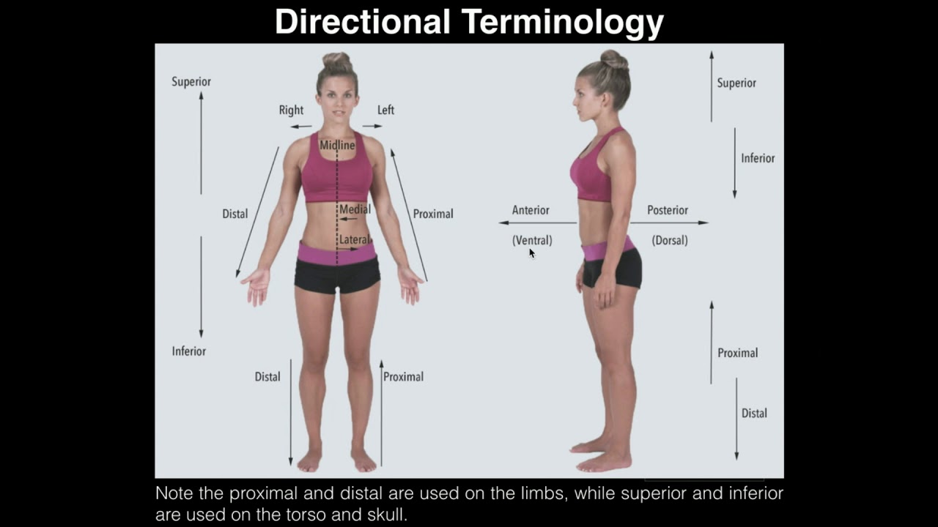

Slide 19
Anatomical Perspective
The body is separated into imaginary lines/planes called sections. It is important to know which half or portion of the body or organ is being discussed. When identifying or comparing structures, you need to know your frame of reference. The anatomical planes are:
_____________________________________– divides the body or organ into anterior or posterior portions – front and back
Sagittal plane – divides the body or organ lengthwise into right and left sections. If the vertical plane runs exactly down the middle of the body, it is referred to as the midsagittal plane.
_____________________________________– divides the body or organ horizontally, into superior and inferior portions – top and bottom.

Slide 20
Anatomical Perspective
The body is divided into two major portions
  _____________________________________– runs right down the center (axis) and consists of everything except the limbs – meaning the head, neck, thorax (chest and back), abdomen, and pelvis
  _____________________________________ – consists of appendages, otherwise known as upper and lower extremities – arms and legs

Slide 21
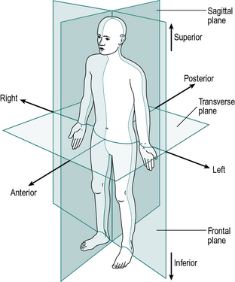
Anatomical Perspective

Slide 22
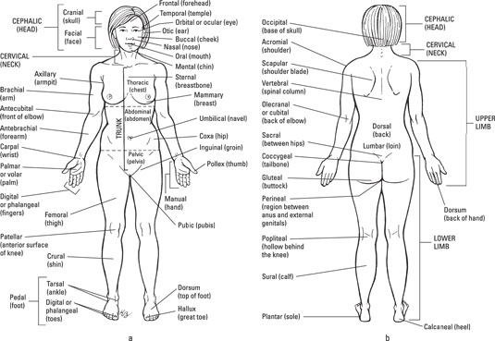
Anatomical Perspective

Slide 23
The Body Cavities
Regions where the body’s organs are held
_____________________________________ cavity
  2 cavities that contain the central nervous system
  Cranial cavity – the space within the skull that holds the brain
  Spinal cavity – the space within the vertebrae where the spinal cord runs through the body

Slide 24
The Body Cavities
_____________________________________ cavity
  Contains all the organs not contained in the dorsal cavity
  Divided by the diaphragm into smaller cavities
    Thoracic cavity
    Abdominopelvic cavity

Slide 25
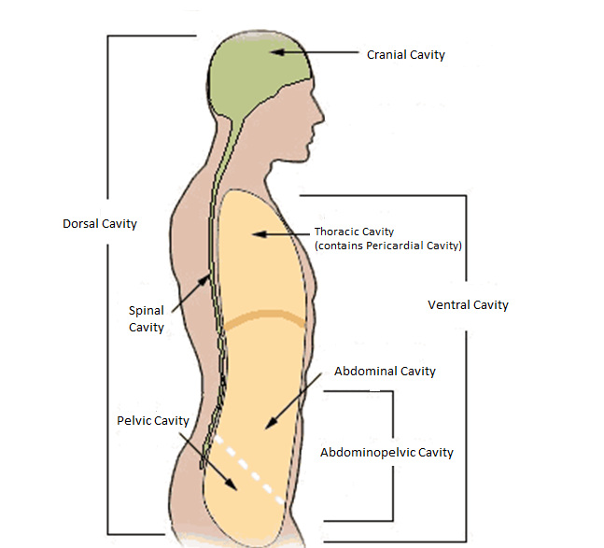
The Body Cavities

Slide 26
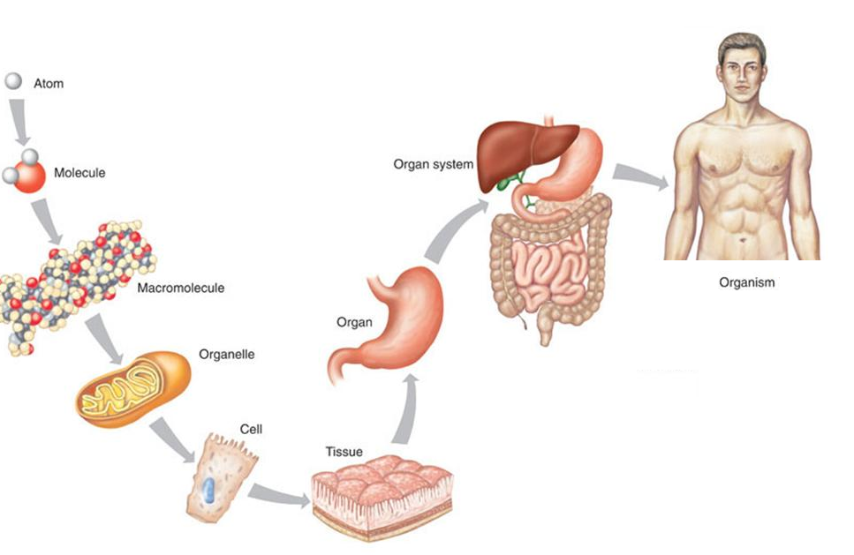
Levels of Organization

Slide 27
Levels of Organization
Level 1 –_____________________________________Level
  All living things are made of cells
  The work of the body occurs in the cells

Slide 28
Level 1 – Cellular Level
Cells arise from other cells
Zygote – first cell, fusion of the sex cells
  _____________________________________ – egg cell from the female
  _____________________________________ – from the male
  The zygote has 2 complete copies of DNA – one from the male parent and one from the female parent
  Now called a diploid – one double set of DNA.

Slide 29
Level 1 – Cellular Level
In the form of cell division called mitosis, one cell divides into two daughter ells, each of them complete but smaller than the original cell.
After mitosis is complete, each daughter cell goes on to its own separate life.
  One or both may start or continue down a path of differentiation, the name for processes that give cells their particular structures and functions.
  A cell to become a nerve cell starts down one path of differentiation and a muscle cell starts down another path.

Slide 30
Level 1 – Cellular Level
_____________________________________ Cells
  Membrane-bound sac containing smaller but distinctive structures called organelles suspended in a gel-like matrix called the cytoplasm
  Organelles are functional subunits of a cell.

Slide 31
Level 1 – Cellular Level
Organelles of Animal Cells
  _____________________________________ – controls the cell; houses the genetic material
  Mitochondrion – cell powerhouse; site of cellular respiration
  Endoplasmic reticulum – plays an important role in protein synthesis; participates in transporting cell products, involved in metabolizing (breaking down) fats as well as drugs
  _____________________________________ – binds amino acids together under the direction of mRNA to make protein
  Golgi apparatus – modifies proteins into functional form; packages cellular products in sacs called vesicles in which products can cross the cell membrane to exit the cell
  Vacuoles – membrane bound spaces in the cytoplasm that aid in endo- and exocytosis
  _____________________________________ – contain enzymes that break down harmful cell products and waste materials and actively transport them out of the cell

Slide 32
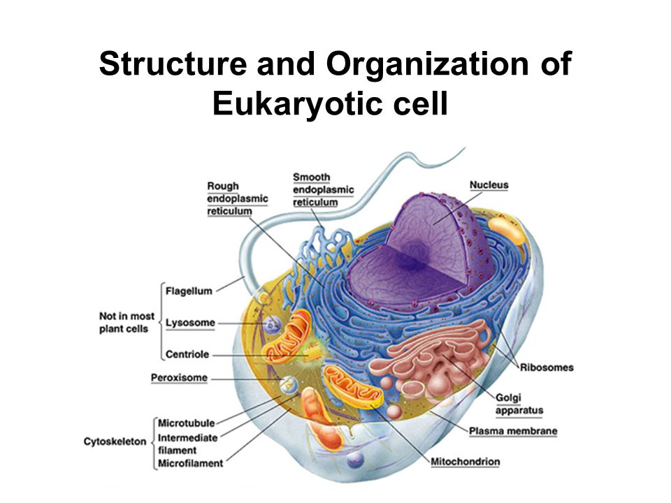
Level 1 – Cellular Level

Slide 33
Level II – Tissue Level
_____________________________________ is a structure made of many cells – usually several different kinds of cells – that perform a specific function.
Tissues are divided into four categories:
  Connective Tissue – serves to support body parts and bind them together
  Epithelial Tissue – functions to line and cover organs as well as carry out absorption and secretion
  Muscle Tissue – found in the muscles, which allow your body parts to move; in the walls of hollow organs (such as intestines and blood vessels) to help move their contents along; and in the heart to move blood along
  Nervous Tissue – transmits impulses and forms nerves

Slide 34
Level III – Organ Level
An _____________________________________ is a group of tissues assembled to perform a specialized physiological function

Slide 35
Level IV – Organ System Level
The body is divided into organ systems, groups of organs that work together to meet a major physiological need.
An organ can “belong” to an organ system yet have functions integral to another system.

Slide 36
Level V – Organism Level
YOU!

