Slide 1
Assessment of Groundwater Potential
C. P. Kumar
Scientist ‘G’
National Institute of Hydrology
Roorkee – 247667 (Uttarakhand)
Email: cpkumar@yahoo.com
These lecture notes can be accessed at http://www.angelfire.com/nh/cpkumar/publication/

Slide 2
Presentation Outline
Groundwater in Hydrologic Cycle
Groundwater in National Water Policy - 2012
Groundwater Balance Equation
Data Requirements
Groundwater Resource Estimation Methodology
Estimation of Groundwater Balance Components
Establishment of Recharge Coefficient

Slide 3
Groundwater in Hydrologic Cycle

Slide 4
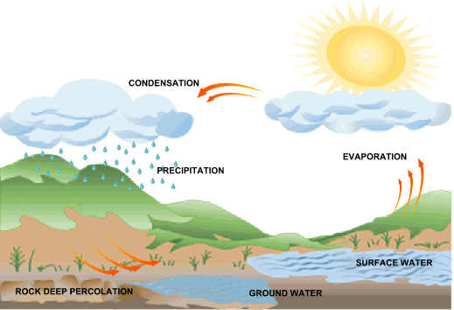

Slide 5
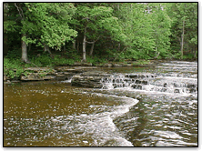
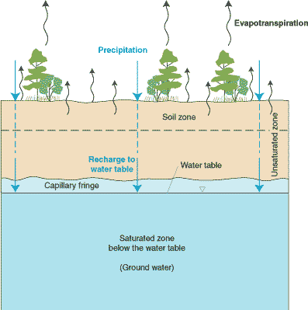
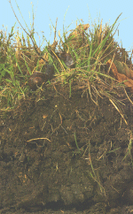
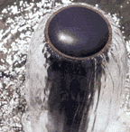
Types of Terrestrial Water
Surface
Water
Soil
Moisture
Ground water

Slide 6
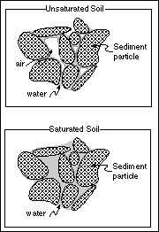
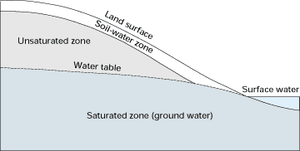
Pores Full of Combination of Air and Water
Unsaturated Zone / Zone of Aeration / Vadose
(Soil Water)
Zone of Saturation (Ground water)
Pores Full Completely with Water

Slide 7

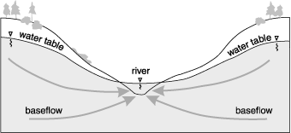
Groundwater
Important source of clean water
More abundant than Surface Water
Baseflow
Linked to SW systems
Sustains flows
in streams

Slide 8
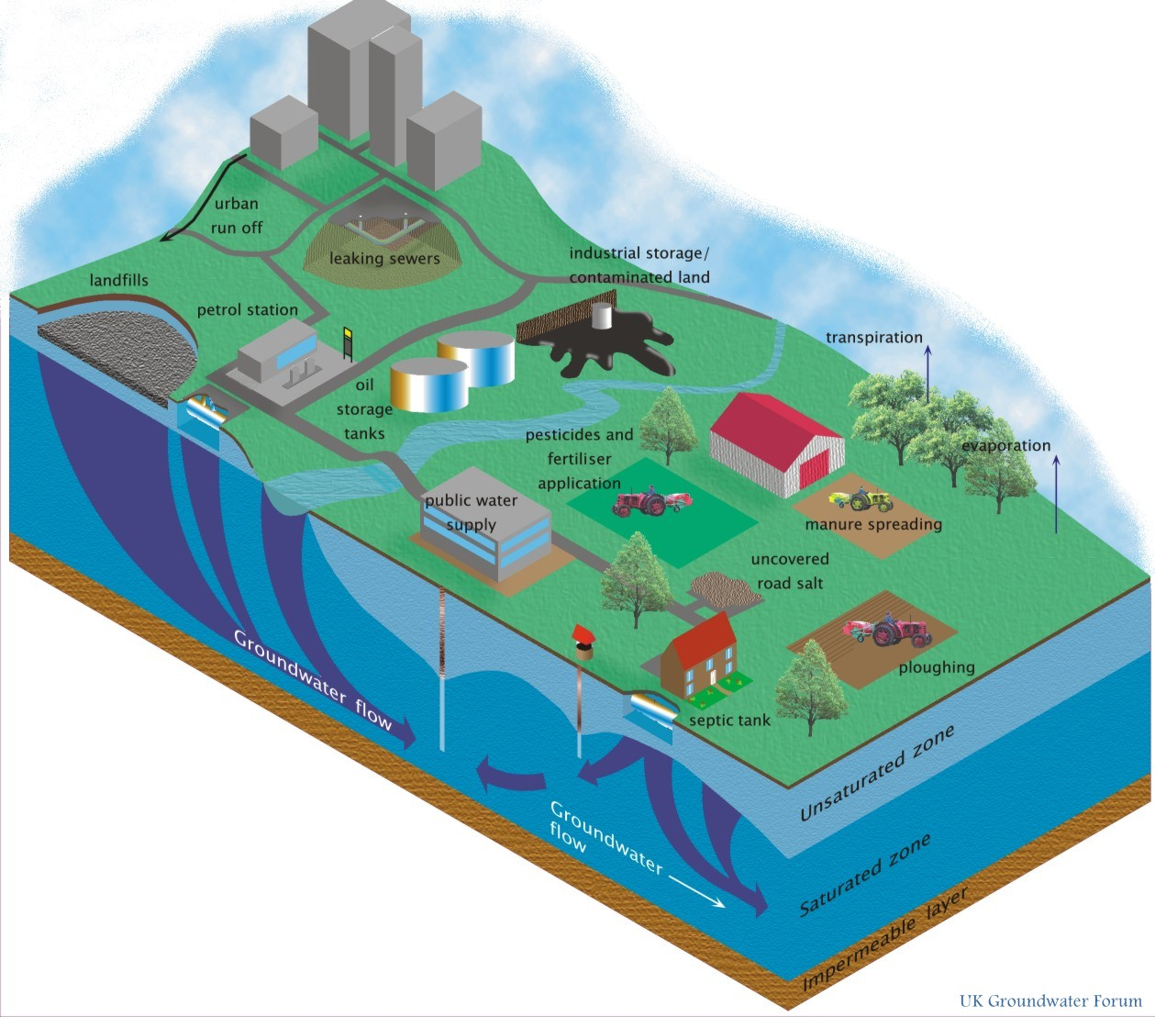
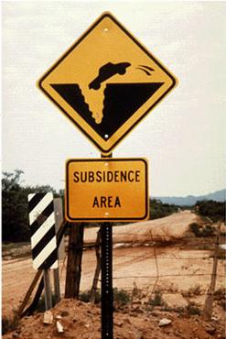
Groundwater Concerns
Pollution
Groundwater mining
Subsidence

Slide 9
Groundwater Concerns
Groundwater overdraft / mining subsidence
Waterlogging and soil salinity
Seawater intrusion in coastal aquifers
Groundwater contamination

Slide 10
Groundwater
An important component of water resource systems.
Extracted from aquifers through pumping wells and supplied for domestic use, industry and agriculture.
With increased withdrawal of groundwater, the quality of groundwater has been continuously deteriorating.
Water can be injected into aquifers for storage and/or quality control purposes.

Slide 11
Groundwater contamination by:
Hazardous industrial wastes
Leachate from landfills
Agricultural activities such as the use of fertilizers and pesticides
Management of a groundwater system, means making such decisions as:
The total volume that may be withdrawn annually from the aquifer.
The location of pumping and artificial recharge wells, and their rates.
Protection and remediation of contaminated aquifers.

Slide 12
Dynamic Groundwater Resources of India (as on 31 March 2013)
Total replenishable groundwater in the country = 447 BCM
Countrywide stage of groundwater development = 62 %
6,584 units (blocks, mandals, talukas, firkas) assessed –
1034 units over-exploited
253 units critical
681 units semi-critical
96 units saline
4520 units safe
Over-exploited blocks are concentrated in the North Western, Western and Southern Peninsular part of the country.

Slide 13

In north-western part of the country including parts of Punjab, Haryana, Delhi and Western Uttar Pradesh where though replenishable resources are abundant, there have been indiscriminate withdrawals of groundwater leading to over-exploitation.
In western part of the country, particularly in parts of Rajasthan and Gujarat where due to arid climate, groundwater recharge itself is limited leading to stress on the resource.
In southern part of peninsular India including parts of Karnataka, Andhra Pradesh, Telangana and Tamil Nadu where due to poor aquifer properties, groundwater availability is low.

Slide 14
Groundwater in National Water Policy - 2012

Slide 15

The ‘National Water Policy’ adopted by the Government of India in 1987 and revised in 2002 and 2012, regards water as one of the most crucial elements in developmental planning. Regarding groundwater, it recommends that
A portion of river flows should be kept aside to meet ecological needs ensuring that the low and high flow releases are proportional to the natural flow regime, including base flow contribution in the low flow season through regulated ground water use.
There is a need to map the aquifers to know the quantum and quality of ground water resources (replenishable as well as non-replenishable) in the country. This process should be fully participatory involving local communities. This may be periodically updated.
Declining ground water levels in over-exploited areas need to be arrested by introducing improved technologies of water use, incentivizing efficient water use and encouraging community based management of aquifers. In addition, where necessary, artificial recharging projects should be undertaken so that extraction is less than the recharge. This would allow the aquifers to provide base flows to the surface system, and maintain ecology.

Slide 16
Water saving in irrigation use is of paramount importance. Recycling of canal seepage water through conjunctive ground water use may also be considered.
There should be concurrent mechanism involving users for monitoring if the water use pattern is causing problems like unacceptable depletion or building up of ground waters, salinity, alkalinity or similar quality problems, etc., with a view to planning appropriate interventions.
The over-drawal of groundwater should be minimized by regulating the use of electricity for its extraction. Separate electric feeders for pumping ground water for agricultural use should be considered.
Quality conservation and improvements are even more important for ground waters, since cleaning up is very difficult. It needs to be ensured that industrial effluents, local cess pools, residues of fertilizers and chemicals, etc., do not reach the ground water.
Water budgeting and water accounting should be carried out for each aquifers.
Appropriate institutional arrangements for each river basin should also be developed for monitoring water quality in both surface and ground waters.

Slide 17
Groundwater Balance Equation

Slide 18
Water Balance Techniques
Water balance techniques have been extensively used to make quantitative estimates of water resources and the impact of man’s activities on the hydrological cycle.
The study of water balance requires the systematic presentation of data on the water supply and its use within a given study area for a specific period.
The water balance of an area is defined by the hydrologic equation, which is basically a statement of the law of conservation of mass as applied to the hydrological cycle.
With water balance approach, it is possible to evaluate quantitatively individual contribution of sources of water in the system, over different time periods, and to establish the degree of variation in water regime due to changes in components of the system.

Slide 19
Study Area
A basinwise approach yields the best results.
Surface water basin and groundwater basin do not always coincide.
The limit of surface water basin is controlled by topography.
In case of groundwater basin, disposition of rocks also plays an important role.
Generally, in igneous and metamorphic rocks, the surface water and groundwater basins are coincident for all practical purposes, but marked differences may be encountered in stratified sedimentary formations.

Slide 20
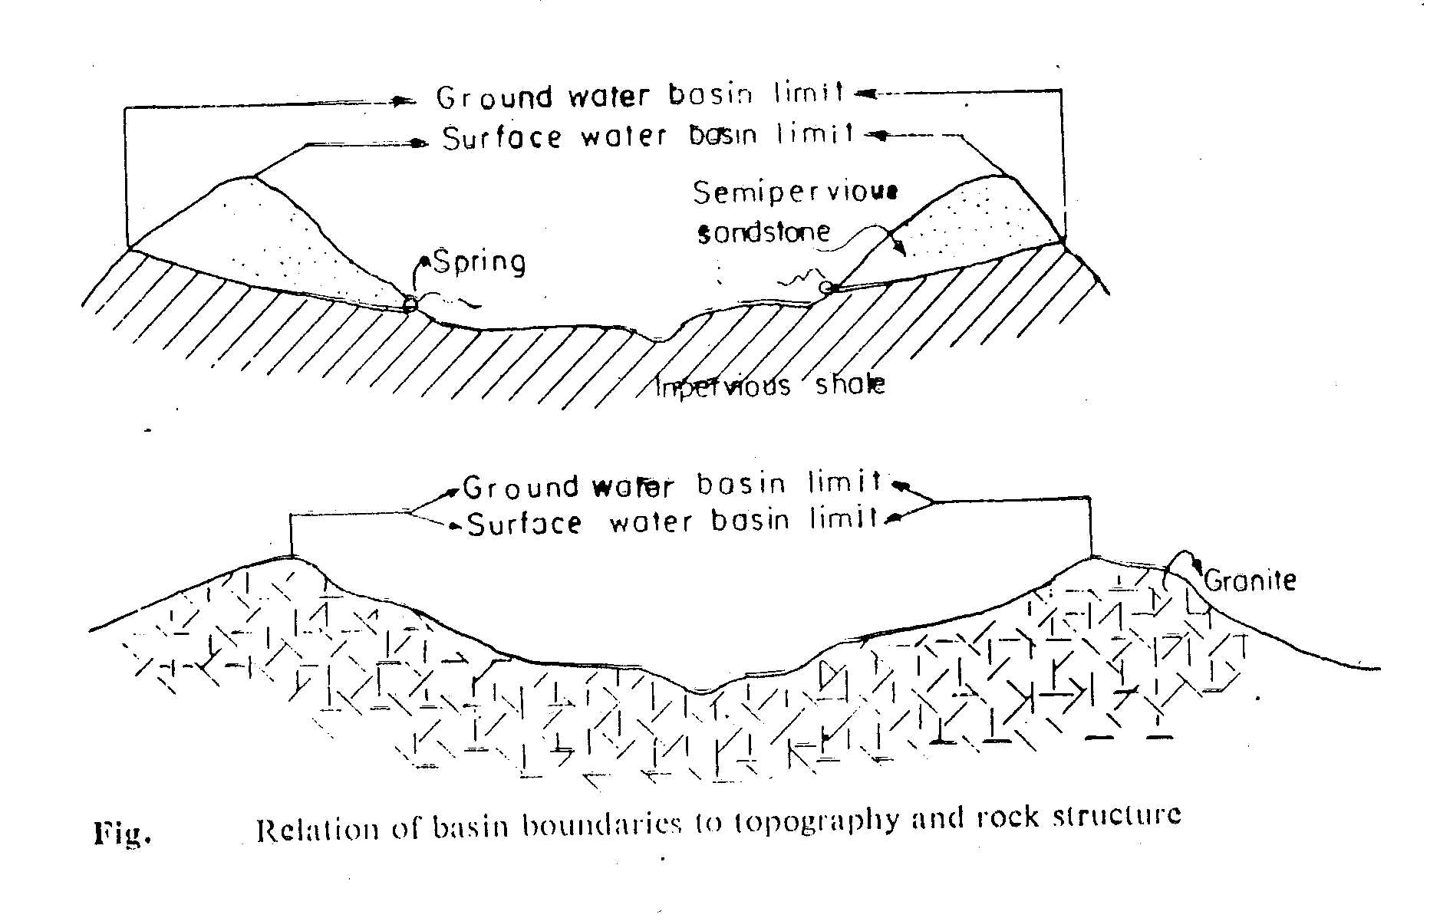
The study area for groundwater balance study is preferably taken as a doab which is bounded on two sides by two streams and on the other two sides by other aquifers or extension of the same aquifer.

Slide 21
Water Balance Concept
The estimation of groundwater balance of a region requires quantification of all individual inflows to or outflows from a groundwater system and change in groundwater storage over a given time period. The basic concept of water balance is:
Input to the system ‑ outflow from the system = change in storage of the system (over a period of time)
The general methodology of computing groundwater balance consists of the following:
Identification of significant components,
Quantifying individual components, and
Presentation in the form of water balance equation.

Slide 22
The groundwater balance study of an area may serve the following purposes:
As a check on whether all flow components involved in the system have been quantitatively accounted for, and what components have the greatest bearing on the problem under study.
To calculate one unknown component of the groundwater balance equation, provided all other components are quantitatively known with sufficient accuracy.

Slide 23
GROUNDWATER BALANCE EQUATION
Considering the various inflow and outflow components in a given study area, the groundwater balance equation can be written as:
R_{r} + R_{c} + R_{i} + R_{t} + S_{i} + I_{g} = E_{t} + T_{p} + S_{e} + O_{g} + ΔS
where,
R_{r} = recharge from rainfall;
R_{c} = recharge from canal seepage;
R_{i} = recharge from field irrigation;
R_{t} = recharge from tanks;
S_{i} = influent seepage from rivers;
I_{g} = inflow from other basins;
E_{t} = evapotranspiration from groundwater;
T_{p} = draft from groundwater;
S_{e} = effluent seepage to rivers;
O_{g} = outflow to other basins; and
ΔS = change in groundwater storage.

Slide 24
Preferably, all elements of the groundwater balance equation should be computed using independent methods.
Computations of various components usually involve errors, due to shortcomings in the estimation techniques. The groundwater balance equation therefore generally does not balance, even if all its components are computed by independent methods.
The resultant discrepancy in groundwater balance is defined as a residual term in the balance equation, which includes errors in the quantitative determination of various components as well as values of the components which have not been accounted in the equation.
The water balance may be computed for any time interval. The complexity of the computation of the water balance tends to increase with increase in area. This is due to a related increase in the technical difficulty of accurately computing the numerous important water balance components.

Slide 25
Data Requirements

Slide 26

For carrying out a groundwater balance study, following data may be required over a given time period:
Rainfall data: Monthly rainfall data of sufficient number of rainguage stations lying within or around the study area, along with their locations, should be available.
Land use data and cropping patterns: Land use data are required for estimating the evapotranspiration losses from the water table through forested area. Cropping pattern data are necessary for estimating the spatial and temporal distributions of groundwater withdrawals, if required. Monthly pan evaporation rates should also be available at few locations for estimation of consumptive use requirements of different crops.
River data: Monthly river stage and discharge data along with river cross‑sections are required at few locations for estimating the river-aquifer interflows.
Canal data: Monthwise water releases into the canal and its distributaries along with running days during each month are required. To account for the seepage losses through the canal system, the seepage loss test data are required in different canal reaches and distributaries.

Slide 27
Tank data: Monthly tank gauges and water releases should be available. In addition, depth vs. area and depth vs. capacity curves should also be available for computing the evaporation and seepage losses from tanks. Field test data are required for computing infiltration capacity to be used to evaluate the recharge from depression storage.
Water table data: Monthly water table data (or at least pre‑monsoon and post‑monsoon data) from sufficient number of well-distributed observation wells along with their locations are required. The available data should comprise reduced level (R.L.) of water table and depth to water table.
Groundwater draft: For estimating groundwater withdrawals, the number of each type of wells operating in the area, their corresponding running hours each month and discharge are required. If a complete inventory of wells is not available, then this can be obtained by carrying out sample surveys.
Aquifer parameters: Data regarding the storage coefficient and transmissivity are required at sufficient number of locations in the study area.

Slide 28
Groundwater Resource Estimation Methodology

Slide 29
The Groundwater Estimation Committee (GEC) was constituted by the Government of India in 1982 to recommend methodologies for estimation of the groundwater resource potential in India.
It was recommended by the committee that the groundwater recharge should be estimated based on groundwater level fluctuation method.
Later Ground Water Estimation Committee (GEC-1997) proposed several improvements in the methodology based on groundwater level fluctuation approach. GEC-1997 has been the basis of groundwater assessment in the country for two decades.
The revised methodology (GEC-2015) has incorporated number of changes in GEC-1997 methodology. Salient features of GEC-2015 recommendations are presented in the next slides.

Slide 30
Aquifer-wise groundwater resource assessment is recommended to which demarcation of lateral as well as vertical extent and disposition of different aquifers is pre-requisite.
Until aquifer geometry is established on appropriate scale, the existing practice of using watershed in hard rock areas and blocks/mandals/ firkas in soft rock areas may be continued as groundwater assessment unit.
Groundwater resources may be assessed to a depth of 100 m in hard rock areas and 300 m in soft rock areas till the aquifer geometry is completely established throughout the country through aquifer mapping.
Estimation of replenishable and in-storage groundwater resources for both unconfined and confined aquifers is recommended.

Slide 31
Wherever spring discharge data is available, the same may be assessed as a proxy for 'groundwater resources' in hilly areas.
Norms for specific yield, rainfall infiltration factor, recharge due to canals, recharge from irrigation have been refined.
Groundwater level trends are proposed to be used as validation of the estimate instead of one of the criterion for categorization.
After the assessment is done, a quality flag may be added to the assessment unit for the parameters - salinity, fluoride and arsenic.
Keeping in view of the rapid change in groundwater extraction, GEC-2015 recommends resources estimation once in every three years.

Slide 32
Estimation of Groundwater Balance Components

Slide 33
The various inflow and outflow components of the groundwater balance equation may be estimated through -
Appropriate empirical relationships suitable for a region,
Groundwater Estimation Committee norms (2015),
Analytical methods,
Field experiments,
Other methods, such as sample survey etc.

Slide 34
1. Recharge from Rainfall (R_{r})
Rainfall is the major source of recharge to groundwater.
Part of the rain water, which falls on the ground, is infiltrated into the soil. A part of this infiltrated water is utilized in filling the soil moisture deficiency while the remaining portion percolates down to reach the water table, which is termed as rainfall recharge to the aquifer.
The amount of rainfall recharge depends on various hydrometeorological and topographic factors, soil characteristics and depth to water table.
The methods for estimation of rainfall recharge involve the empirical relationships established between recharge and rainfall developed for different regions, Groundwater Resource Estimation Committee norms, groundwater balance approach, and soil moisture data based methods.

Slide 35
Empirical Methods
Several empirical formulae have been worked out for various regions in India on the basis of detailed studies. Some of the commonly used formulae are:
(a) Chaturvedi formula: Based on the water level fluctuations and rainfall amounts in Ganga‑Yamuna doab, Chaturvedi in 1936, derived an empirical relationship to arrive at the recharge as a function of annual precipitation.
R_{r} = 2.0 (P ‑ 15)^{0.4}
where,
R_{r} = net recharge due to precipitation during the year, in inches; and
P = annual precipitation, in inches.
This formula was later modified by further work at the U.P. Irrigation Research Institute, Roorkee and the modified form of the formula is
R_{r} = 1.35 (P ‑ 14)^{0.5}

Slide 36
(b) Kumar and Seethapathi (2002): They conducted a detailed seasonal groundwater balance study in Upper Ganga Canal command area for the period 1972-73 to 1983-84 to determine groundwater recharge from rainfall.
It was observed that as the rainfall increases, the quantity of recharge also increases but the increase is not linearly proportional.
The recharge coefficient (based upon the rainfall in monsoon season) was found to vary between 0.05 to 0.19 for the study area.
The following empirical relationship (similar to Chaturvedi formula) was derived by fitting the estimated values of rainfall recharge and the corresponding values of rainfall in the monsoon season through the non-linear regression technique.
R_{r} = 0.63 (P - 15.28)^{0.76}
where,
R_{r} = Groundwater recharge from rainfall in monsoon season (inch);
P = Mean rainfall in monsoon season (inch).

Slide 37
(c) Amritsar formula:
Using regression analysis for certain doabs in Punjab, the Irrigation and Power Research Institute, Amritsar, developed the following formula in 1973.
R_{r} = 2.5 (P ‑ 16)^{0.5}
where, R_{r} and P are measured in inches.

Slide 38
(d) Krishna Rao:
Krishna Rao gave the following empirical relationship in 1970 to determine the groundwater recharge in limited climatological homogeneous areas:
R_{r} = K (P ‑ X)
The following relation is stated to hold good for different parts of Karnataka:
R_{r} = 0.20 (P ‑ 400) for areas with annual normal rainfall (P) between 400 and 600 mm
R_{r} = 0.25 (P ‑ 400) for areas with P between 600 and 1000 mm
R_{r} = 0.35 (P ‑ 600) for areas with P above 2000 mm
where, R_{r} and P are expressed in millimetres.

Slide 39
Groundwater Resource Estimation Committee Norms
In units or sub-areas where adequate data on groundwater level fluctuations are not available, groundwater recharge may be estimated using rainfall infiltration factor method only.
The rainfall recharge during non-monsoon season may be estimated using rainfall infiltration factor method only.
It is suggested that 10% of normal annual rainfall may be taken as minimum rainfall threshold and 3000 mm as maximum rainfall limit. While computing the rainfall recharge, 10% of the normal annual rainfall is to be deducted from the monsoon rainfall and balance rainfall would be considered for computation of rainfall recharge.
The same recharge factor may be used for both monsoon and non-monsoon rainfall, with the condition that the recharge due to non-monsoon rainfall may be taken as zero, if the normal rainfall during the non-monsoon season is less than 10% of normal annual rainfall.
Groundwater Resource Estimation Committee (2015) recommended the following rainfall infiltration factors for various aquifer units.

Slide 40
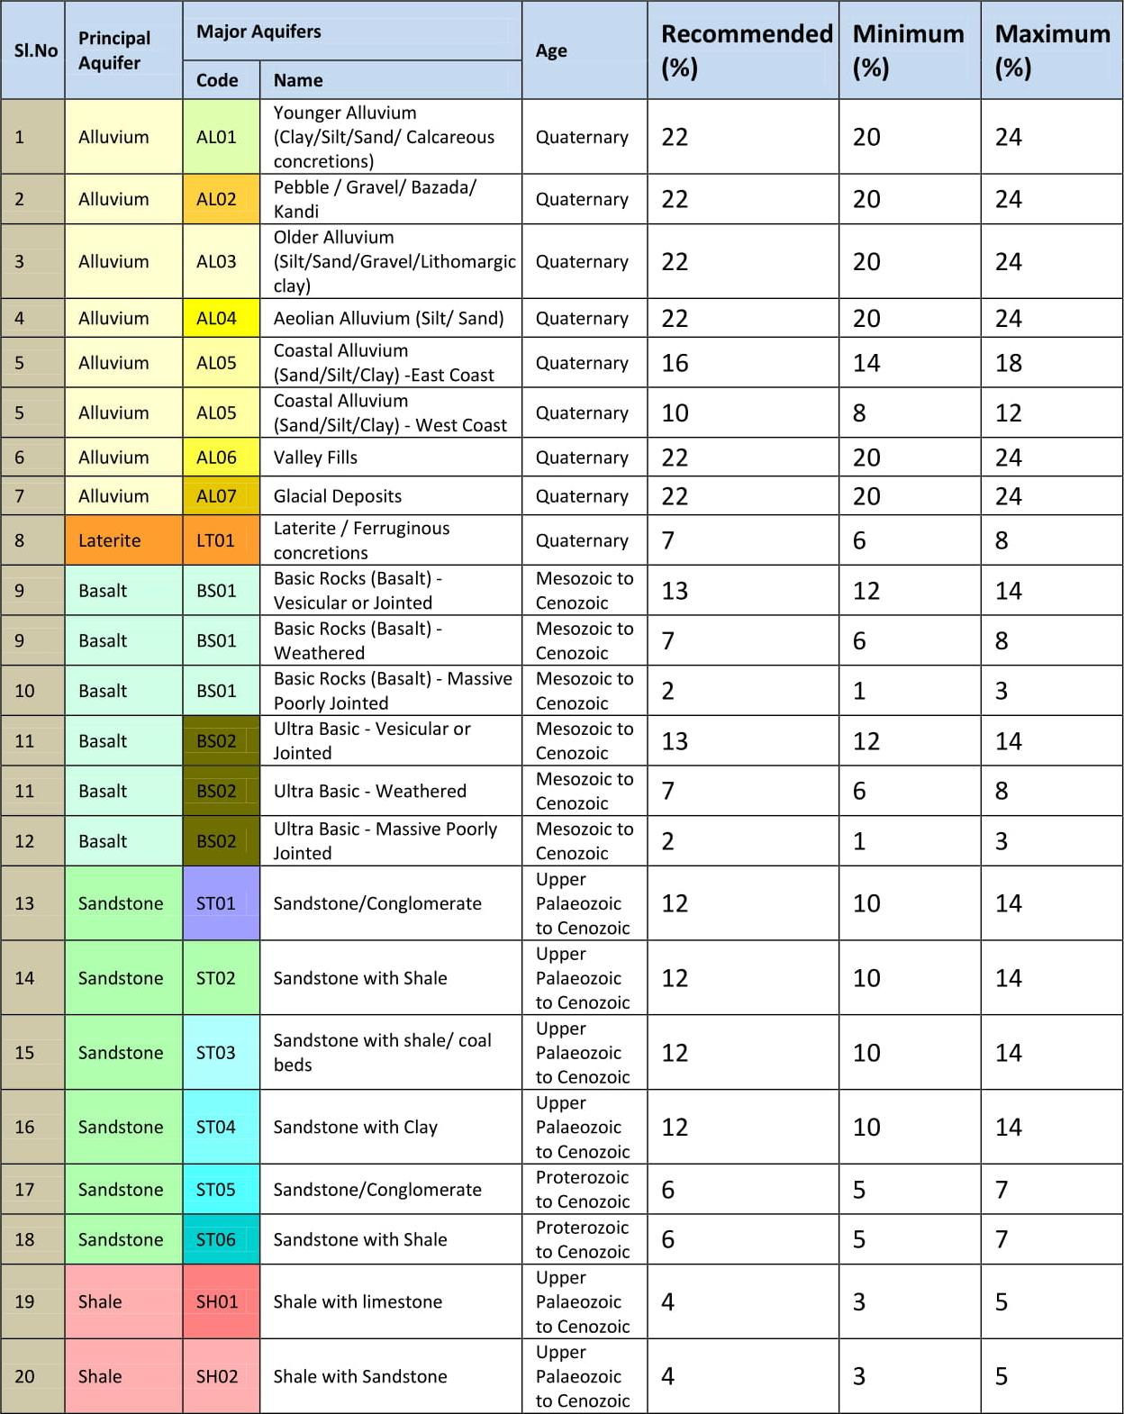

Slide 41
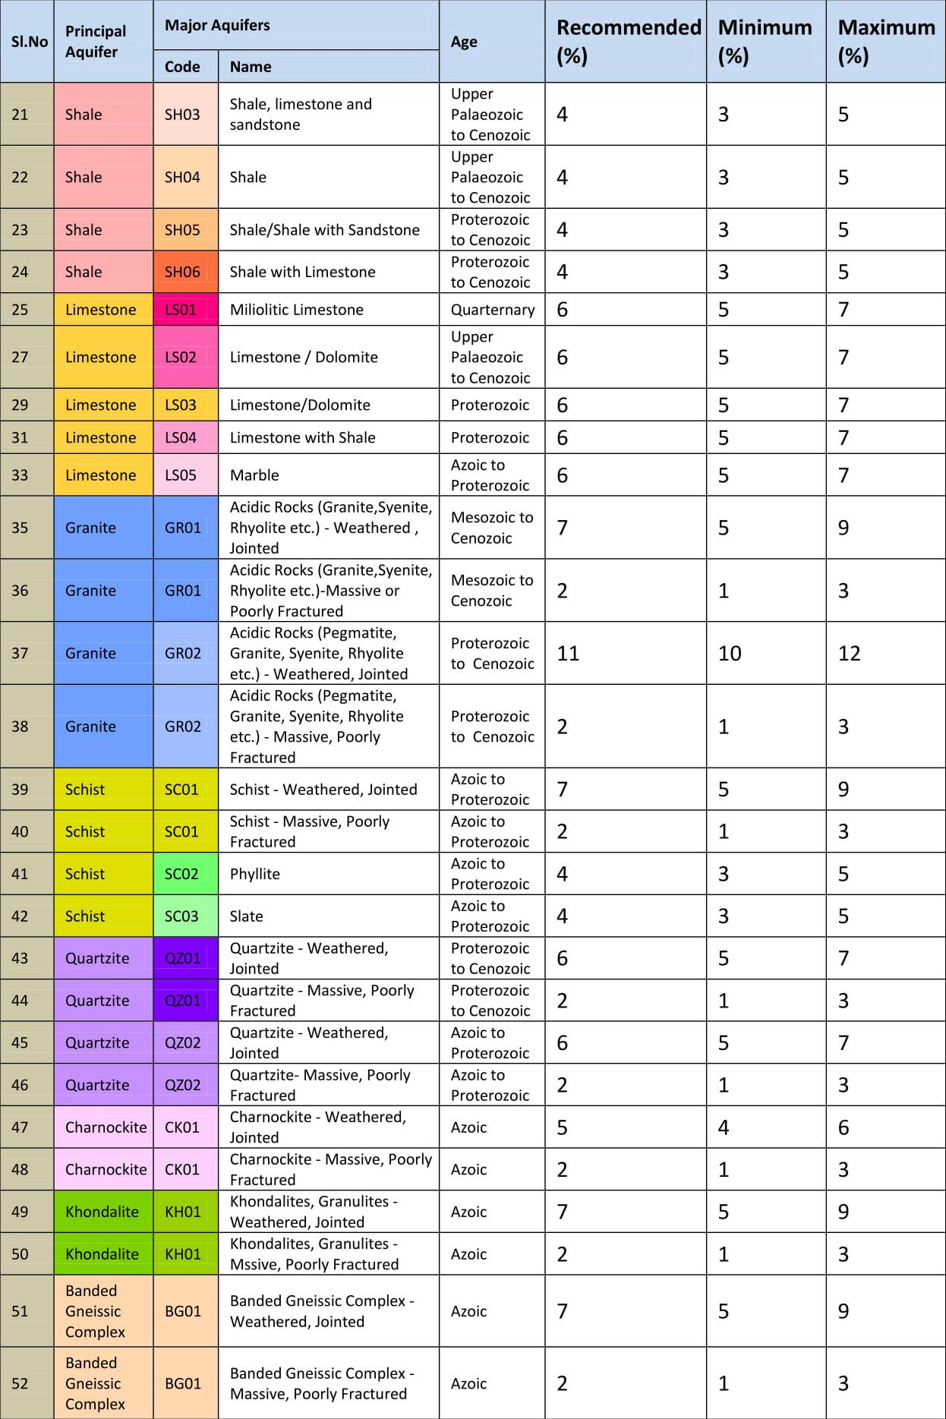

Slide 42
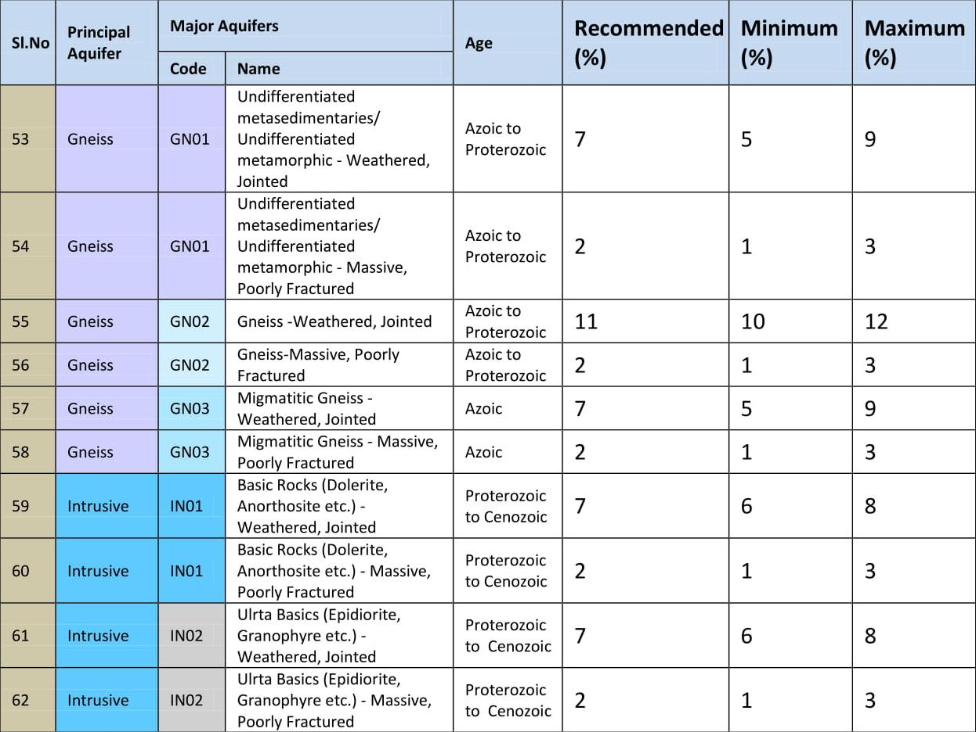

Slide 43
Groundwater Balance Approach
In this method, all components of the groundwater balance equation, except the rainfall recharge, are estimated individually. The algebraic sum of all input and output components is equated to the change in groundwater storage, as reflected by the water table fluctuation, which in turn yields the single unknown in the equation, namely, the rainfall recharge.
The groundwater balance approach is valid for the areas where the year can be divided into monsoon and non‑monsoon seasons with the bulk of rainfall occurring in former.
Groundwater balance study for monsoon and non‑monsoon periods is carried out separately. The former yields an estimate of recharge coefficient and the later determines the degree of accuracy with which the components of water balance equation have been estimated.
Alternatively, the average specific yield in the zone of fluctuation can be determined from a groundwater balance study for the non‑monsoon period and using this specific yield, the recharge due to rainfall can be determined using the groundwater balance components for the monsoon period.

Slide 44
Soil Moisture Data Based Methods
Soil moisture data based methods are -
Lumped model
Distributed model
Nuclear methods
In the lumped model, the variation of soil moisture content in the vertical direction is ignored and any effective input into the soil is assumed to increase the soil moisture content uniformly. Recharge is calculated as the remainder when losses, identified in the form of runoff and evapotranspiration, have been deducted from the precipitation with proper accounting of soil moisture deficit.
In the distributed model, variation of soil moisture content in the vertical direction is accounted and the method involves the numerical solution of partial differential equation (Richards equation) governing one‑dimensional flow through unsaturated medium, with appropriate initial and boundary conditions.

Slide 45
Lumped Model - Soil Moisture Balance Approach
The soil moisture balance for any time interval can be expressed as:
P = AE + I + R + S_{m}
Where, P = rainfall, AE= actual evapotranspiration, S_{m} = change in soil moisture storage, I= groundwater recharge, R= surface runoff
Thornthwaite’s Book-Keeping Method (1945)
Monthly PET and rainfall are tabulated and compared.
If rainfall P in a month is less than PET, then AE is equal to P, the period being one of water deficit.
If rainfall is more than PET, then AE = PET, the balance of rainfall raising the moisture level of soil to field capacity.
After meeting the soil-moisture deficit, the excess of rainfall over PET becomes the moisture surplus.
The moisture surplus results in surface runoff and recharge to groundwater body.
The runoff can be determined by gauging at the basin outlet, or estimated from the rainfall-runoff curves.
The difference between moisture surplus and runoff gives the groundwater recharge.

Slide 47

Distributed Model – Richards Equation
For one-dimensional vertical flow:
This equation is known as the RICHARDS EQUATION, and is the most general unsaturated flow equation used in practice.

Slide 48
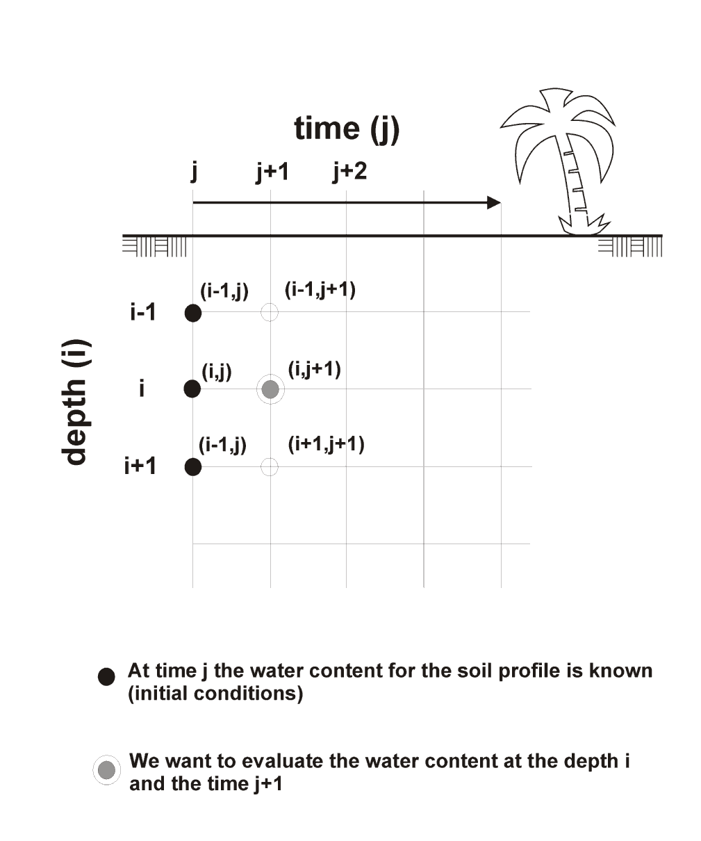
Numerical Solutions of Richards Equation
Numerical Approximations (Finite Difference Method) are based on:
Discretization of the flow domain into a grid: "layers" for one dimensional flow or a mesh for two-dimensional flow.
Discretization of the continuous partial differential equation into a series of approximated difference equations, one for each of the spatial nodes.
Application of initial and boundary conditions.
Formulation of the problem into a computer code which is able to solve the equations for the entire flow domain at various time steps.

Slide 49
Nuclear Methods
Nuclear techniques can be used for the determination of recharge by measuring the travel of moisture through a soil column.
The technique is based upon the existence of a linear relation between neutron count rate and moisture content (% by volume).
Neutron Soil Moisture Probe
Neutron soil moisture probe is used to determine soil moisture contents at different depths in the unsaturated zone.
The neutron probe consists of a fast neutron source of radioactive isotopes (Radium and Beryllium) and a slow neutron detector adjacent to the neutron source.
The number of neutrons slowed down is proportional to the moisture content of the soil.
By repeated measurements of moisture contents through neutron soil moisture probe, at different times during the rainy season, groundwater recharge can be estimated.

Slide 50
Tritium Tagging Technique
The basic principle of estimation of recharge to groundwater by using this method assumes that soil water in the unsaturated zone moves downward ‘layer by layer’ similar to a piston flow.
If the tritium radioisotope is tagged below the active root zone and sun-heating zone, it will be mixed with the soil moisture available at that depth and act as an impermeable layer.
Therefore, if any water is added to the top soil, it will be infiltrated into the soil strata by pushing down the older water, this shift in the tritium can be observed after a specified period depending upon the input supply of water.
However, the injected tritium will be found in the form of a broadened peak due to molecular diffusion, stream line dispersion, asymmetrical flow and other heterogeneities of the soil media.

Slide 51
2. Recharge from Canal Seepage (R_{c})
Seepage refers to the process of water movement from a canal into and through the bed and wall material.
Seepage losses from irrigation canals often constitute a significant part of the total recharge to groundwater system.
Recharge by seepage from canals depends upon the size and cross-section of the canal, depth of flow, characteristics of soils in the bed and sides.
A number of empirical formulae and formulae based on theoretical considerations have been proposed to estimate the seepage losses from canals.

Slide 52
Recharge from canals that are in direct hydraulic connection with a phreatic aquifer underlain by a horizontal impermeable layer at shallow depth, can be determined by Darcy's equation, provided the flow satisfies Dupuit assumptions.
where, h_{s} and h_{l} are water‑level elevations above the impermeable base, respectively, at the canal, and at distance L from it. For calculating the area of flow cross‑section, the average of the saturated thickness (h_{s} + h_{l})/2 is taken.

Slide 53
A number of investigations have been carried out to study the seepage losses from canals. The following formulae/values are in vogue for the estimation of seepage losses:
As reported by the Indian Standard (IS: 9452 Part 1, 1980), the loss of water by seepage from unlined canals in India varies from 0.3 to 7.0 cumec per million square meter of wetted area. Transmission loss of 0.60 cumec per million square meter of wetted area of lined canal is generally assumed (IS: 10430, 1982).
(b) For unlined channels in Uttar Pradesh, it has been proposed that the losses per million square meter of wetted area are 2.5 cumec for ordinary clay loam to about 5 cumec for sandy loam with an average of 3 cumec. Empirically, the seepage losses can be computed using the following formula:
where, B and D are the bed width and depth, respectively, of the channel in meters, C is a constant with a value of 1.0 for intermittent running channels and 0.75 for continuous running channels.

Slide 54
For lined channels in Punjab, the following formula is used for estimation of seepage losses:
R_{c} = 1.25 Q^{0.56}
where, R_{c} is the seepage loss in cusec per million square foot of wetted area and Q, in cusec, is the discharge carried by the channel. In unlined channels, the loss rate on an average is four times the value computed using the above formula.
U. S. B. R. recommended the channel losses based on the channel bed material, as given below:
Material Seepage Losses
(cumec per million square meter
of wetted area)
Clay and clay loam : 1.50
Sandy loam : 2.40
Sandy and gravely soil : 8.03
Concrete lining : 1.20

Slide 55
(e) Groundwater Resource Estimation Committee (2015) has recommended the following norms:

Slide 56
The above norms take into consideration the type of soil in which the canal runs while computing seepage.
However, the actual seepage will also be controlled by the width of canal (B), depth of flow (D), hydraulic conductivity of the bed material (K) and depth to water table.
Knowing the values of B and D, the range of seepage losses (R_{c_max} and R_{c_min}) from the canal may be obtained as
R_{c_max} = K (B + 2D) (in case of deeper water table)
R_{c_min} = K (B - 2D) (in case of water table at the level of channel bed)

Slide 57
The various guidelines for estimating losses in the canal system, are only approximate. The seepage losses may best be estimated by conducting actual
tests in the field.
Inflow ‑ outflow method: In this method, the water that flows into and out of the section of canal, under study, is measured using current meter. The difference between the quantities of water flowing into and out of the canal reach is attributed to seepage. This method is advantageous when seepage losses are to be measured in long canal reaches with few diversions.
Ponding method: In this method, bunds are constructed in the canal at two locations, one upstream and the other downstream of the reach of canal with water filled in it. The total change in storage in the reach is measured over a period of time by measuring the rate of drop of water surface elevation in the canal reach. The ponding method provides an accurate means of measuring seepage losses and is especially suitable when they are small (e.g. in lined canals).
Seepage meter method: Seepage meters are suitable for measuring local seepage rates in canals or ponds and used only in unlined or earth‑lined canals. They are quickly and easily installed and give reasonably satisfactory results but it is difficult to obtain accurate results when seepage losses are low.

Slide 58
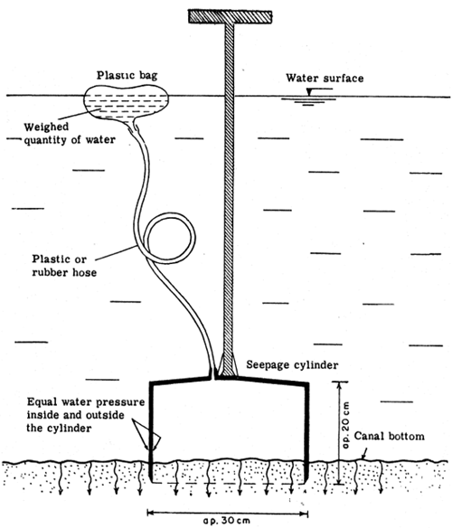
Seepage meter with submerged plastic bag

Slide 59
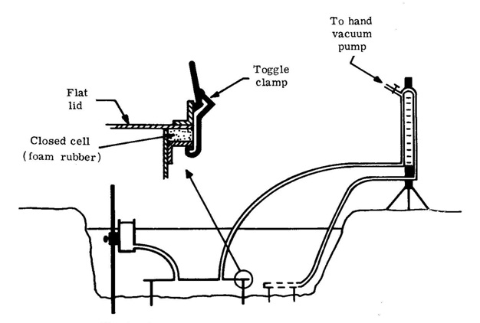
Falling-head seepage meter in a canal (USDA)

Slide 60
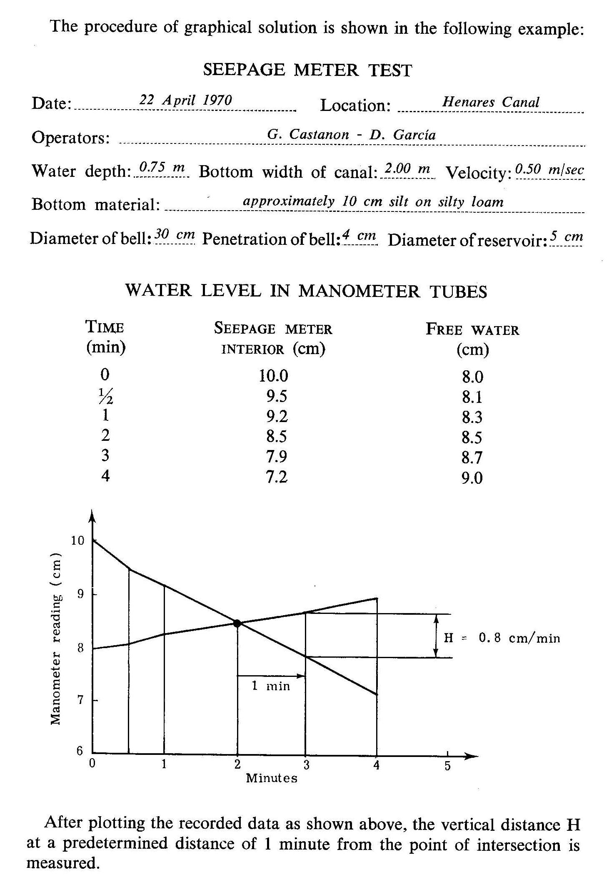

Slide 61
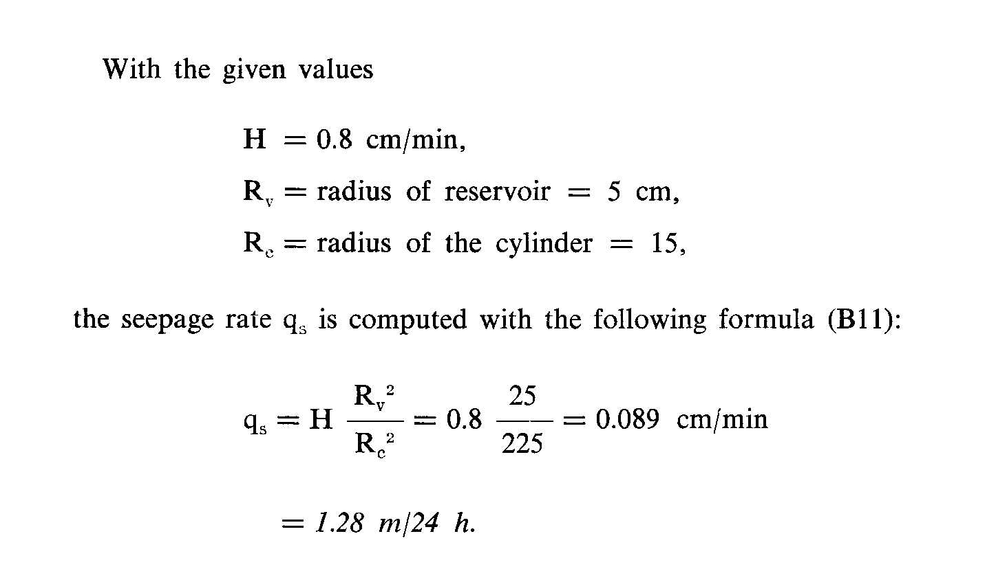

Slide 62
The total losses from the canal system generally consist of the evaporation losses (E_{c}) and the seepage losses (R_{c}).
The evaporation losses are generally 10 to 15 percent of the total losses. Thus, the R_{c} value is 85 to 90 percent of the losses from the canal system.

Slide 63
3. Recharge from Field Irrigation (R_{i})
Water requirements of crops are met, in parts, by rainfall, contribution of moisture from the soil profile, and applied irrigation water.
A part of the water applied to irrigated field crops is lost in consumptive use and the balance infiltrates to recharge the groundwater. The process of re‑entry of a part of the water used for irrigation is called return flow.
For a correct assessment of the quantum of recharge by applied irrigation, studies are required to be carried out on experimental plots under different crops in different seasonal conditions.
The method of estimation comprises application of the water balance equation involving input and output of water in experimental fields.

Slide 64
Drum-Culture Method
In the drum-culture method, paddy crop is raised under controlled conditions in drums of standard size, in representative paddy plots.
Drums of size 0.9 X 0.9 X 1.0 m dimension have been widely used. Two drums, one with bottom open and other with bottom closed are sunk into the plot to a depth of 75 cm. Both are filled with same soil to field level.
Within the open-ended drum, all agricultural operations are carried out as in the surrounding plot. The heights of the water columns in the drums are maintained equal to that outside.
Water levels in the drums are observed twice a day, with the help of gauges, to determine the water consumed. Rainfall and evaporation data are also recorded in the nearby hydrometeorological station.
The water loss from the drum with closed bottom gives the consumptive use, while that from the drum with open bottom gives the consumptive use plus percolation. The difference in values of the water applied in the two drums gives the percolation.

Slide 65
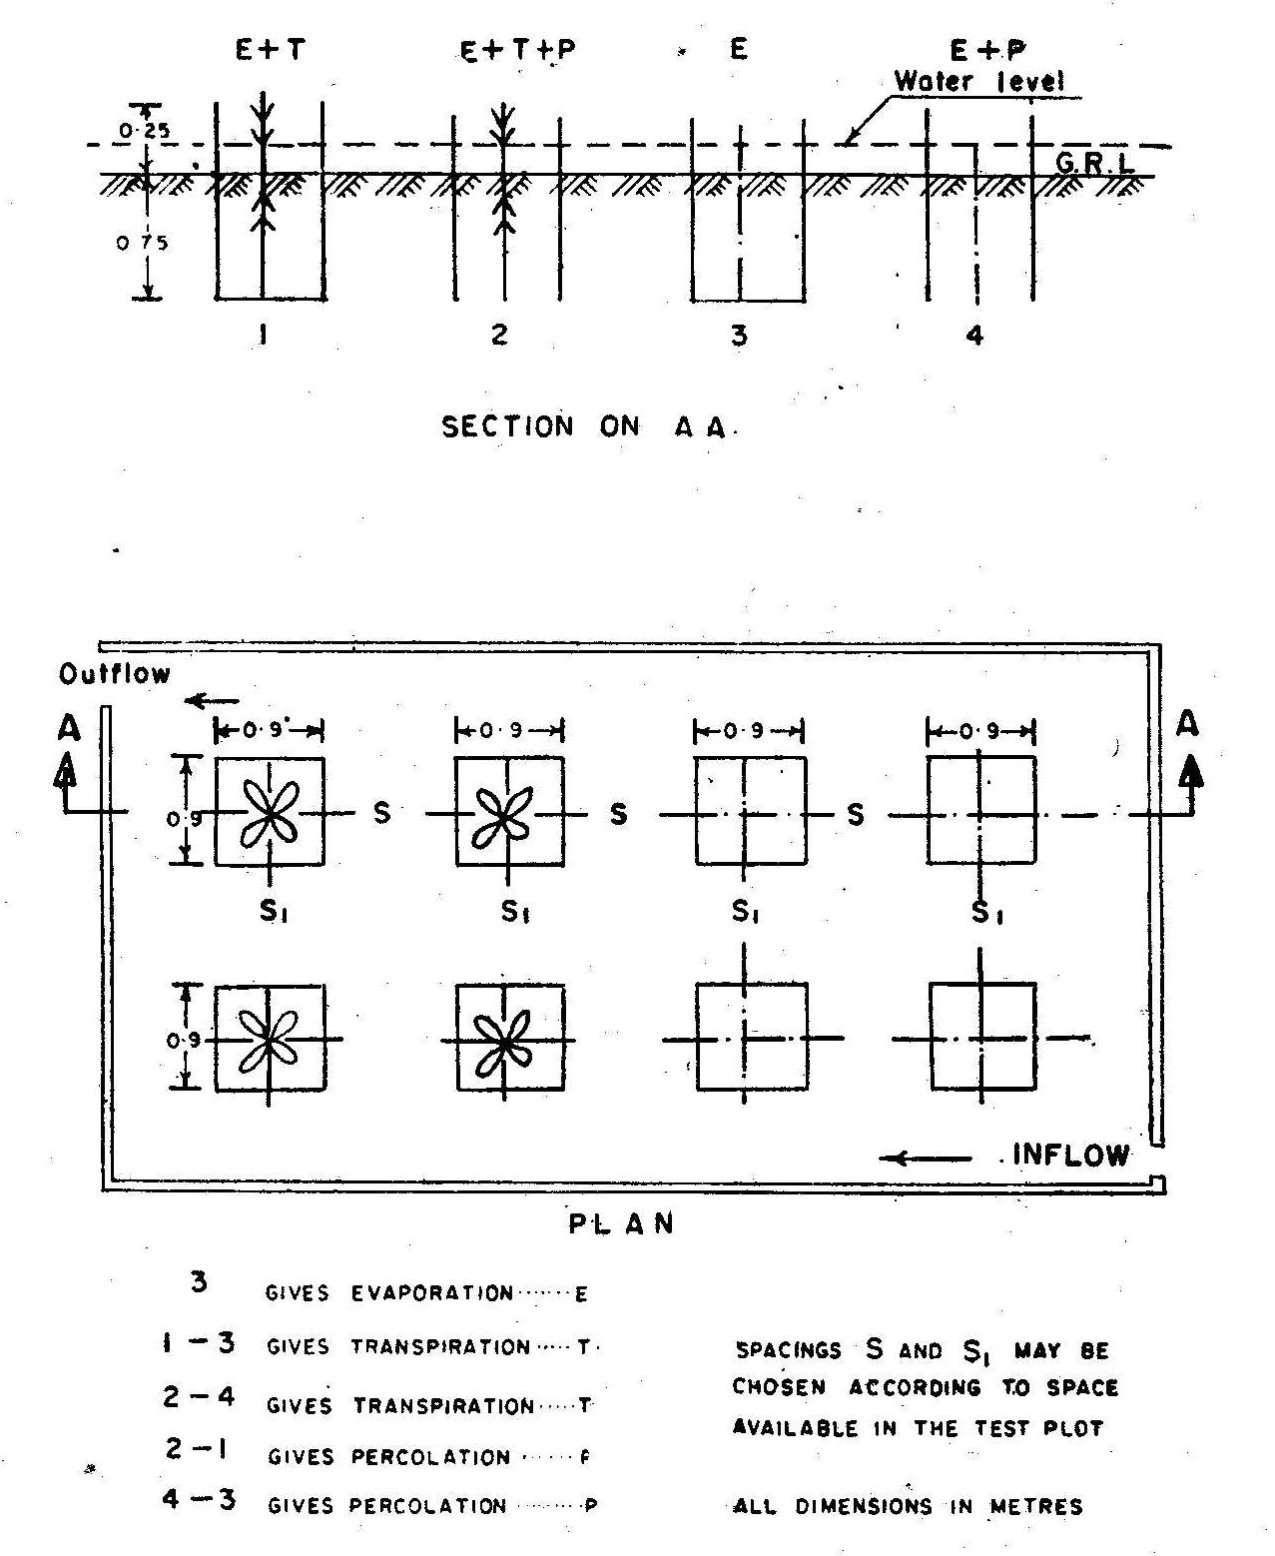

Slide 66
The recharge due to irrigation return flow may also be estimated, based on the source of irrigation (groundwater or surface water), the type of crop (paddy, non-paddy) and the depth of water table below ground surface, using the norms provided by Groundwater Resource Estimation Committee (2015), as given below (as percentage of water application):
For surface water, the recharge is to be estimated based on water released at the outlet from the canal/distribution system. For groundwater, the recharge is to be estimated based on gross draft. Specific results from case studies may be used, if available.

Slide 67
4. Recharge from Tanks (R_{t})
Studies have indicated that seepage from tanks varies from 9 to 20 percent of their live storage capacity.
However, as data on live storage capacity of large number of tanks may not be available, seepage from tanks may be taken as 44 to 60 cm per year over the total water spread.
The seepage from percolation tanks is higher and may be taken as 50 percent of its gross storage. In case of seepage from lakes, the norms as applied to tanks may be taken.

Slide 68
Groundwater Resource Estimation Committee (2015) has recommended that based on the average area of water spread, the recharge from storage tanks and ponds may be taken as 1.4 mm/day for the period in which tank has water.
If data on the average area of water spread is not available, 60% of the maximum water spread area may be used instead of average area of water spread.
In case of percolation tanks, recharge may be taken as 50% of gross storage, considering the number of fillings, with half of this recharge occurring in monsoon season and the balance in non-monsoon season.
Recharge due to check dams and nala bunds may be taken as 50% of gross storage (assuming annual desilting maintenance exists) with half of this recharge occurring in the monsoon season and the balance in the non-monsoon season.

Slide 69
5. Influent and Effluent Seepage (S_{i} & S_{e})
The river-aquifer interaction depends on the transmissivity of the aquifer system and the gradient of water table in respect to the river stage.
Depending on the water level in the river and in the aquifer (in the vicinity of river), the river may recharge the aquifer (influent) or the aquifer may contribute to the river flow (effluent).
The seepage from/to the river can be determined by dividing the river reach into small sub‑reaches and observing the discharges at the two ends of the sub‑reach along with the discharges of its tributaries and diversions, if any. The discharge at the downstream end is expressed as:
Q_{d}. Δt = Q_{u}. Δt + Q_{g}. Δt + Q_{t}. Δt ‑ Q_{o}. Δt ‑ E. Δt ± S_{rb}
where,
Q_{d} = discharge at the downstream section;
Q_{u} = discharge at the upstream section;
Q_{g} = groundwater contribution (unknown quantity; -ve computed value indicates influent conditions);
Q_{t} = discharge of tributaries;
Q_{o} = discharge diverted from the river;
E = rate of evaporation from river water surface and flood plain (for extensive bodies of surface water and for long time periods, evaporation from open water surfaces can not be neglected);
S_{rb} = change in bank storage ( + for decrease and ‑ for increase); and
Δt = time period.

Slide 70
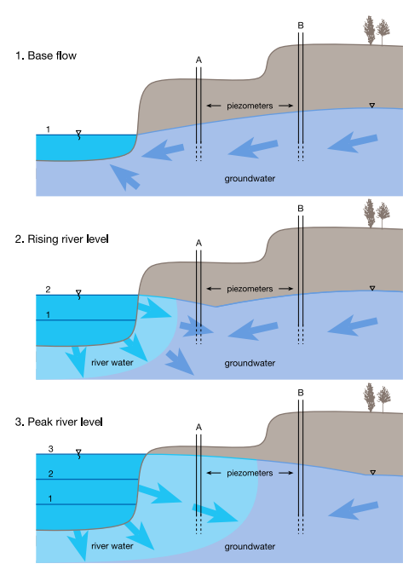
River Bank Storage

Slide 71
Using this equation, seepage from/to the river over a certain period of time Δt can be computed.
However, this would be the contribution from aquifers on both sides of the stream. The contribution from each side can be separated by the following method:
where, I_{L} and T_{L} are gradient and transmissivity respectively on the left side and I_{R} and T_{R} are those on the right.

Slide 72
6. Inflow from and Outflow to Other Basins (I_{g} & O_{g})
For the estimation of groundwater inflow/outflow from/to other basins, regional water table contour maps are drawn based on the observed water level data from wells located within and outside the study area.
The flows into and out of a region are governed mainly by the hydraulic gradient and transmissivity of the aquifer.
The gradient can be determined by taking the slope of the water table normal to water table contour. The length of the section, across which groundwater inflow/outflow occurs, is determined from contour maps, the length being measured parallel to the contour.
The inflow/outflow is determined as follows:
where, T is the transmissivity and I is the hydraulic gradient averaged over a length ΔL of contour line.

Slide 73
7. Evapotranspiration from Groundwater (E_{t})
Evapotranspiration from groundwater occurs in waterlogged areas or in forested areas with roots extending to the water table.
Depth to water table maps may be prepared based on well inventory data to bring into focus the extensiveness of shallow water table areas.
During well inventory, investigation should be specifically oriented towards accurately delineating water table depth for depths less than 2 meters. The evapotranspiration can be estimated based on the following equations:
E_{t} = PE_{t} * A if h > h_{s}
E_{t} = 0 if h < (h_{s} - d)
E_{t} = PE_{t} * A (h - (h_{s} - d))/d if (h_{s}-d) ≤ h ≤ h_{s}
where,
E_{t} = evapotranspiration in volume of water per unit time[L³ T⁻¹];
PE_{t} = maximum rate of evapotranspiration in volume of water per unit
area per unit time [L³ L⁻² T⁻¹];
A = surface area [L²];
h = water table elevation [L];
h_{s} = water table elevation at which the evapotranspiration loss
reaches the maximum value; and
d = extinction depth. When the distance between h_{s} and h
exceeds d, evapotranspiration from groundwater ceases [L].

Slide 74
PE_{t}
h_{s}
d
h_{s}-d
0
E_{t} = PE_{t} * A if h > h_{s}
E_{t} = 0 if h < (h_{s} - d)
E_{t} = PE_{t} * A (h - (h_{s} - d))/d if (h_{s}-d) ≤ h ≤ h_{s}

Slide 75
8. Draft from Groundwater (T_{p})
Draft is the amount of water lifted from the aquifer by means of various lifting devices.
To estimate groundwater draft, an inventory of wells and a sample survey of groundwater draft from various types of wells (state tubewells, private tubewells and open wells) are required.
In areas where wells are energised, the draft may be computed using power consumption data. By conducting tests on wells, the average draft per unit of electricity consumed can be determined for different ranges in depth to water levels.
By noting the depth to water level at each distribution point and multiplying the average draft value with the number of units of electricity consumed, the draft at each point can be computed for every month.

Slide 76
In the absence of sample surveys, the draft can be indirectly estimated from the net crop water requirement which is based upon the cropping pattern and irrigated areas under various crops.
The consumptive use requirements of crops are calculated using the consumptive use coefficient and effective rainfall. The consumptive use coefficient for crops is related to percentage of crop growing season.
The consumptive use for each month can be evaluated by multiplying consumptive use coefficient with monthly pan evaporation rates.

Slide 77
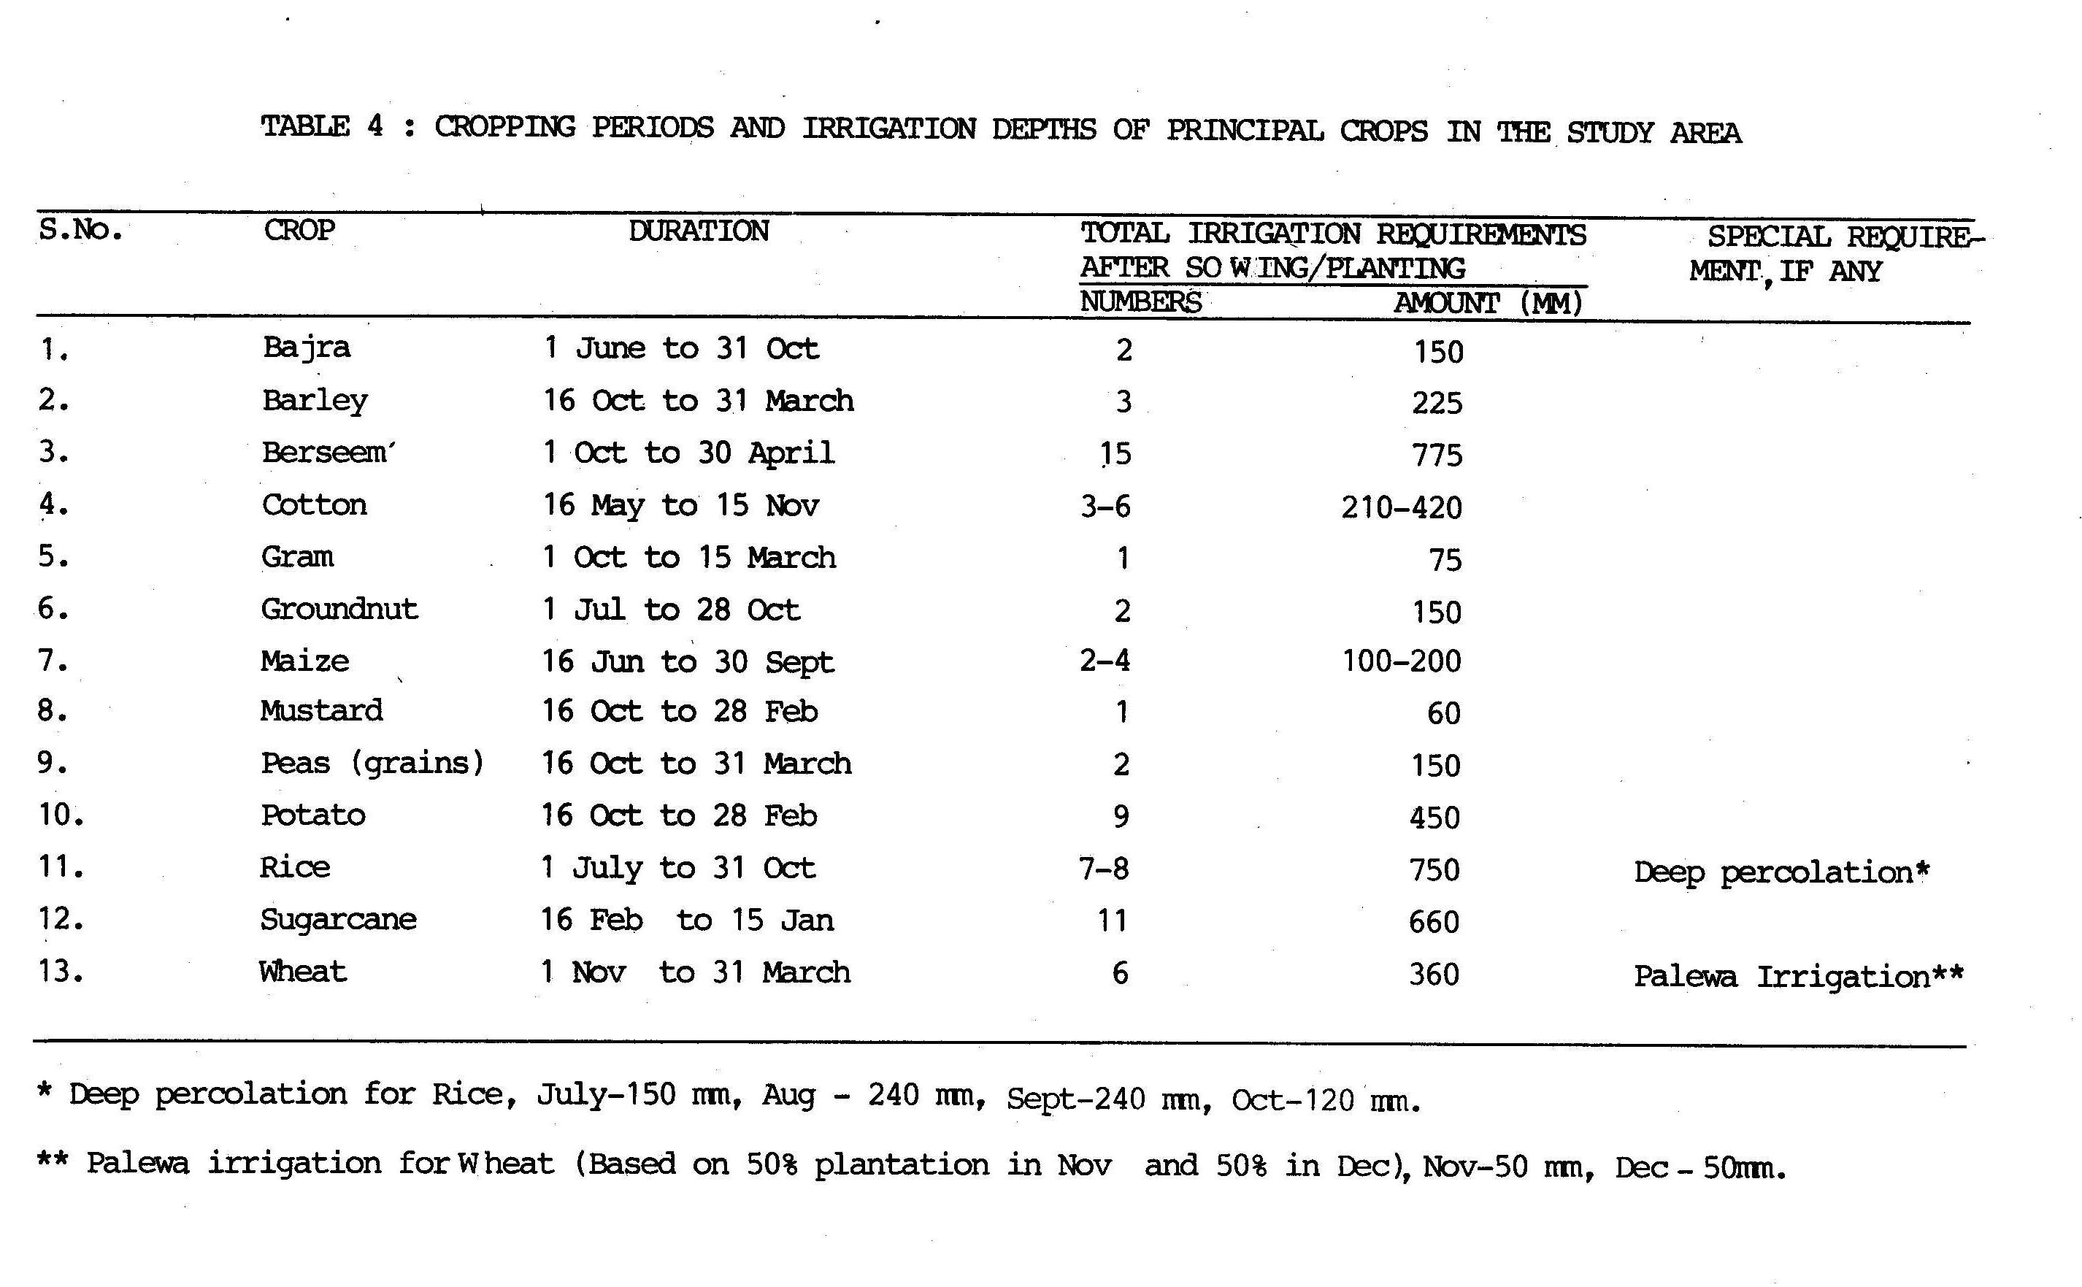

Slide 78


Slide 79
For the computation of net irrigation requirement, the effective rainfall has to be evaluated. Effective rainfall is the portion of rainfall that builds up the soil moisture in the root zone after accounting for direct runoff and deep percolation.
The normal monthly effective rainfall is related to average monthly consumptive use.
Net crop water requirement is obtained after subtracting effective rainfall from consumptive use requirement.
The groundwater draft can thus be estimated by subtracting canal water released for the crops from the net crop water requirement.

Slide 80

http://www.fao.org/docrep/x5560e/x5560e03.htm

Slide 81
9. Change in Groundwater Storage (ΔS)
To estimate the change in groundwater storage, the water levels are observed through a network of observation wells spread over the area.
During the monsoon season, the recharge is more than the extraction; therefore, the change in groundwater storage between the beginning and end of monsoon season indicates the total volume of water added to the groundwater reservoir.
While the change in groundwater storage between the beginning and end of the non‑monsoon season indicates the total quantity of water withdrawn from groundwater storage.
The change in storage (ΔS) is computed as follows:
ΔS = ∑ Δh A S_{y}
where, Δh = change in water table elevation during the given time period;
A = area influenced by the well; and
S_{y} = specific yield.

Slide 82
Groundwater Resource Estimation Committee (1997) recommended that the size of the watershed as a hydrological unit could be of about 100 to 300 sq. km. area and there should be at least three spatially well-distributed observation wells in the unit, or one observation well per 100 sq. km., whichever is more.
As per IILRI (1974), the following specification may serve as a rough guide:
Size of the Number of Observation Number of Observation
Area (ha) Points Points per 100 hectares
100 20 20
1,000 40 4
10,000 100 1
1,00,000 300 0.3
The specific yield may be computed from pumping tests.
The values of specific yield in the zone of fluctuation of water table in different parts of the basin can also be approximately determined from the soil classification triangle showing relation between particle size and specific yield (Johnson, 1967).
Groundwater Resource Estimation Committee (2015) recommended the following values of specific yield for different aquifer units:

Slide 83
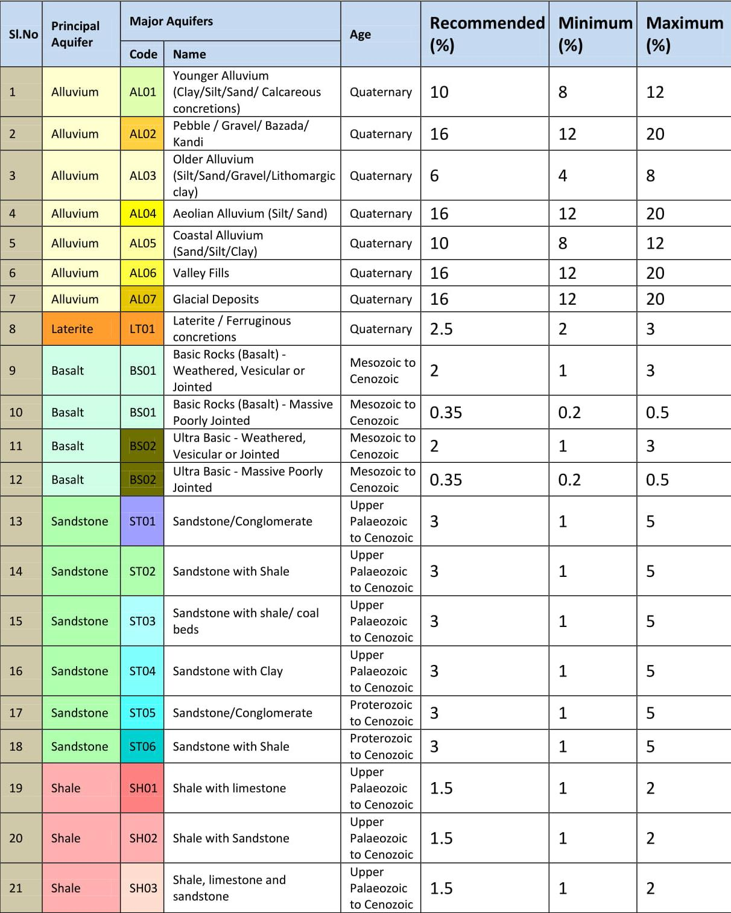

Slide 84
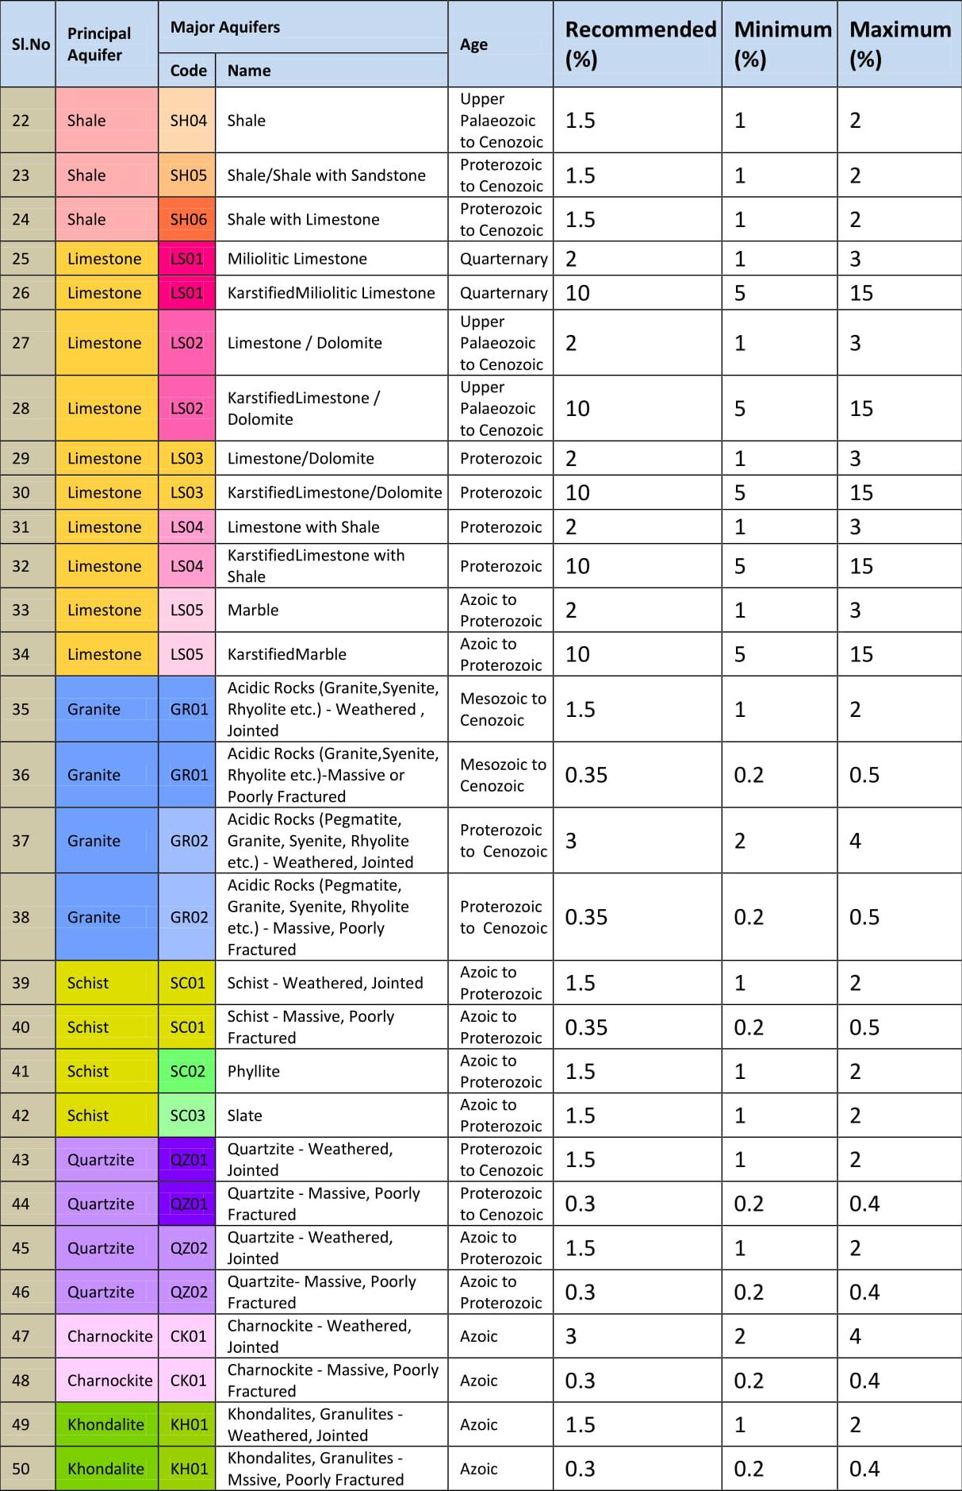

Slide 85
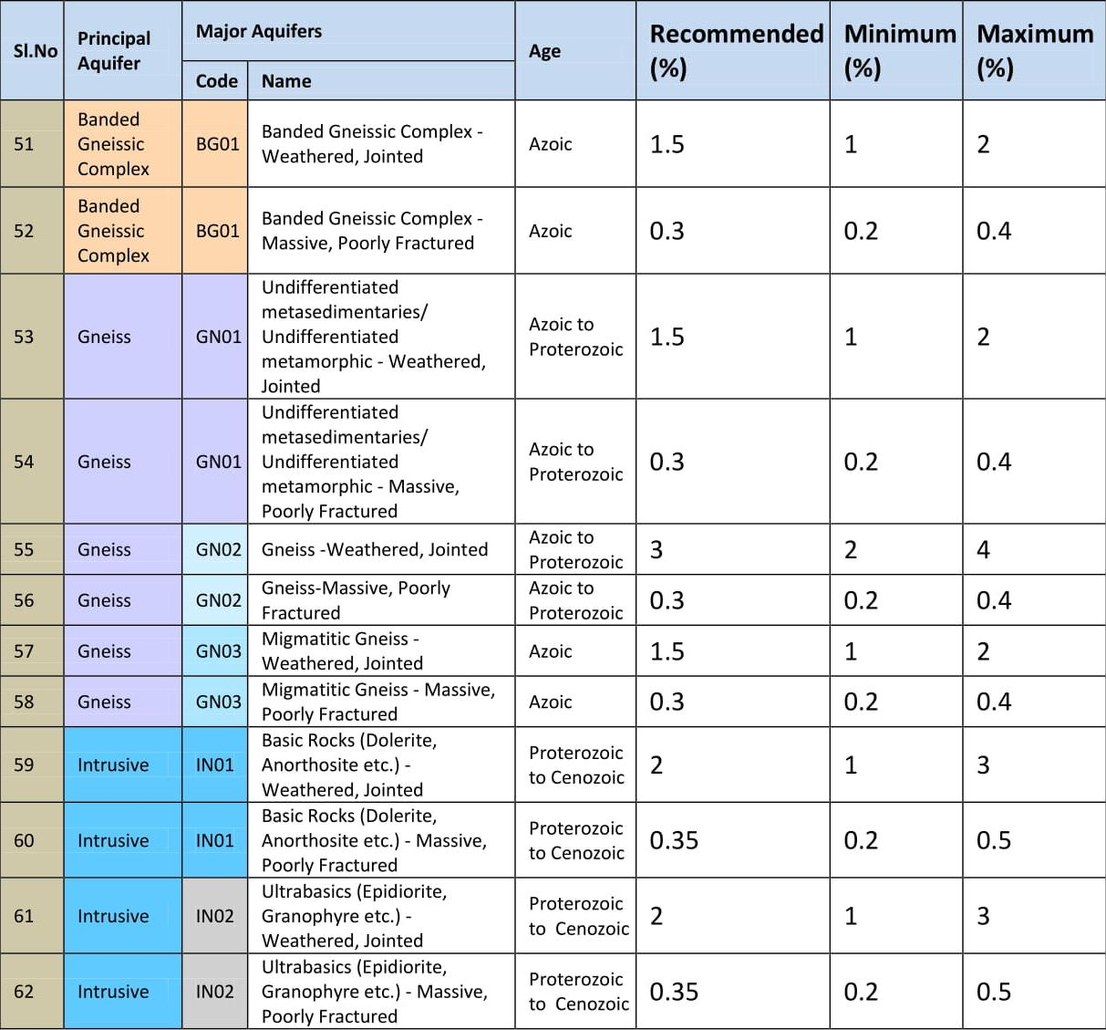

Slide 86
Establishment of Recharge Coefficient

Slide 87

Groundwater balance study is a convenient way of establishing the rainfall recharge coefficient, as well as to cross check the accuracy of the various prevalent methods for the estimation of groundwater losses and recharge from other sources. The steps to be followed are:
Divide the year into monsoon and non‑monsoon periods.
Estimate all the components of the water balance equation other than rainfall recharge for monsoon period using the available hydrological and meteorological information and employing the prevalent methods for estimation.
Substitute these estimates in the water balance equation and thus calculate the rainfall recharge and hence recharge coefficient (recharge/rainfall ratio). Compare this estimate with those given by various empirical relations valid for the area of study.
4. For non‑monsoon season, estimate all the components of water balance equation including the rainfall recharge which is calculated using recharge coefficient value obtained through the water balance of monsoon period. The rainfall recharge (R_{r}) will be of very small order in this case. A close balance between the left and right sides of the equation will indicate that the net recharge from all the sources of recharge and discharge has been quantified with a good degree of accuracy.

Slide 88
By quantifying all the inflow and outflow components of a groundwater system, one can determine which particular component has the most significant effect on the groundwater flow regime.
Alternatively, a groundwater balance study may be used to compute one unknown component (e.g. the rainfall recharge) of the groundwater balance equation, when all other components are known.

Slide 89
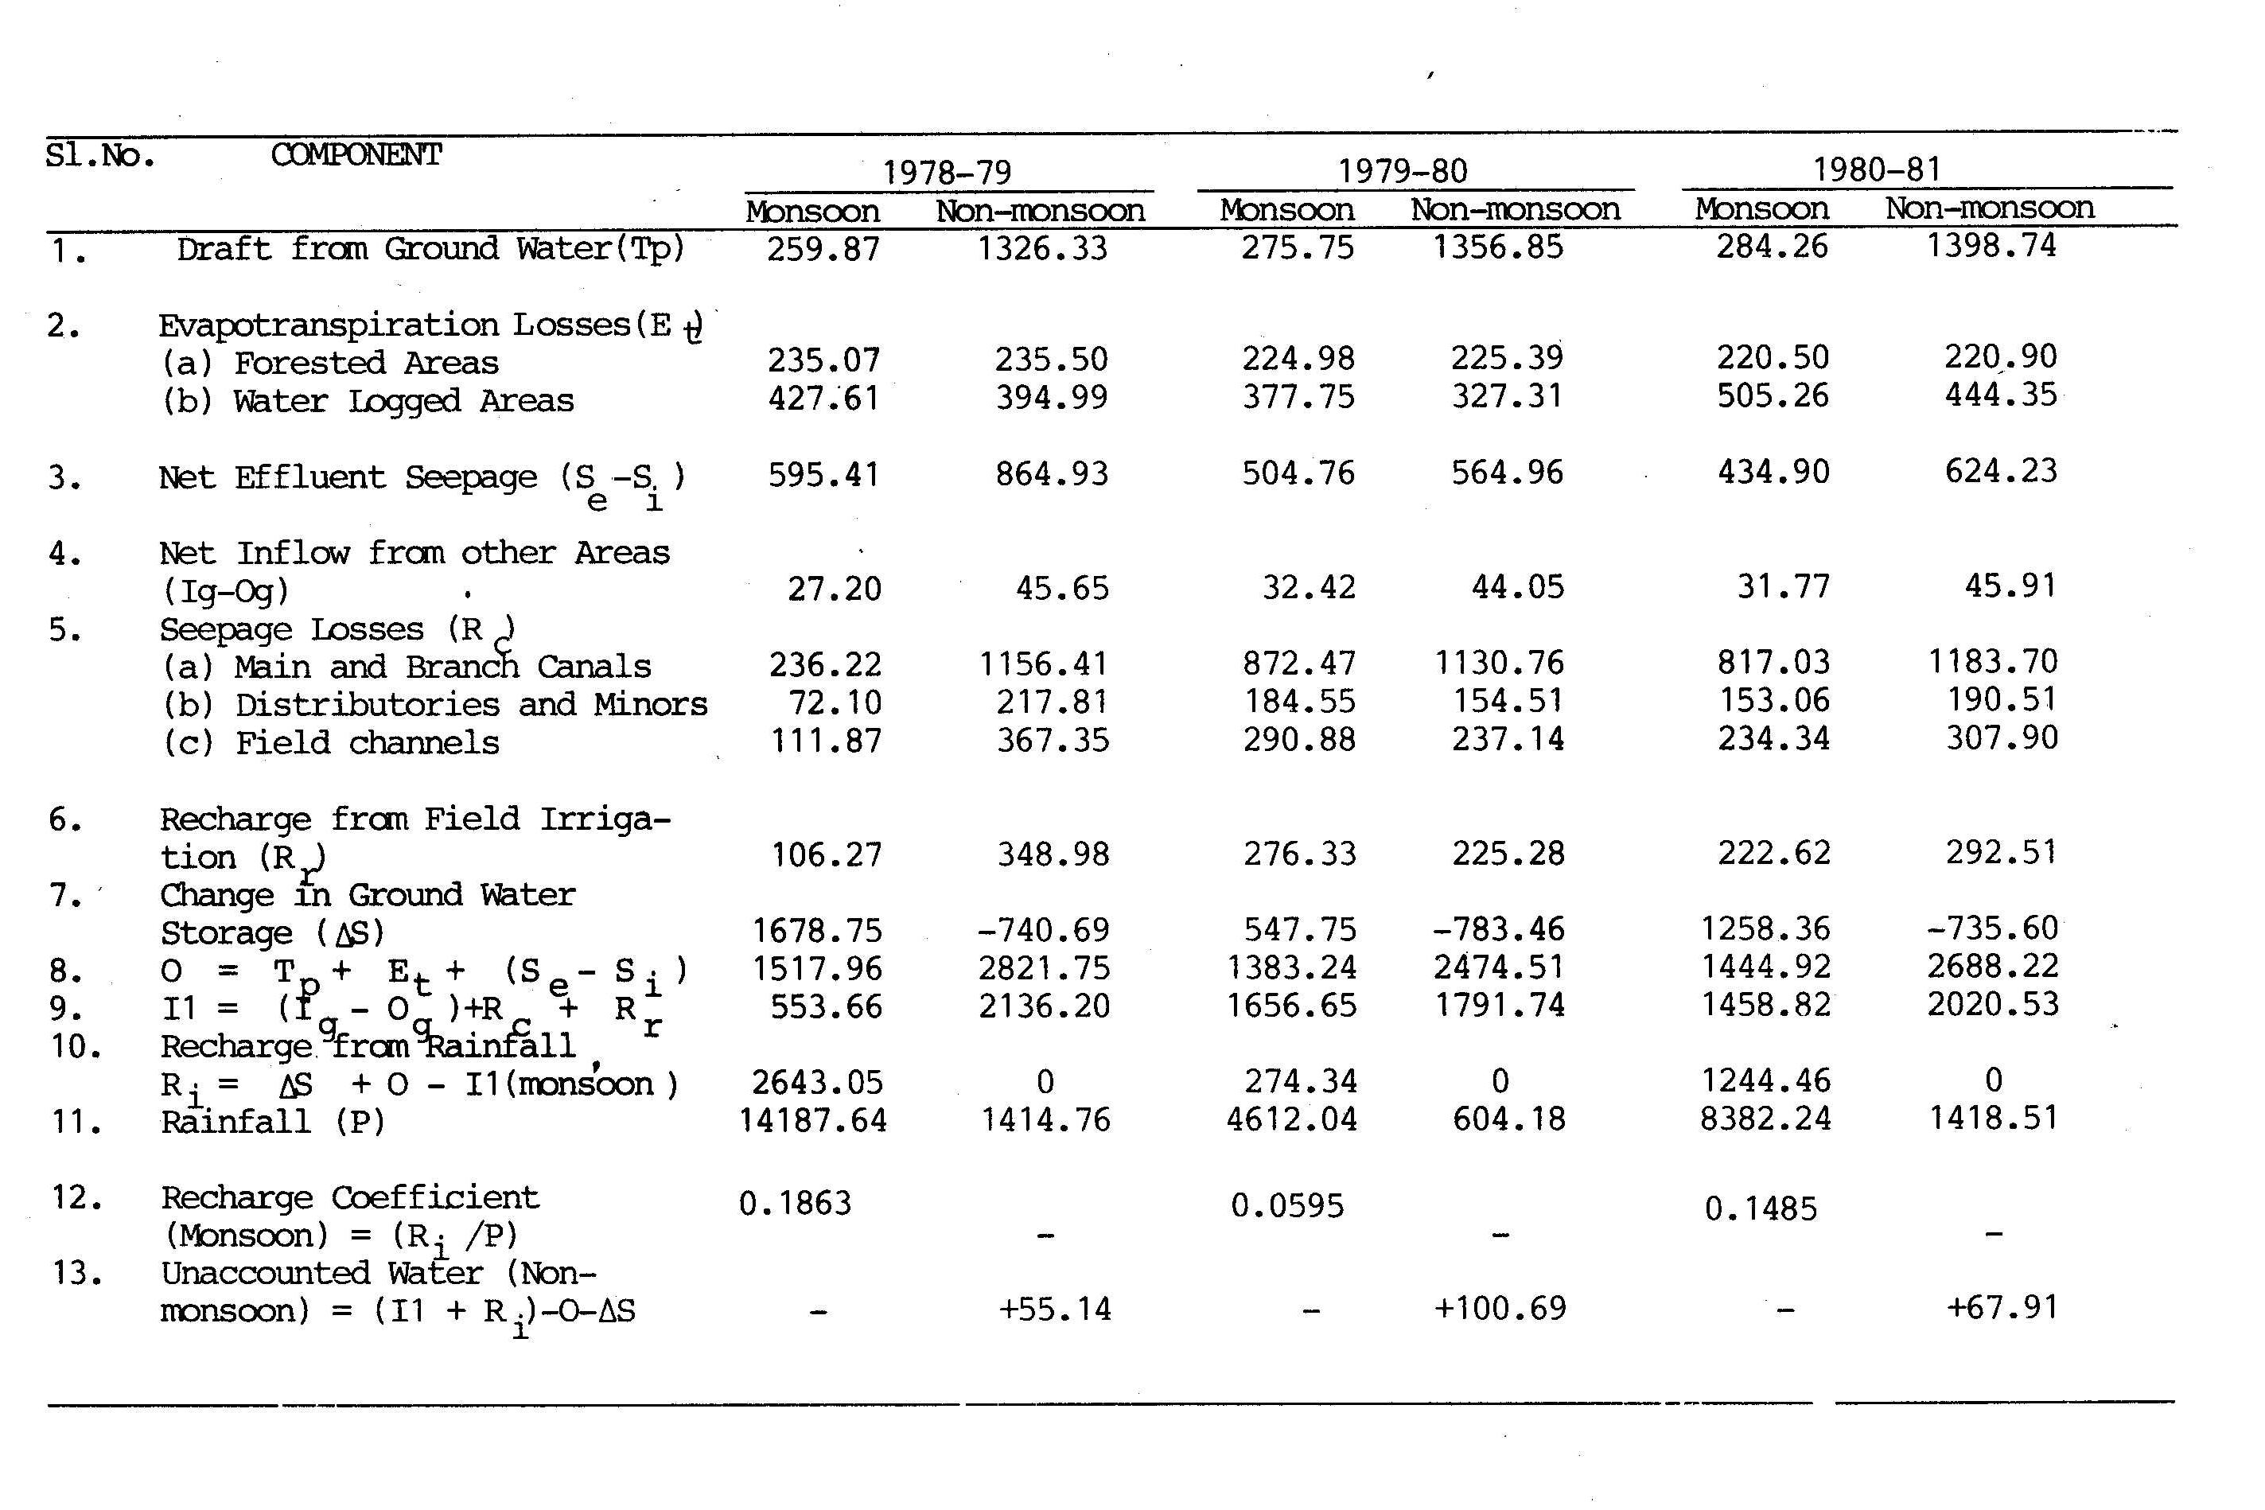
Groundwater Balance Study - An Example

Slide 90
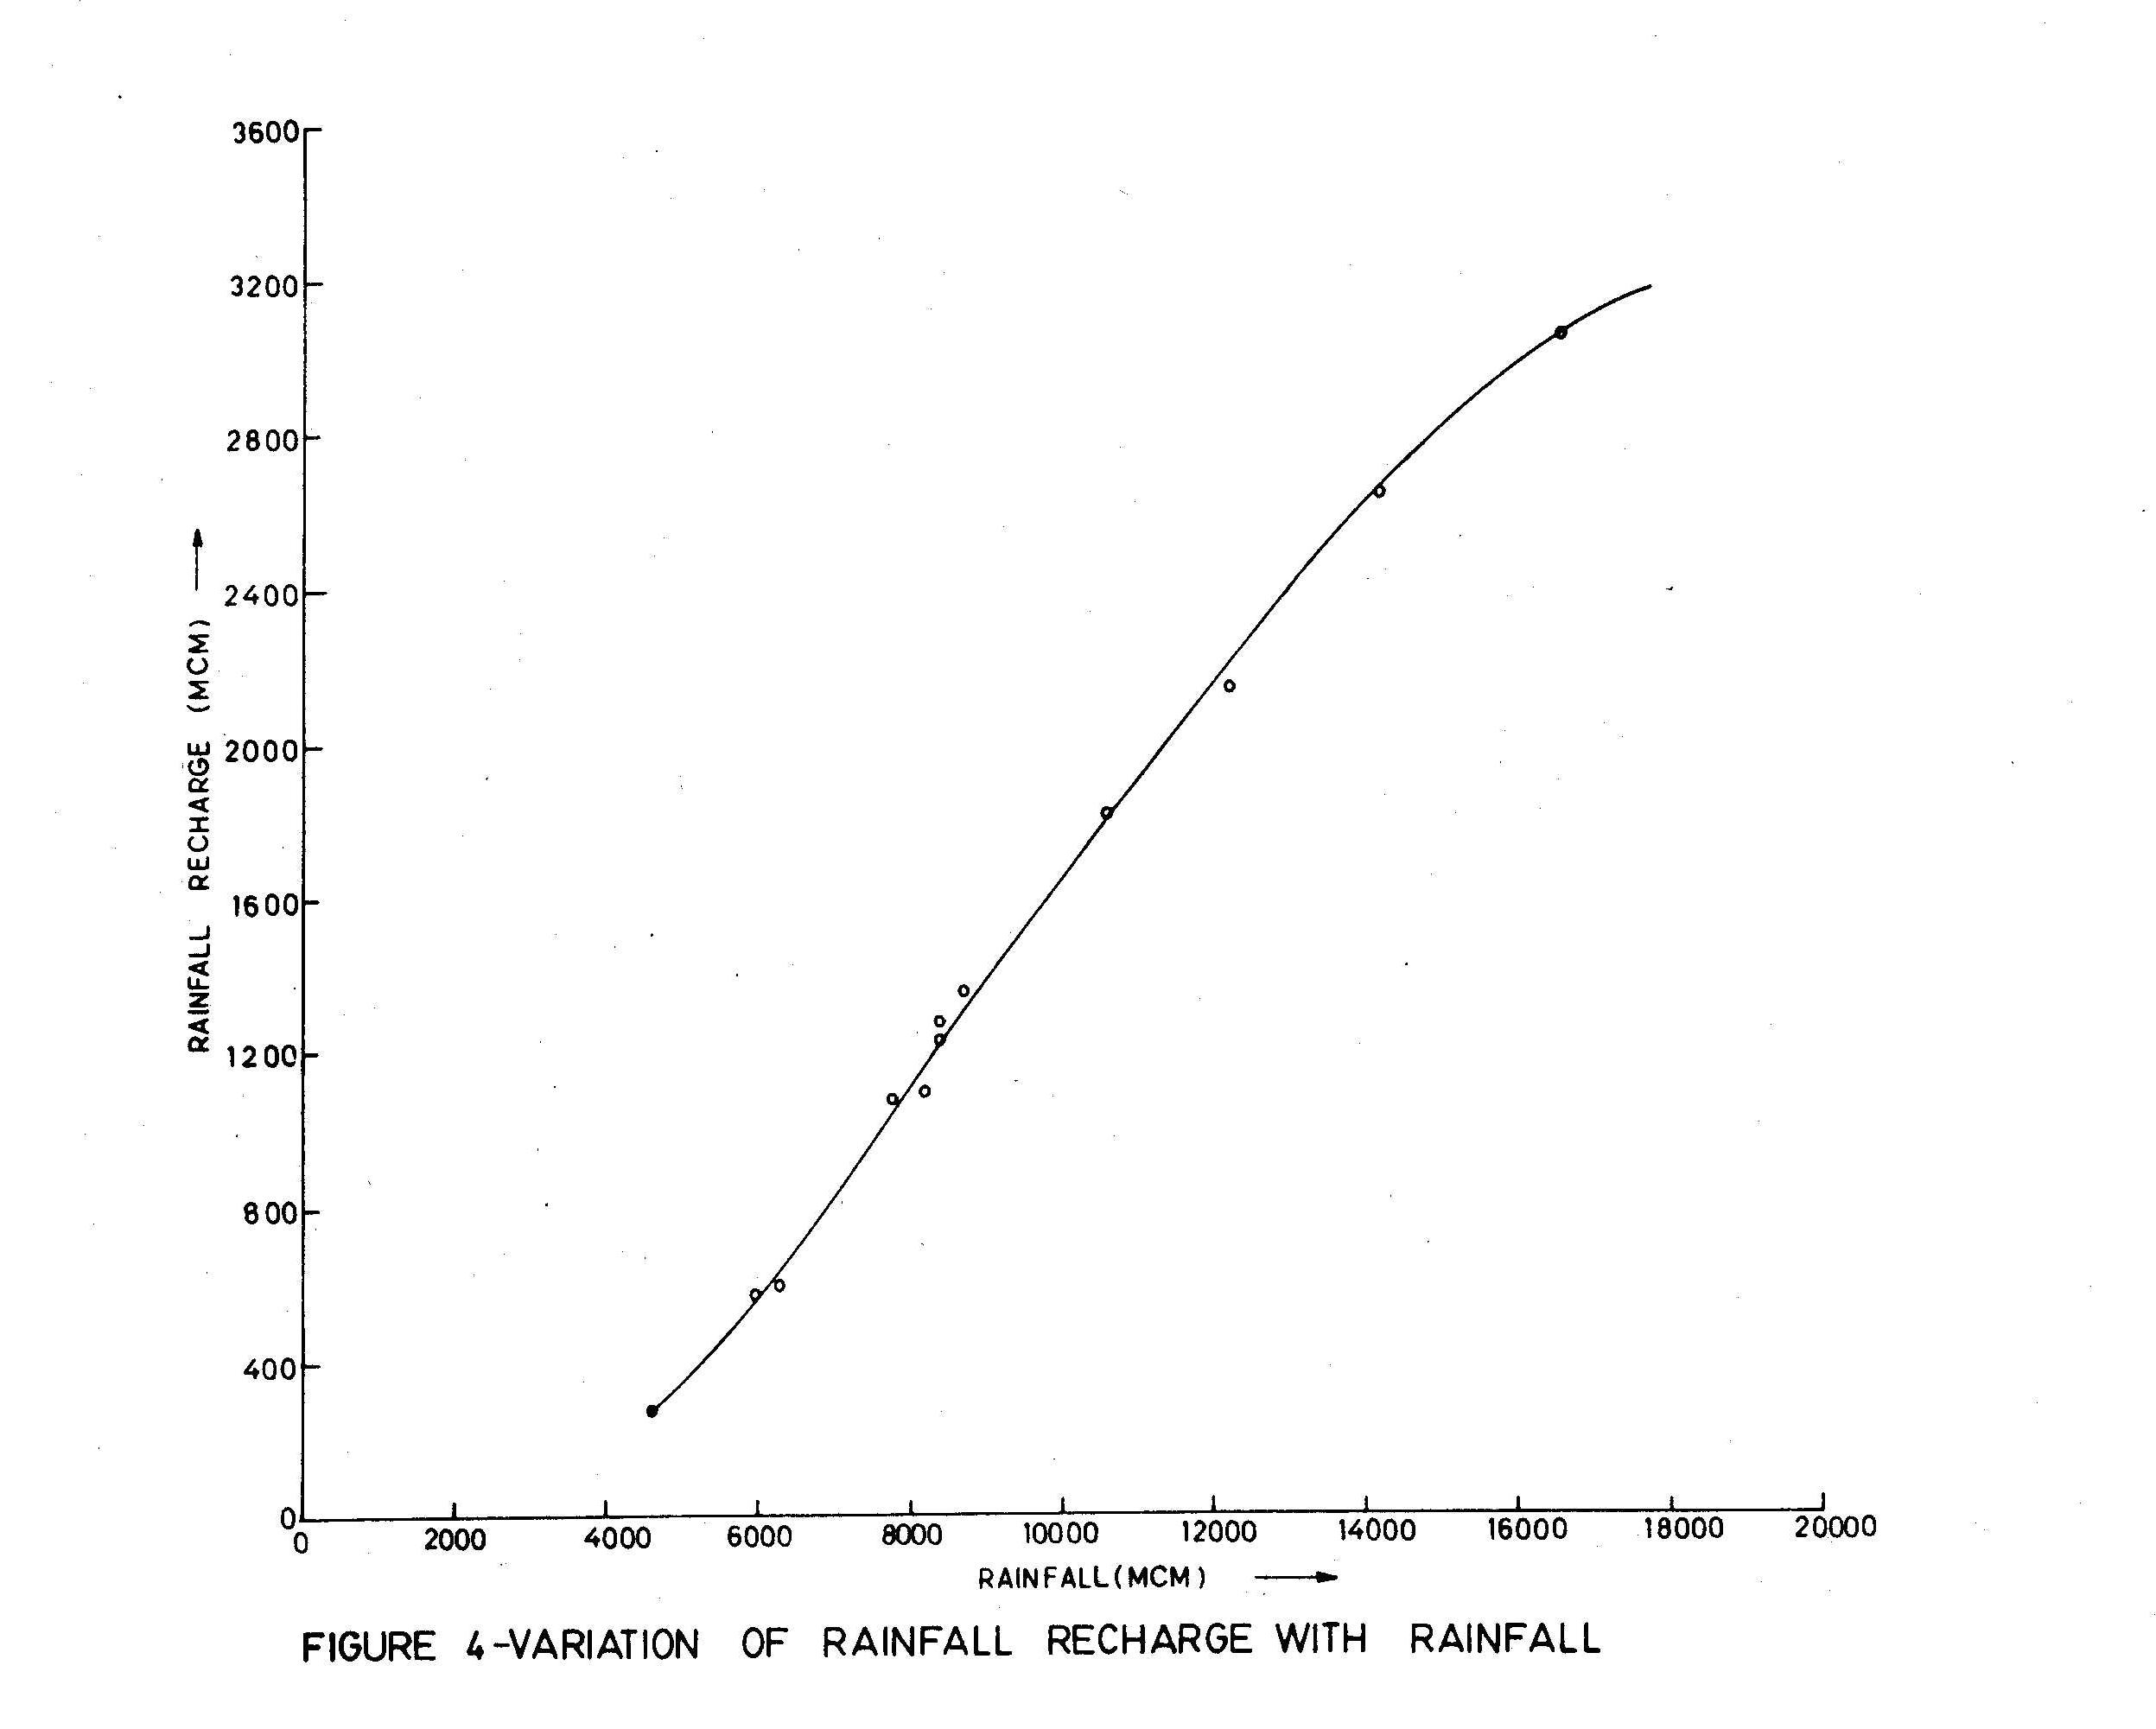

Slide 91
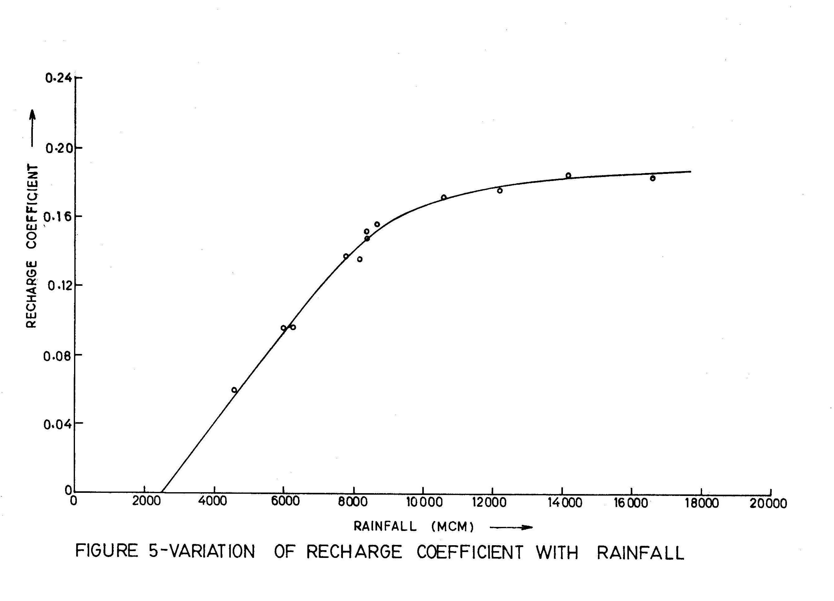

Slide 93
Hydrology Forum
A forum for discussion of scientific research in all aspects of Hydrology including hydrologic design, surface water analysis and modelling, flood studies, drought studies, watershed development, groundwater assessment and modelling, conjunctive use, drainage, mountain hydrology, environmental hydrology, lake hydrology, nuclear hydrology, urban hydrology, forest hydrology, hydrological investigations, remote sensing and GIS applications etc. Exchange of ideas and experiences regarding use and application of hydrological softwares are also included.
Post message: hydforum@yahoogroups.com
Subscribe: hydforum-subscribe@yahoogroups.com
Unsubscribe: hydforum-unsubscribe@yahoogroups.com
List owner: hydforum-owner@yahoogroups.com

Slide 94
Ground Water Modelling Discussion Group
An email discussion group related to ground water modelling and analysis. This group is a forum for the communication of all aspects of ground water modelling including technical discussions; announcement of new public domain and commercial softwares; calls for abstracts and papers; conference and workshop announcements; and summaries of research results, recent publications, and case studies.
Group home page : http://groups.yahoo.com/group/gwmodel/
Post message : gwmodel@yahoogroups.com
Subscribe : gwmodel-subscribe@yahoogroups.com
Unsubscribe : gwmodel-unsubscribe@yahoogroups.com
List owner : gwmodel-owner@yahoogroups.com

Slide 95
Thank You !!!

